Slide 1
BATHYMETRIC DATA DERIVED FROM FREE SOURCE SATELLITE IMAGERY

Slide 2
Reason for Study:
71% of the Earth surface is covered with water, yet only about 10% of the seafloor has been surveyed in detail.
IHO figures indicate that at least 50% of the World’s coastal waters are un-surveyed or are inadequately surveyed (IHO, 2015).
What methods could rapidly increase coverage in the coastal zone?
(IHO Publication C-55 - Status of Surveying and Charting Worldwide, 2015)

Slide 3
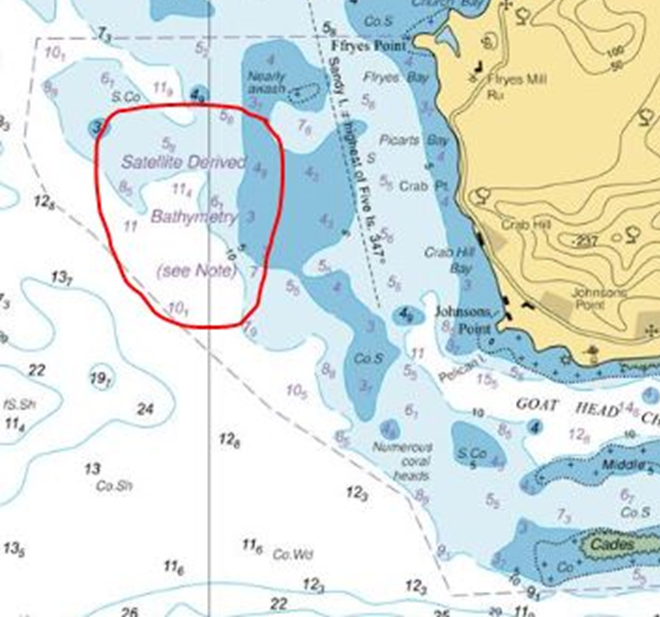
Current UKHO SBD Practices:
A case study from the UKHO and commercial partners, produced the first nautical chart (BA2066) with depths derived from satellite imagery. The area of study, was off the Southwest coast of Antigua in the Caribbean.

Slide 4
Satellite Imagery Resolution:
ESA Sentinel-2 (10m resolution)
Worldview (0.3 - 2m resolution)
(Sentinel-2, ESA 2015)
(World-view, Digital Globe 2014)
Notes:
World-view 3 is the quality used by UKHO and EOMAPS 0.31m spatial resolution each picture approx. 0.1m2 per pixel
Sentinel-2 which is free source has a spatial resolution of 10m each pixel equates to 100m2
Approx. x1000 more information in the worldview-3 imagery
That’s is 1000 pixels for each pixel from sentinel-2 imagery
Images;
Digital globe sample product – (World-view 3, Digital Globe 2014) https://www.digitalglobe.com/resources/imagery-product-samples/30cm-imagery
European Space Agency (ESA) Sentinel-2 product – (Sentinel-2, ESA 2015) https://scihub.copernicus.eu

Slide 5
Research Area – Isles of Scilly, UK:
Notes:
Water leaving radiometer??
Brownell, A.T., Hapke, C.J., Spore, N.J., and McNinch, J.E., 2015, Bathymetry of the Wilderness Breach at Fire Island, New York, June 2013: U.S. Geological Survey Data Series 914, http://dx.doi.org/10.3133/ds914.
Images:
Sand – (Dimitris Siskopoulos, 2012) https://www.flickr.com/photos/dimsis/7409895672
Kelp – (Kike Ballesteros, 2014) http://voices.nationalgeographic.com/2014/04/14/diving-through-kelp-with-a-beautiful-giant/
Coral – (Toby Hudson, 2010) https://en.wikipedia.org/wiki/File:Coral_Outcrop_Flynn_Reef.jpg
Rock – (Fungus Guy, 2010) https://commons.wikimedia.org/wiki/File:Underwater_veins,_Agawa_Rock.JPG

Slide 6
Ground Truthing Data – SBES:
(Will Dann with Plymouth University, 2016)
Notes:
Water leaving radiometer??
Brownell, A.T., Hapke, C.J., Spore, N.J., and McNinch, J.E., 2015, Bathymetry of the Wilderness Breach at Fire Island, New York, June 2013: U.S. Geological Survey Data Series 914, http://dx.doi.org/10.3133/ds914.
Images:
Sand – (Dimitris Siskopoulos, 2012) https://www.flickr.com/photos/dimsis/7409895672
Kelp – (Kike Ballesteros, 2014) http://voices.nationalgeographic.com/2014/04/14/diving-through-kelp-with-a-beautiful-giant/
Coral – (Toby Hudson, 2010) https://en.wikipedia.org/wiki/File:Coral_Outcrop_Flynn_Reef.jpg
Rock – (Fungus Guy, 2010) https://commons.wikimedia.org/wiki/File:Underwater_veins,_Agawa_Rock.JPG

Slide 7
Ground Truthing Data – LiDAR:
(Plymouth Coastal Observatory, 2015)
Notes:
Water leaving radiometer??
Brownell, A.T., Hapke, C.J., Spore, N.J., and McNinch, J.E., 2015, Bathymetry of the Wilderness Breach at Fire Island, New York, June 2013: U.S. Geological Survey Data Series 914, http://dx.doi.org/10.3133/ds914.
Images:
Sand – (Dimitris Siskopoulos, 2012) https://www.flickr.com/photos/dimsis/7409895672
Kelp – (Kike Ballesteros, 2014) http://voices.nationalgeographic.com/2014/04/14/diving-through-kelp-with-a-beautiful-giant/
Coral – (Toby Hudson, 2010) https://en.wikipedia.org/wiki/File:Coral_Outcrop_Flynn_Reef.jpg
Rock – (Fungus Guy, 2010) https://commons.wikimedia.org/wiki/File:Underwater_veins,_Agawa_Rock.JPG

Slide 8
Satellite Image Processing:
Raw Sentinel-2 Multi Spectral Image from ESA
(Sentinel-2, ESA 2016)

Slide 9
Satellite Image Processing:
Atmospherically corrected and Land Masked, via ESA SNAP
(Sentinel-2, ESA 2016)

Slide 10
Sun Glint Removal – Hedley, et al (2005):
Band (R_{i}) before Glint Removal
Band (R’_{i}) after Glint Removal
(Sentinel-2, ESA 2016)

Slide 11
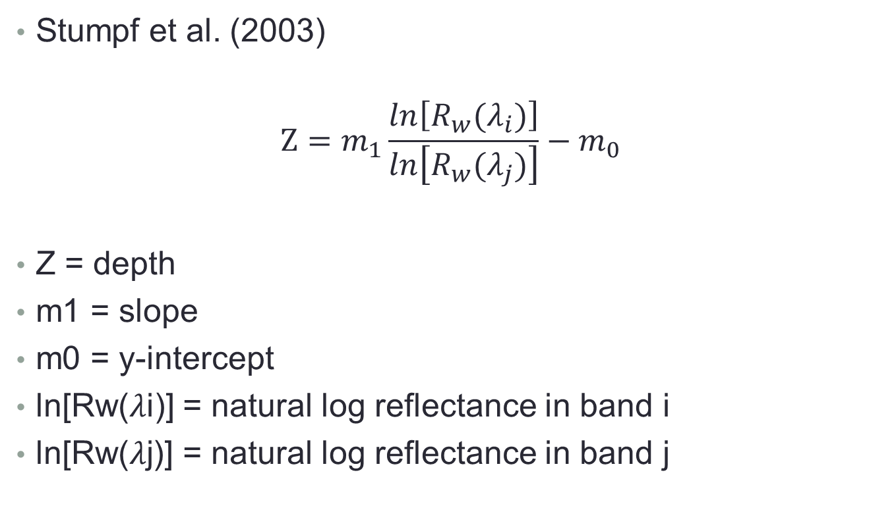
Band Ratio Method:
Stumpf et al. (2003)
$$Z=m_{1}\frac{ln\left[R_{w}(λ_{i})\right]}{ln\left[R_{w}(λ_{j})\right]}−m_{0}$$
Z = depth
m1 = slope
m0 = y-intercept
ln[Rw(𝜆i)] = natural log reflectance in band i
ln[Rw(𝜆j)] = natural log reflectance in band j

Slide 12
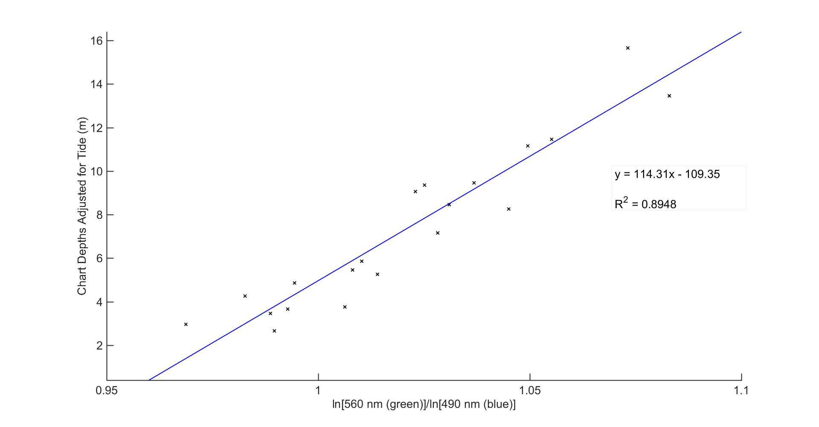
Band Ratio Method – Stumpf et al. (2003):
Green(560nm)/Blue(490nm) Band Ratio

Slide 13
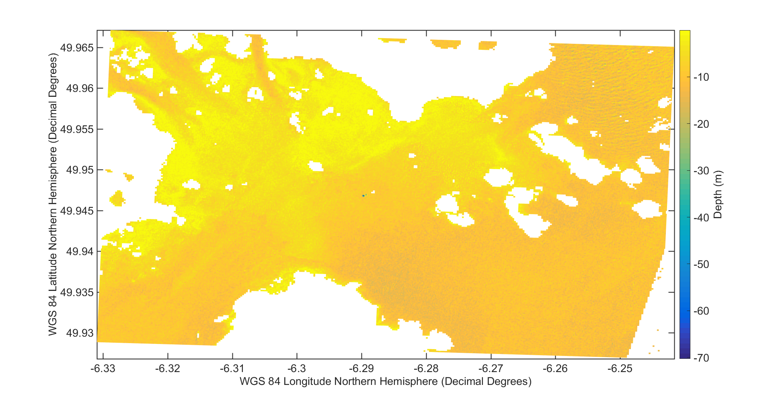
Applying the Algorithm:
Initial Results with Anomalous Data

Slide 14
Applying the Algorithm:
Median Filter and Reduction to Chart Datum

Slide 15
Areas of Interest – LiDAR vs. SDB:

Slide 16
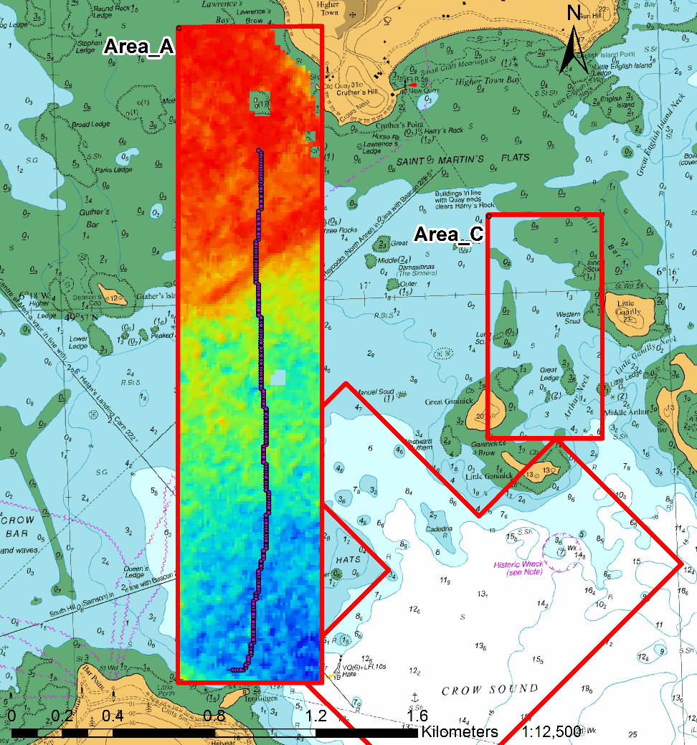
Areas of Interest: A
Survey Area A with SDB and Profile Transect

Slide 17
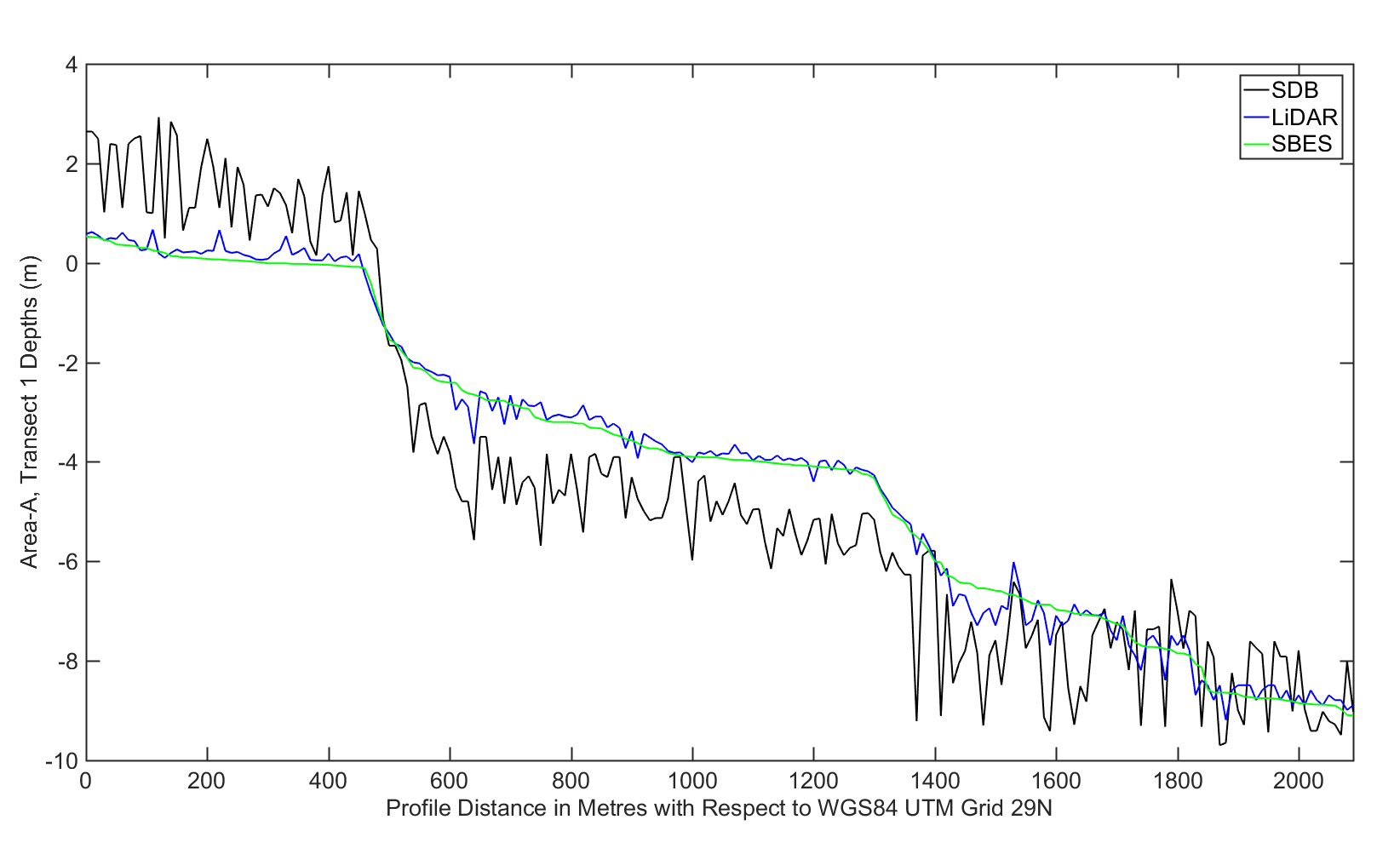
Results: Area-A
Profile of Area-A including SDB, LiDAR and SBES

Slide 18
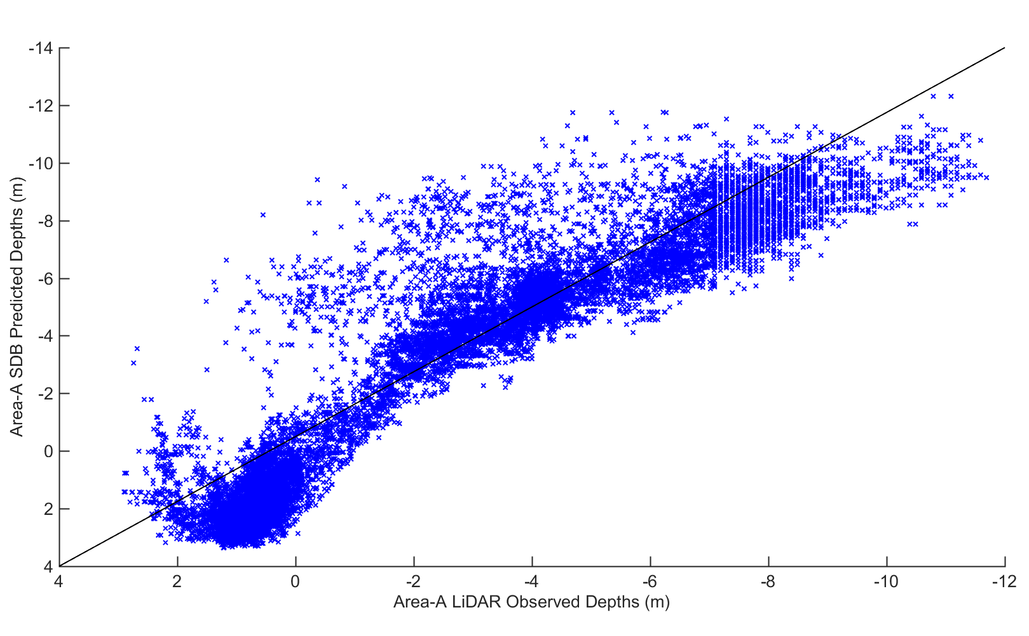
Results: Area-A
Comparison Between SDB and LiDAR Surfaces

Slide 19
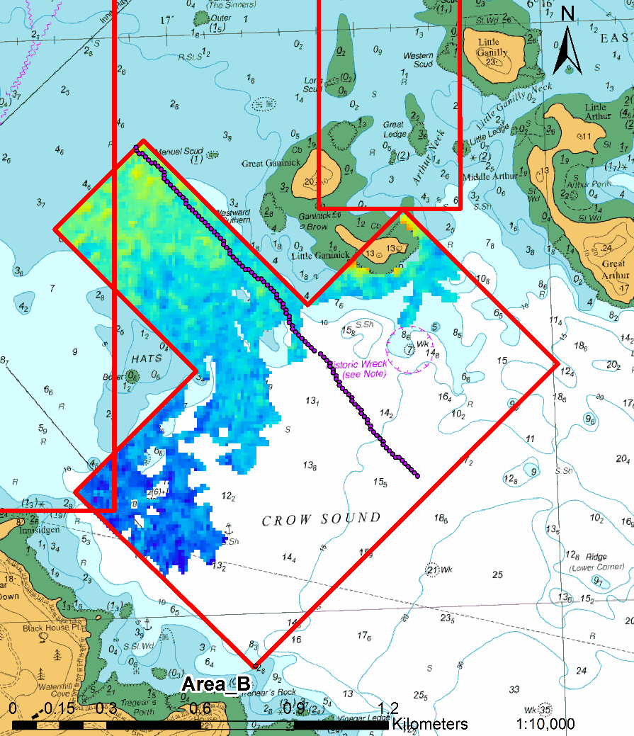
Area of Interest: B
Survey Area B with SDB and Profile Transect

Slide 20
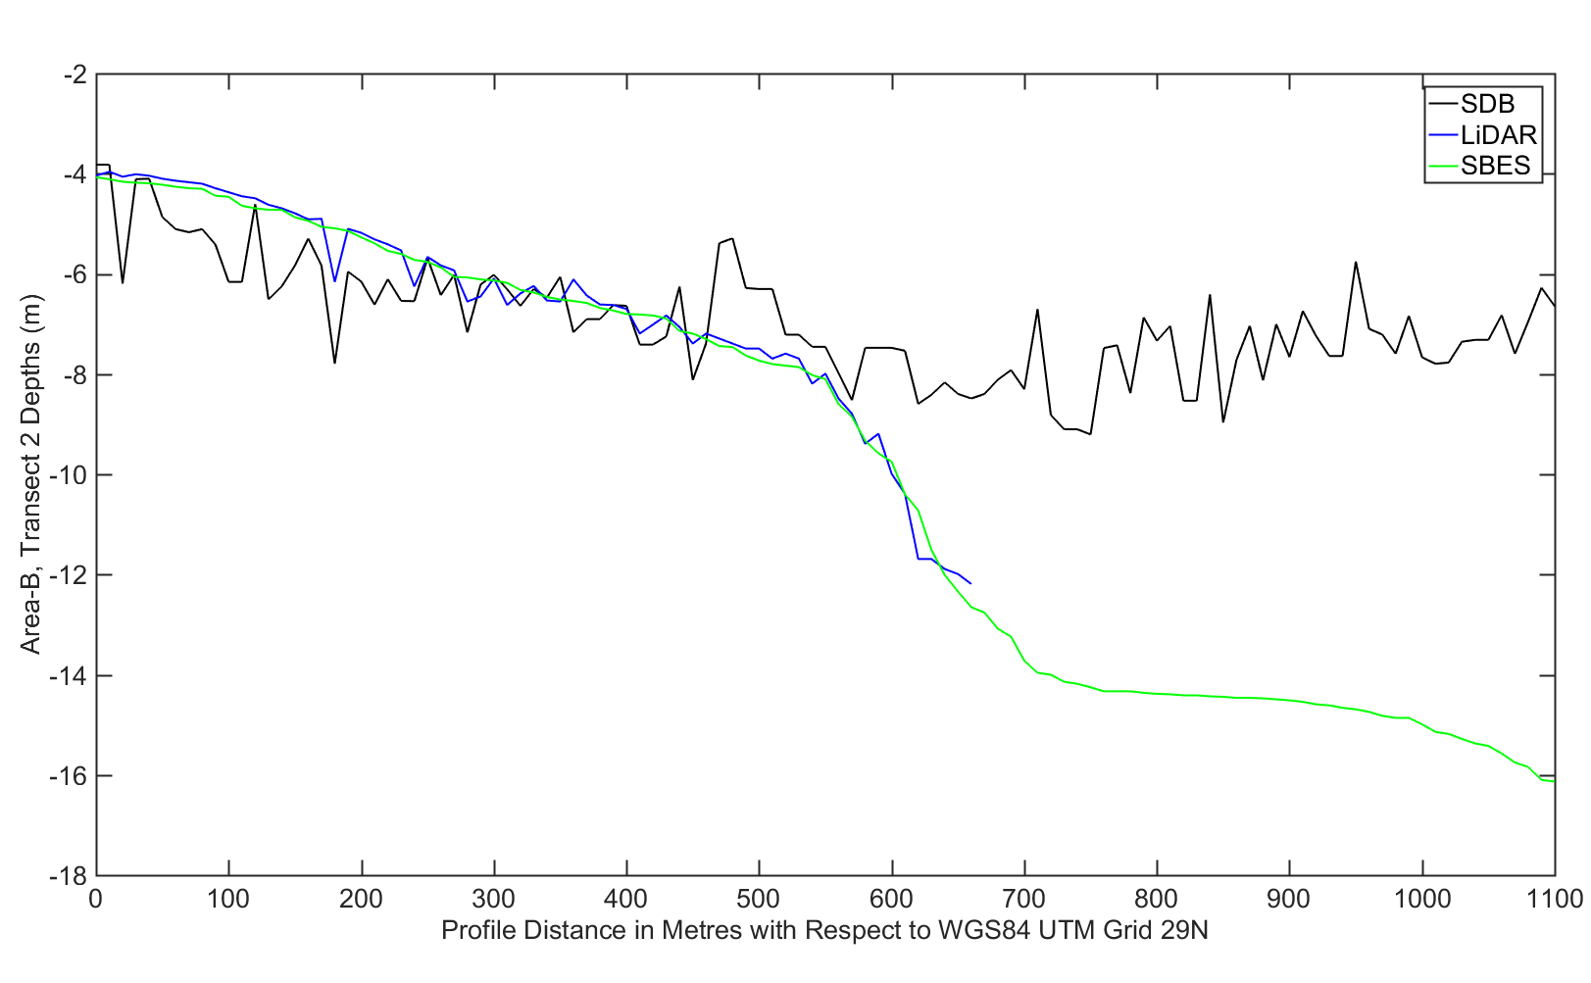
Results: B
Profile of Area-B including SDB, LiDAR and SBES

Slide 21
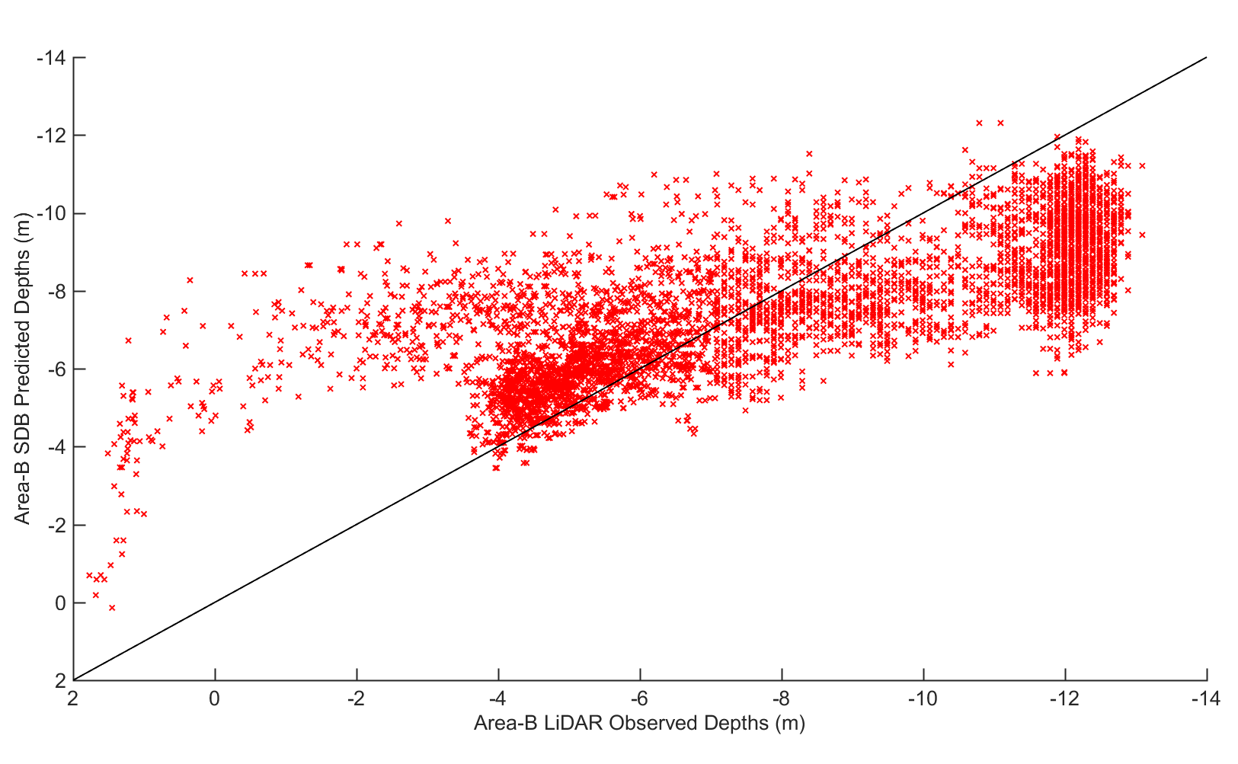
Results: Area-B
Comparison Between SDB and LiDAR Surfaces

Slide 22
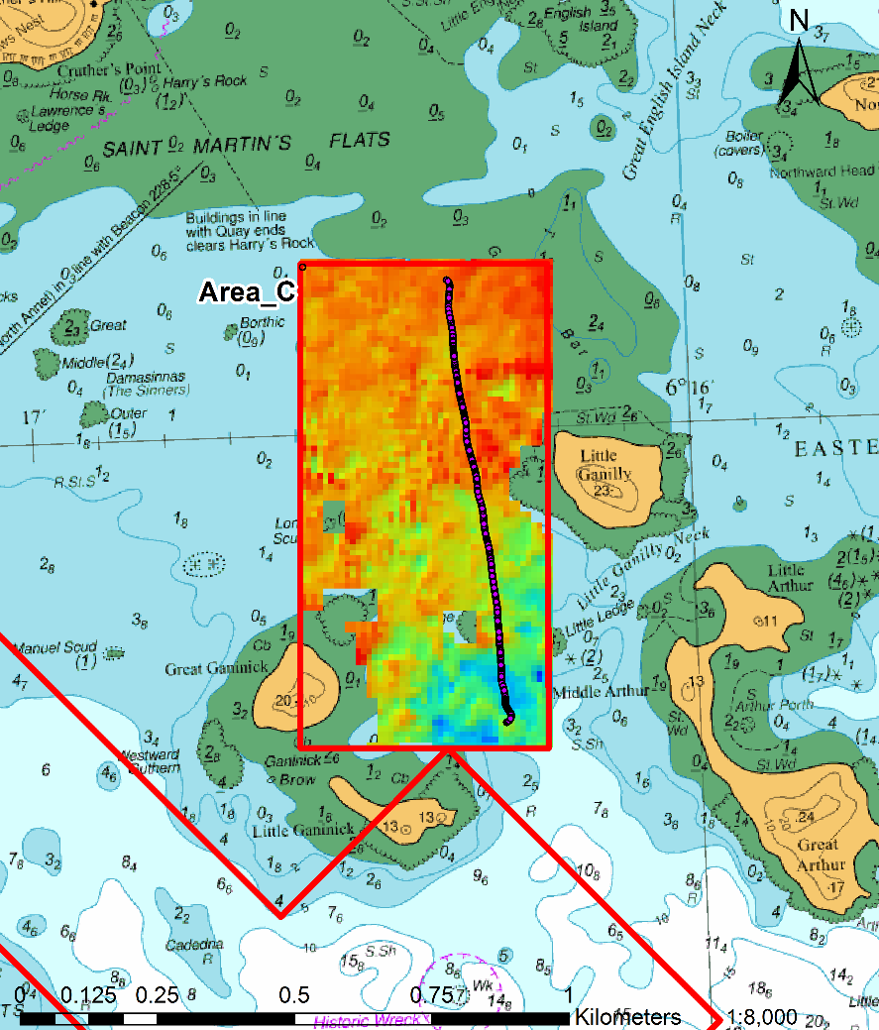
Area of Interest: C
Survey Areas C with SDB and Profile Transect

Slide 23
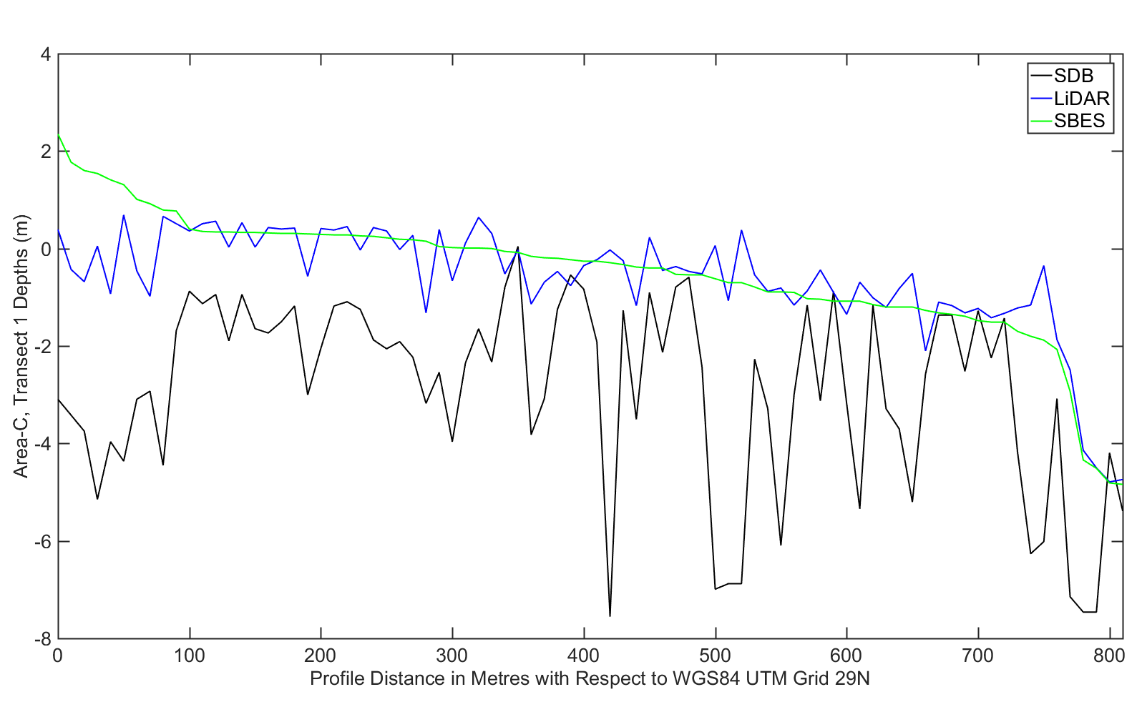
Results: Area-C
Profile of Area-C including SDB, LiDAR and SBES

Slide 24
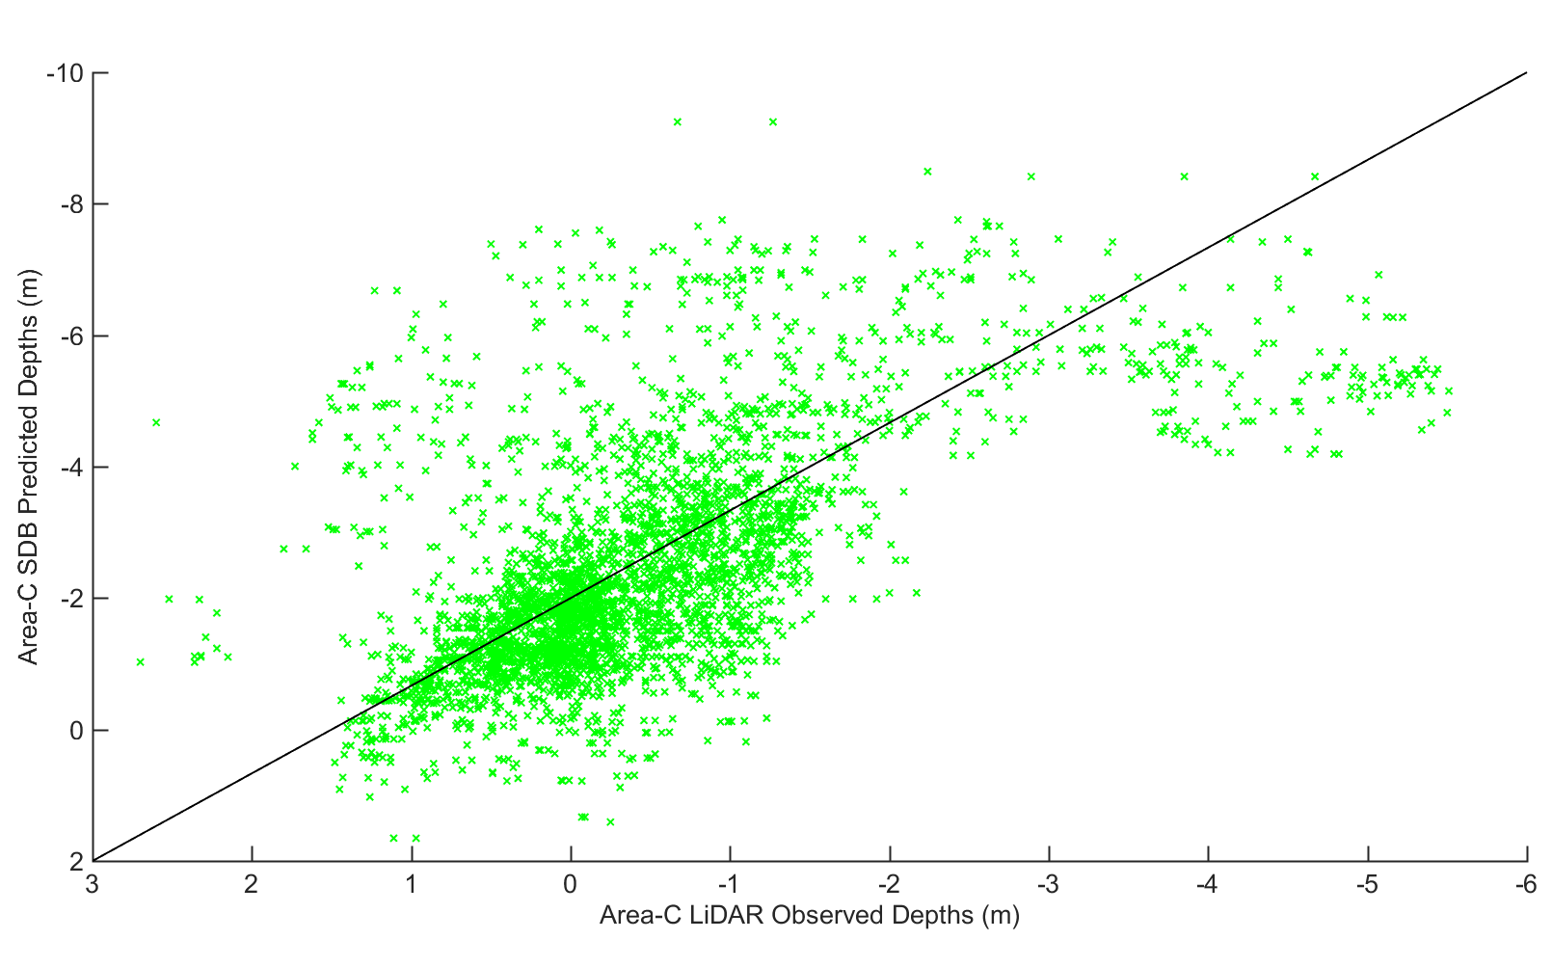
Results: Area-C
Comparison Between SDB and LiDAR Surfaces

Slide 25
Conclusion:
Could it be used in nautical charting?
  No, more work is needed.
Better more complex algorithms
A way of describing the uncertainty

Slide 26
References:
Gordon, H. R., 1989. Can the Lambert-Beer law be applied to the diffuse attenuation coefficient of ocean water?. Limnology and Oceanography, 34(8), pp. 1389-1409.
Hedley, J. D., Harborne, A. R. & Mumby, P. J., 2005. Simple and robust removal of sun glint for mapping shallow-water. International Journal of Remote Sensing, 26(10), p. 2107–2112.
International Hydrographic Organization , 2008. IHO STANDARDS FOR HYDROGRAPHIC SURVEYS, Monaco: International Hydrographic Bureau .
International Hydrographic Organization, 2000. IHO TRANSFER STANDARD for DIGITAL HYDROGRAPHIC DATA, Monaco: International Hydrographic Bureau.
International Hydrographic Organization, 2017. Status of Hydrographic Surveying and Charting Worldwide, Monaco: International Hydrographic Organization.
Müller-Wilm, U., 2016. Sentinel-2 MSI – Level-2A Prototype Processor Installation and User Manual, Darmstadt: Telespazio VEGA Deutschland GmbH.
Stumpf, R. P., Holderied, K. & Sinclair, M., 2003. Determination of water depth with high-resolution satellite imagery over variable bottom types. Limnology and Oceanography, 48(1, part 2), pp. 547-556.
United Kingdom Hydrographic Office, 2015. Satellite Derived Bathymetry, Monaco: International Hydrographic Bureau.

