Slide 1
Data Centric Hydrography - Bringing Knowledge to Action Dr Mathias Jonas Secretary-General International Hydrographic Organization (IHO)

Slide 2
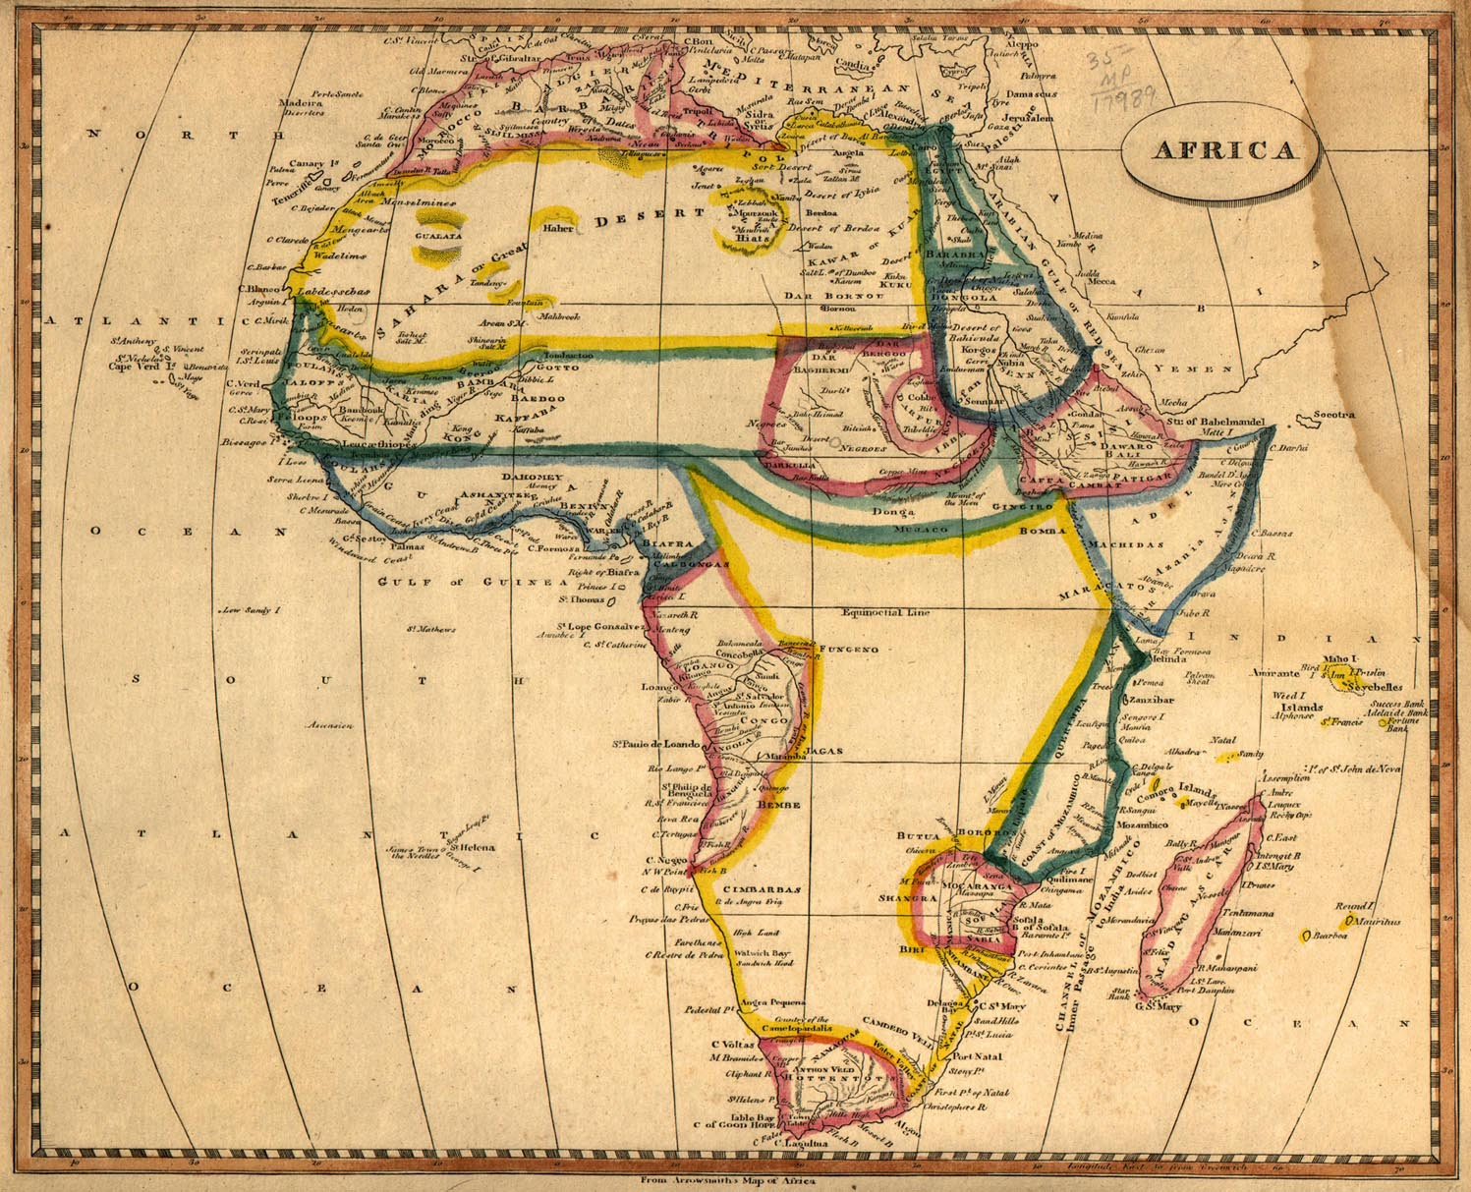
The European knowledge about Africa`s topogaphy in 1812

Slide 3
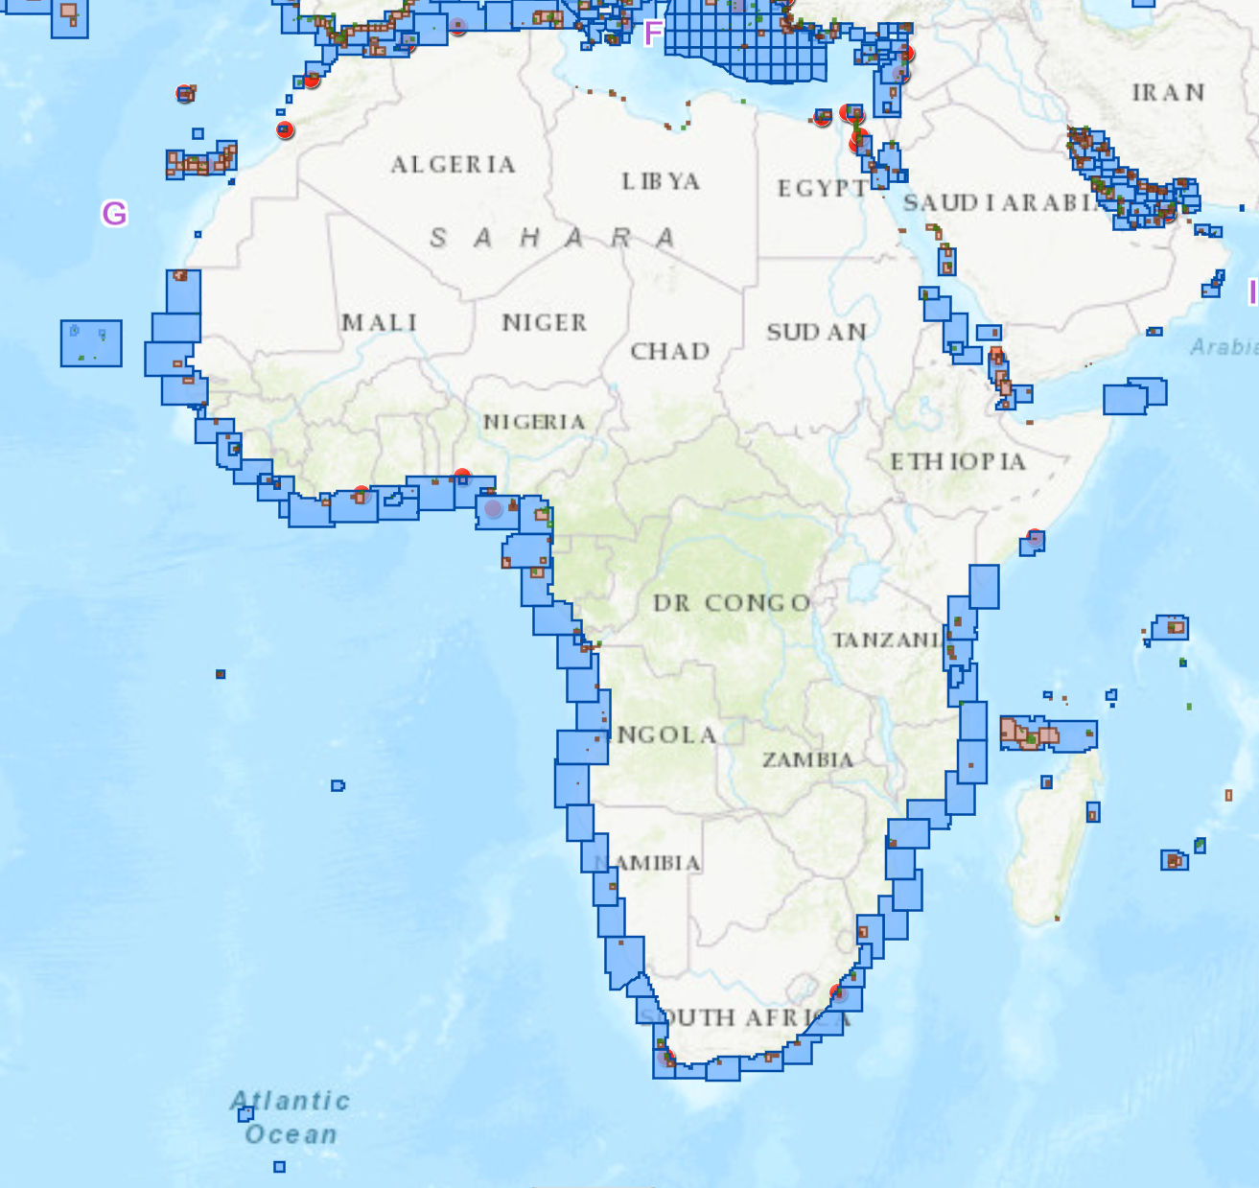
1:80,000 – 1:40,000 scale ENC Coverage (Nov 2017)

Slide 4
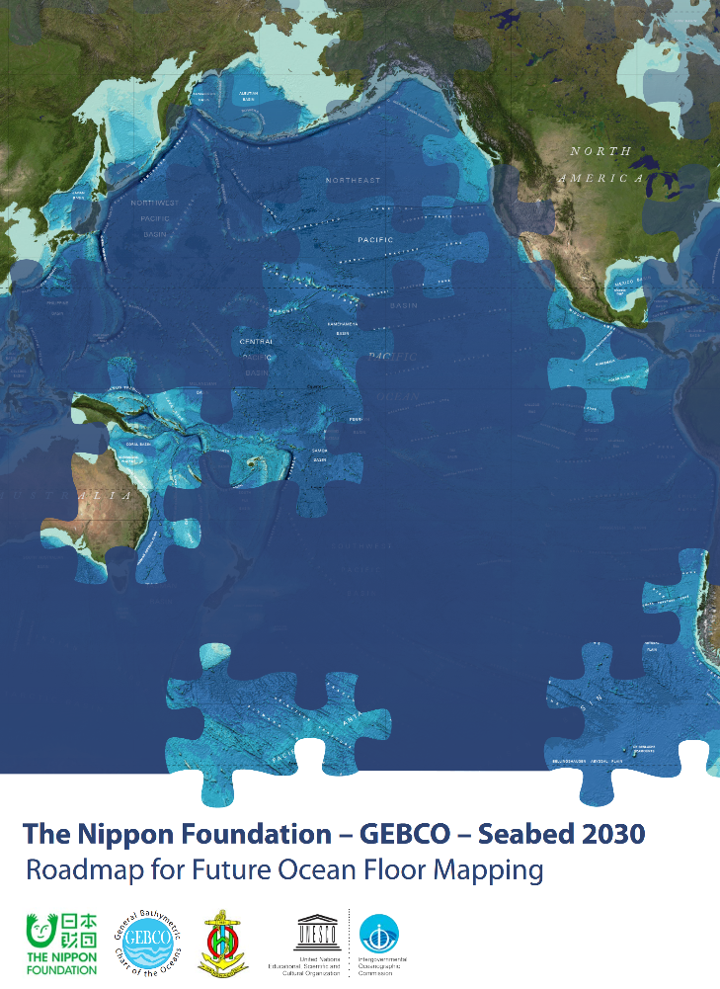
SEABED 2030 Aspiration:
No features of the accessible parts of the World Ocean floor larger than 100 m remains to be portrayed.

Slide 5
Basics of data chain standardizations
Need | Activity
Give marine data an identity | Associate to the Unified Resource Naming system: Maritime Resource name <http://www.mrnregistry.org/
Give marine data a nature | IHO Guideline on Metadata definition for crowd sourced data
Give marine data a quality | Revision process for IHO Standards for Hydrographic Surveys (S-44) to adopt quality criteria for the widest range of use of survey data (not limited to navigation)
Give various marine data a consistent model | S-100 Universal Hydrographic Data Model according to ISO 19000 series
Please visit and fill https://www.surveymonkey.co.uk/r/HSPT_S-44_Q

Slide 6
Marine data box standardizations
Need | Activity
Give marine data modeler’s the option to continuously improve and share their modelling | IHO Registry consisting of machine readable registers of Features, Attributes, Symbols, portrayal rules
Give marine data boxes individuality | Support customized machine readable data product specifications (S-1xx → S-4xx)
Give boxed marine data a face | Machine readable portrayal for basic symbols and coded visualization rules
Enable integration of marine data coming in different S-XXX data boxes | Set up machine readable interoperability specifications to control visualization and referencing of entities

Slide 7
Creation, dissemination and use standardizations
Need | Activity
Create data sets (semi) automatically | Handle big data. Process automatic classification, failure detection, generalization and modelling.
Give data sets a common accessible place | Maritime Connectivity Platform MCD – former Maritime Cloud – an e-navigation concept
Forward data sets to the user (at sea) | To provision streams: high bandwidth solutions (INMARSAT, VSAT) and low bandwidth solutions (VDES)
Combine interoperable data sets to constitute “the all the physics of the seas” composite at the end users front end | Use the versatility of maritime data sets in smart Applications
– Fill the digital aquarium!

Slide 8
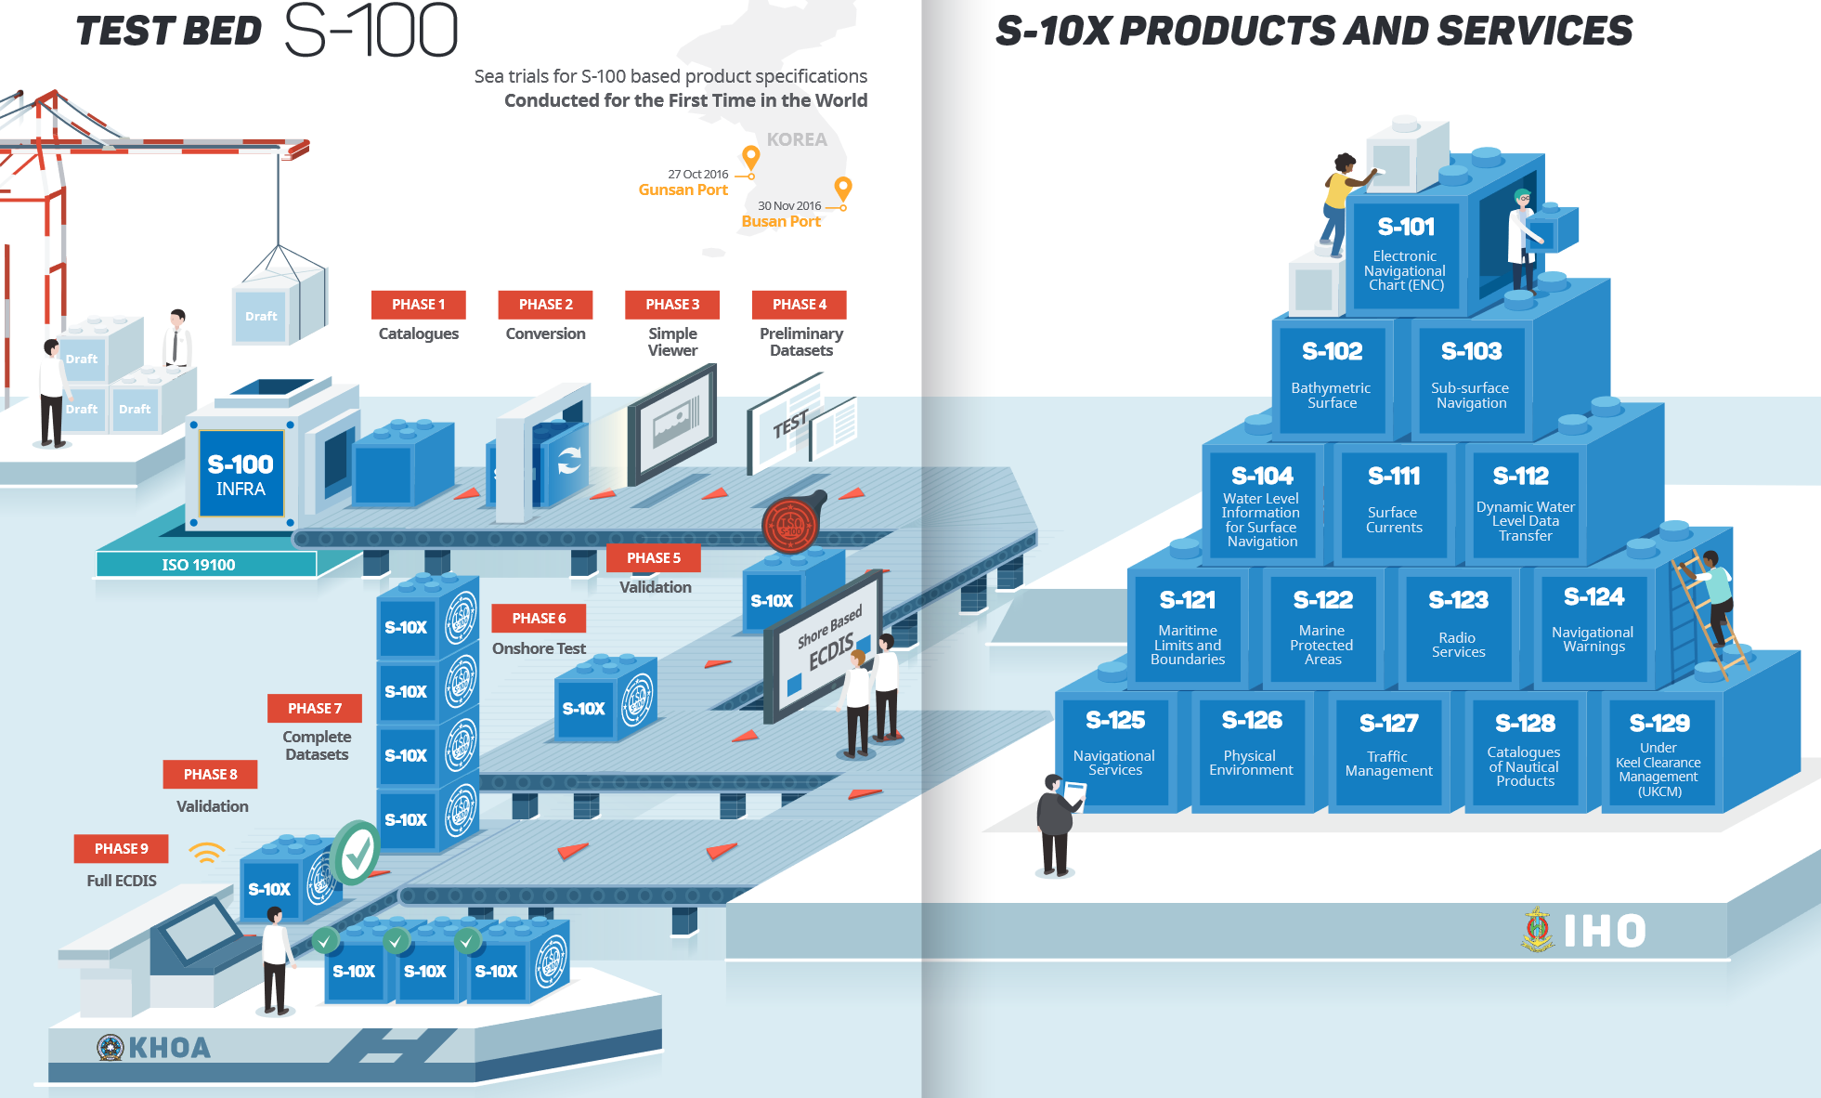
The IHO S-100 Standards Factory

Slide 9
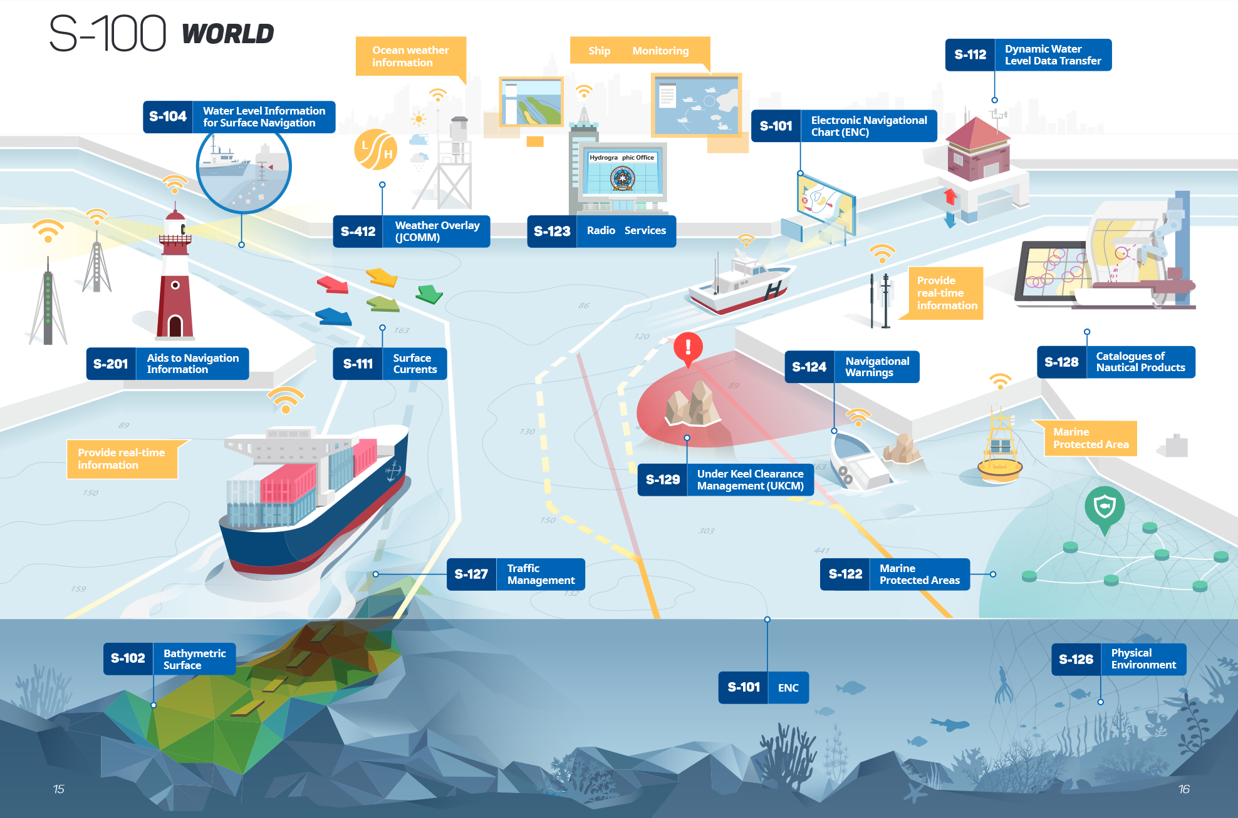
The IHO S-100 Standards Aquarium

Slide 10
How to bring knowledge to action?
For data centric hydrography, it is (almost) all about standardization!
Thank you!

