Slide 1
A new Era for Hydrographic Surveying
The hydrographic surveyor ashore

Slide 2
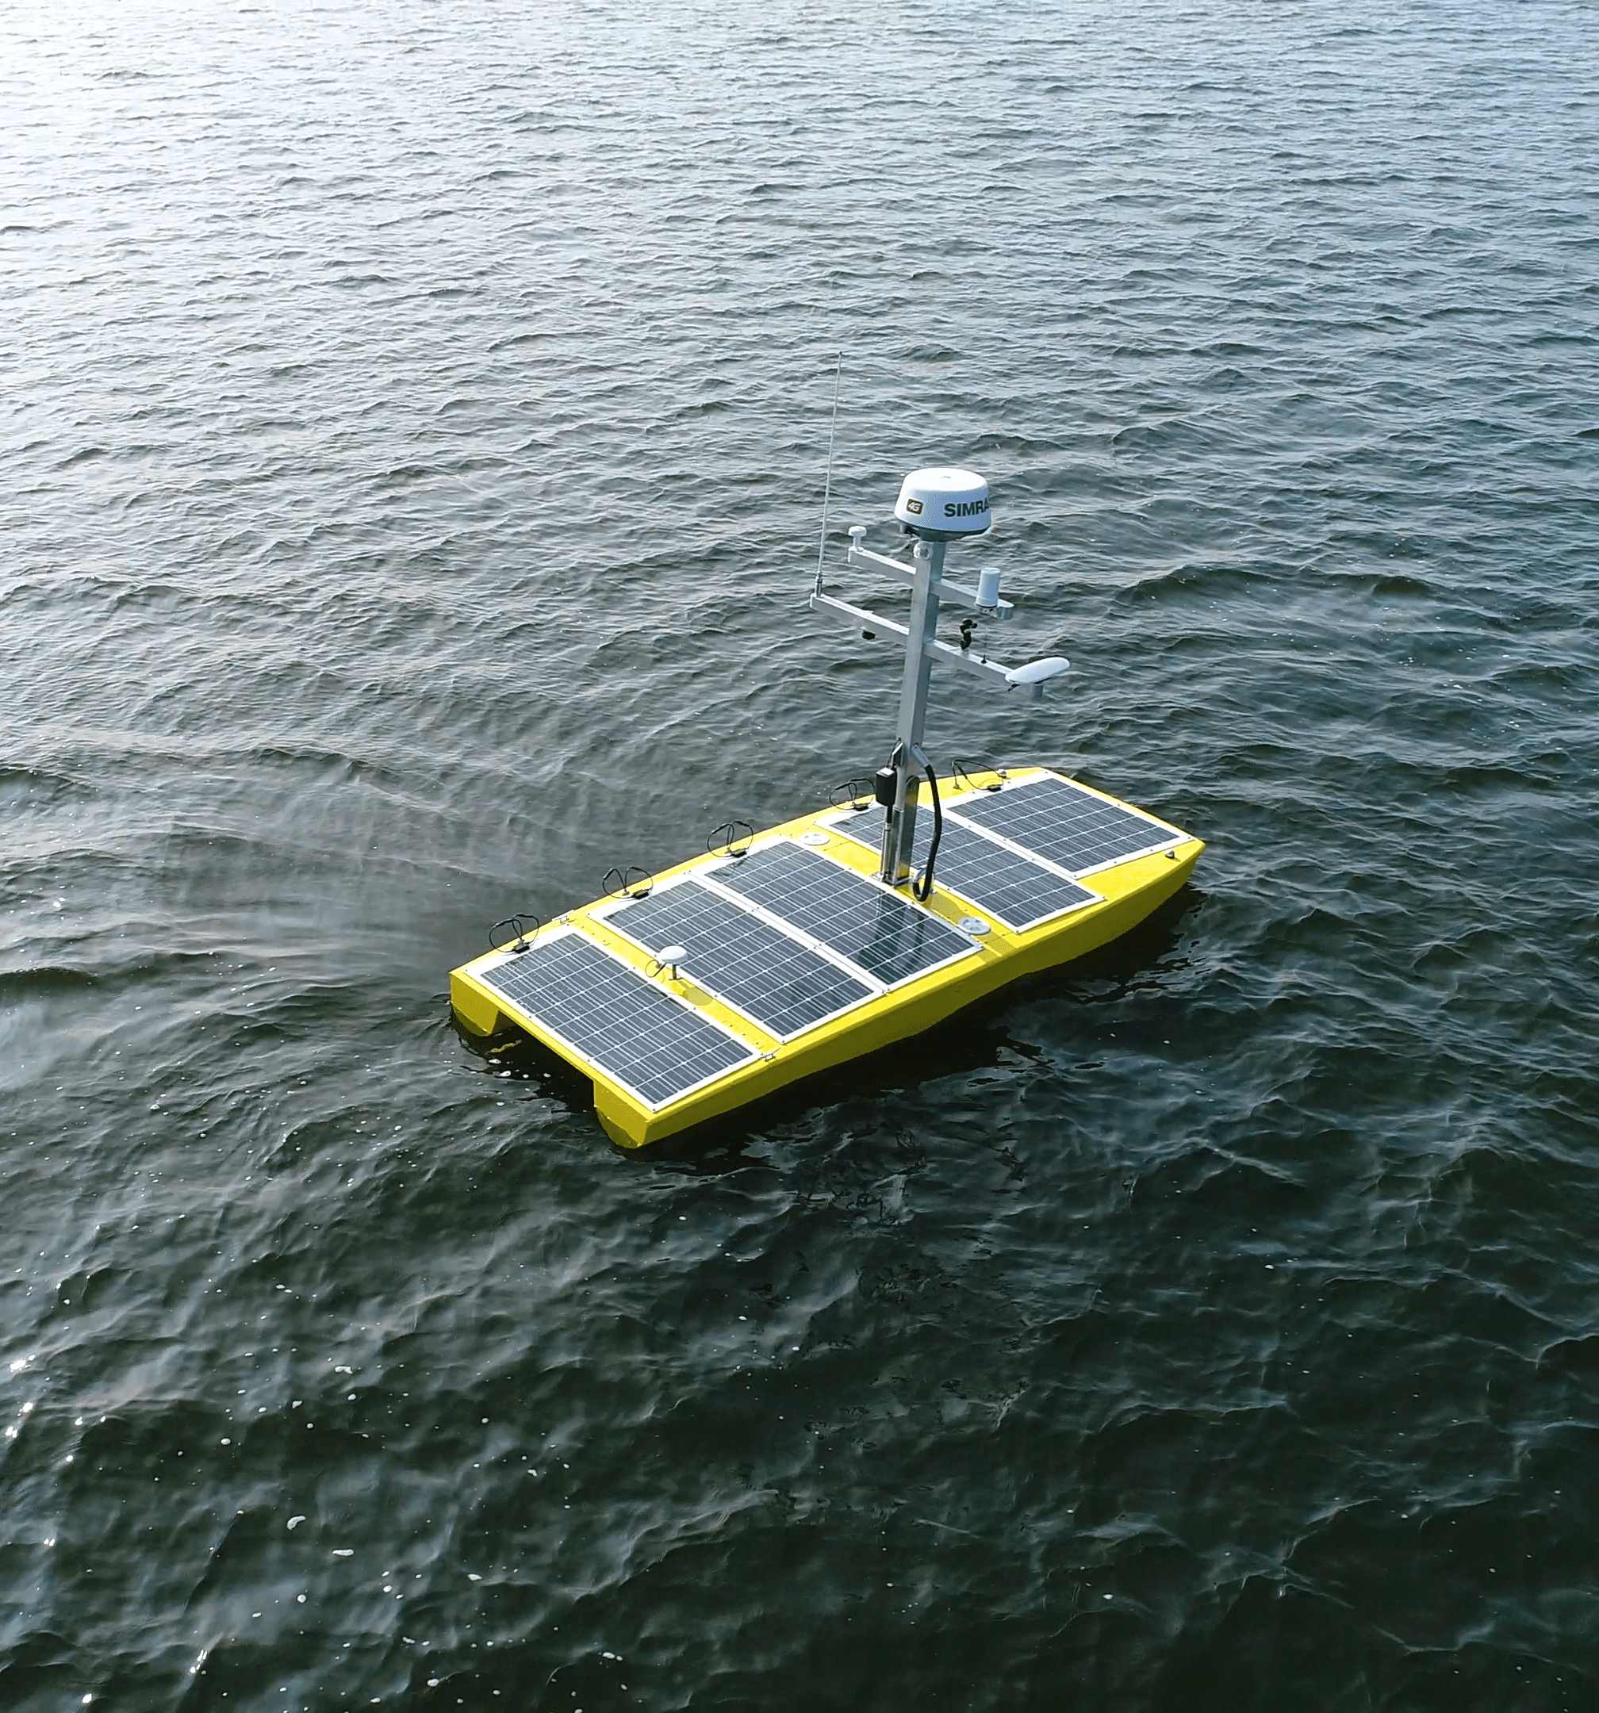
Unmanned Technologies changing Hydrography
Is the role of a hydrographer changing?
Will the hydrographer, i.e. specialist disappear?
Notes:
We are more and more living in an automated world. Self driving cars, Internet of things, automated check-ins at the airport and so on. In our hydrographic world these changes are also surfacing and unmanned systems are coming slowly but gradually in our hydrographic environment. In terms of Unmanned Surface Vehicles, what I will be focussing on during this presentation, the systems are getting more and more mature. For seafloor mapping several missions are being carried out. Should we worry that these technologies are being introduced in our environment? Is it a threat for our profession? Unmanned marine technologies are giving the hydrographic industry a new dimension and possibilities. In contrary the marine drones are giving new oppurtunities to the seafloor mapping. The actual surveying, pressing the F5, F3 button at start and end of a line is less of a concern with autonomous operations the scales of an hydrographers are still required in terms of mobilization, integration, data analyses quality control and identifying anomalies in the hydrographic data.

Slide 3
Benefits
Hazardous areas
Force multiplier
Challenging areas
…but what does the survey process look like on USVs?
Notes:
Different solutions are now already being show cased around the world. Examples such as on the Wave glider or drones surveying with a mother ship. One sees still the majority surveying with a single USV, however having the possibility to survey with multiple drones gives even more possibilities. Having USVs working in different locations or simply by its own this creates challenges regarding the processing of the data. By increasing the survey capacity one might not want to increase the man-power, instead the hydrographic specialic manpower should be made more free to work on new innovative projects.

Slide 4
Traditional Survey Process
Acquire Data
Process Data
Analyze Data
End Product Creation
Notes:
Traditionally a survey process sats by acquiring data. Often a surveyor manually activates the running of a first line and stops this as well. This data is then being converted into a processing software package to remove noise in the data, apply different / new offsets and remove anomalies in the datasets. In general a processor on the survey vessel uses data stored or copies it to be processed afterwards on different computers. The processing often happens after the whole survey or part of the survey has been finalized. Many steps are done manual between the processes and different files are being exported in each phase.

Slide 5
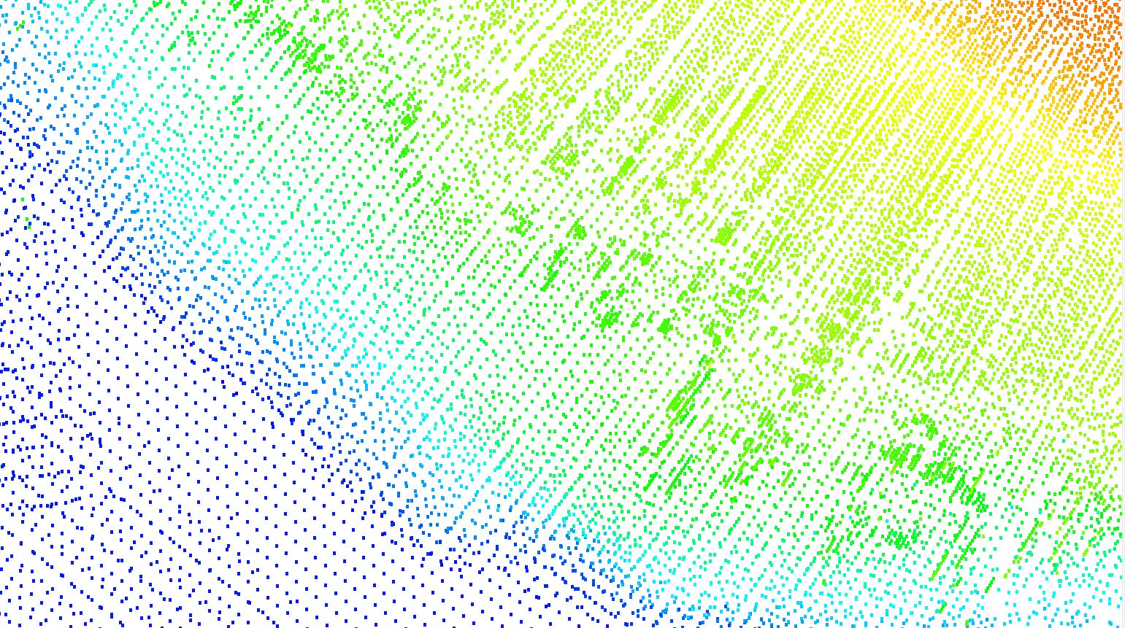
USV Data Processing Challenges
Delayed processing
Overviewing all incoming data
Quality control data
Varying data resolutions
Significantly more data
Calibration challenges
Notes:
When looking at an autonomous operation the manual steps we are being used to are limiting us from benefiting from the capacity of unmanned systems. The USV will collect all survey data, though only when the unit is back to shore it is possible to start downloading and processing the collected data. Until then many survey lines were sailed without knowing what the processed results might look like, with little idea whether the specifications are being achieved. This results also in a backlog of data having to be processed. In traditional processing workflows surveyors make a compromise in grid resolution when processing. Depending on depth changes and data densities the ideal grid resolution is being chosen and this can result in creating different grid resolutions in the same area, meaning creating and updating different grids. On a USV the manual interaction is more challenging and hence selecting the correct resolution is also challenging. Another processing challenge is the volume of data. If one looks at a replacement of a regular survey vessel with by an USV than this would not make a lot of difference. However when USVs start acting as a force multiplier or even operating in groups autonomously then the data volumes are increasing fast. In relation one would also want to keep a complete overview of all processed data in one screen and not having to follow different remote desktop control windows or TeamViewer windows each having a view to the actual processed data. When an autonomous platform are surveying the gridded data is not able to adjust that. An alternative is to monitor the processed results through a remote desktop control. That would require multiple demote desktop displays to be opened increasing the bandwidth usage and is not allowing for providing an overall view of all incoming data.

Slide 6
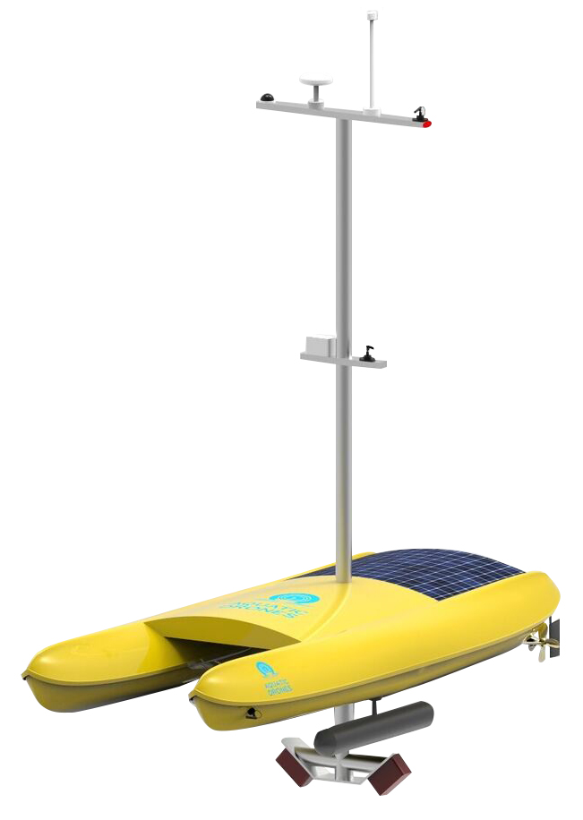
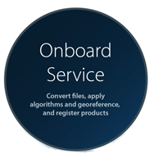
Processing Onboard
Notes:
What about moving the processing on the USV and perform this automatically? What if we would move all filtering, svc, tidal creation, quality analysis to the vessel

Slide 7
Workflow improvements
Traditional Workflow
Platform Setup
Acquire Data
Download
Process Data
Final Product Generation
Return USV
Final Product – asset ready for redeployment
USV Deployed
New Workflow
Platform Setup
Acquire & Process Data
Download
Process Data
Final Product Generation
Time Saved
Notes:
When looking at the traditional workflows we see that there are different steps involved with many manual steps involved and are pretty much sequential being carried out or in other words one step after the other. For example once the multibeam data has been acquired the processing can start. Only at this stage one would know whether we meet the specifications. For example Traditionally we after our survey is going step by step in these steps. However as we acknowledge on USVs processing should be done automatically onboard processing is essential. Another time saving aspect is to have instantly access to the data in order to make instantly decisions about data quality, coverage and to perform further analyses on the data.

Slide 8
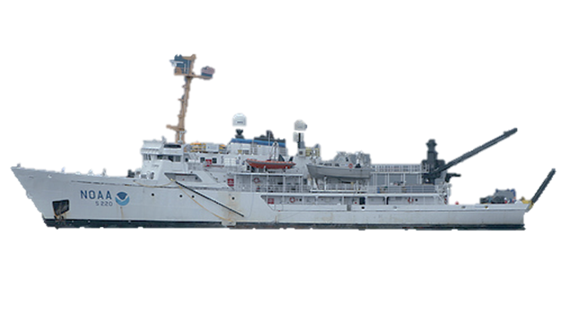
Cellular Network (3G/4G)
Radio Link
Satellite Communication

Slide 9
Data Accessibility
Large data transmission
volumes
Multiple windows required
Limited to one person
Notes:
In order to obtain access to the hydrographic expert could use remote desktop controls, such as for example Team Viewer. This has a couple of drawbacks though. The hydrographic expert could only work with the obtain data, others in an organization could only view the same window. Another disadvantage would be that the data volume using these kind of remote desktop controls are usually quite high, resulting in extra costs during the operations and last but not least when multiple USVs are in use one would have to open multiple remote desktop session.

Slide 10
CARIS CSAR - Gridding
Scalable to billions multi-attributed grid points
Terabytes of data
Multiple user capabilities
Level-of-detail pyramid
Notes:
Instead one would like to view, analyse and above all use the processed data live from multiple platform in one application. CARIS Onboard is designed in such a way that it can handle the large quantities of data. Using the CARIS CSAR framework one is capable to handle extremely large volumes of data, allow multiple users to have access to the processed results and be able to work with the data while it is being collected. Remotely from an office the hydrographic expert receives the data and can monitor what the progress is of the processing. The CSAR technology is designed in such a way that the data volume transmitted is limited. Complete gridded datasets do not have to be transmitted to each user. One can compare this with Google Earth……

Slide 11
Variable Resolution surfaces
One surface created - respecting the depth variances plus sounding density of sensor
Prevents creation of multiple grids!
Notes:
The USVs allow us to work remotely and in difficult areas. One would like to still have an overview whether the data meets the required specifications, such as IHO norm or meeting your density specifications.

Slide 12
Automatic Calibration
Simple calibration line planning
Pitch, Roll and Yaw calculated at once
Cross-coupling solved

Slide 13
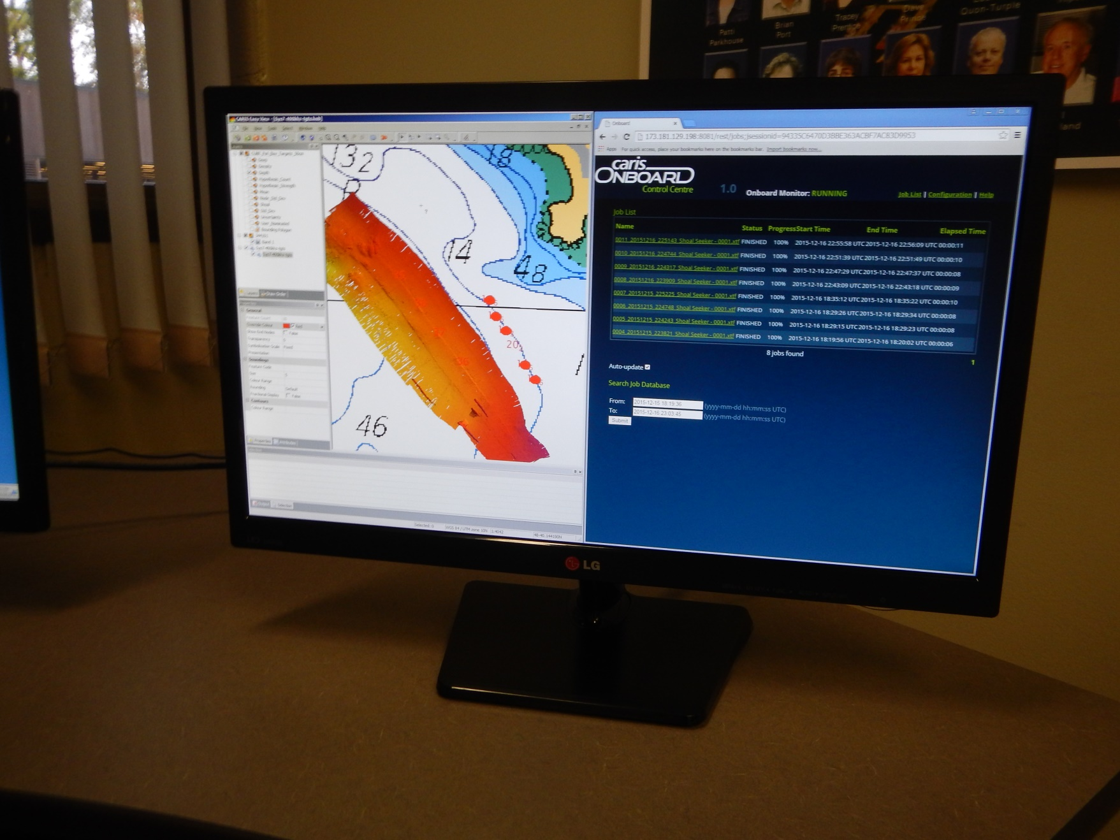
Surveyor on-shore
Monitoring onshore
Data availability anywhere
Quality control in real-time
Less risks and costs involved
Near-real time verification of survey specifications

Slide 14
Live USV demonstration with CARIS Onboard
Partners: Aquatic Drones, Ixblue,
Teledyne Marine and Navigation Solutions
Location: Trinidad meeting room
Day: Wednesday
Time: 11.15 AM

