Slide 2
Seapix :
an innovative multibeam multiswath echosounder
for water column and seabed analysis
Guillaume Matte, Didier Charlot, Olivier Lerda, Trung-Kien N'Guyen, Vinicius Giovanini, Maxence Rioblanc and Frédéric Mosca
Ixblue Sonar System Division, ENSICAEN
David Vincentelli

Slide 3
Sonar Imaging at iXblue
Seapix
Station Based Imaging
Backscatter Imaging
Conclusion

Slide 4
1
Sonar Imaging at iXblue

Slide 5
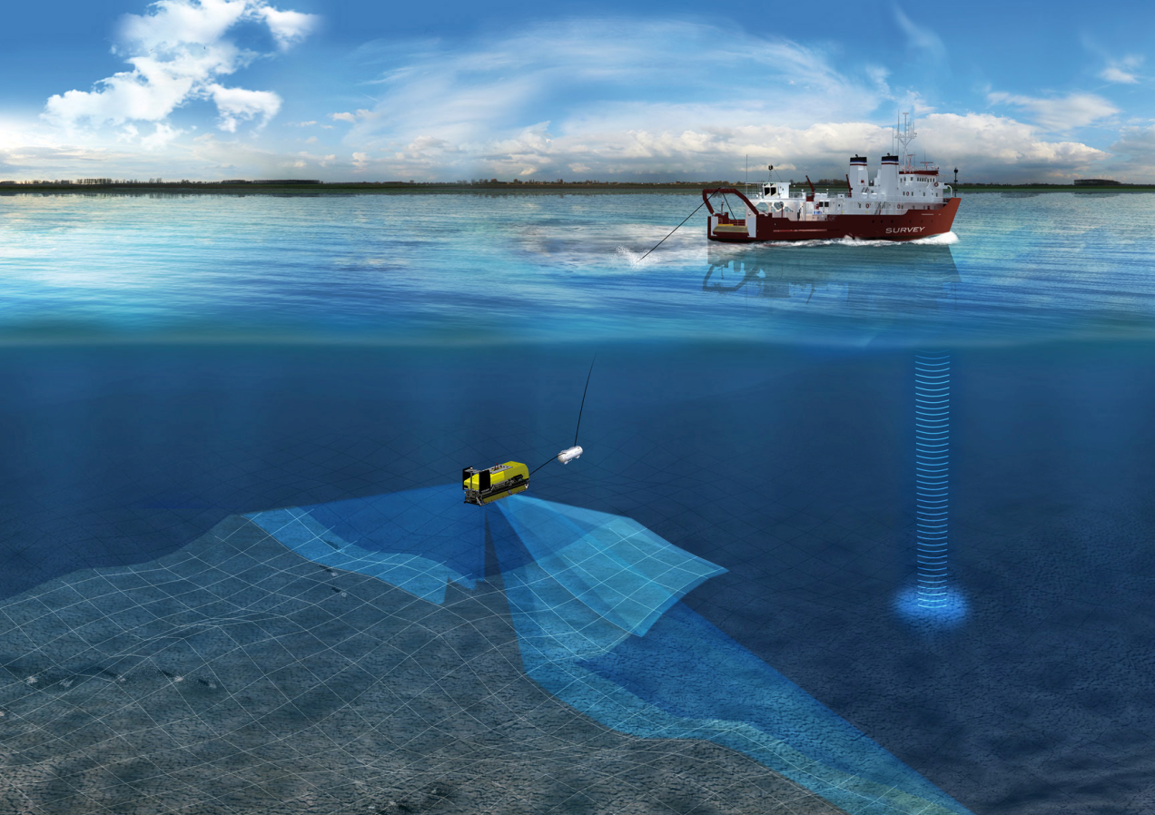
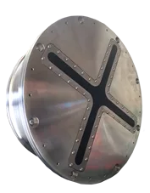
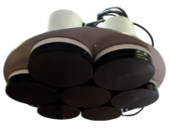
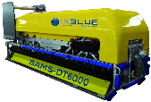
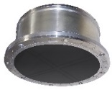
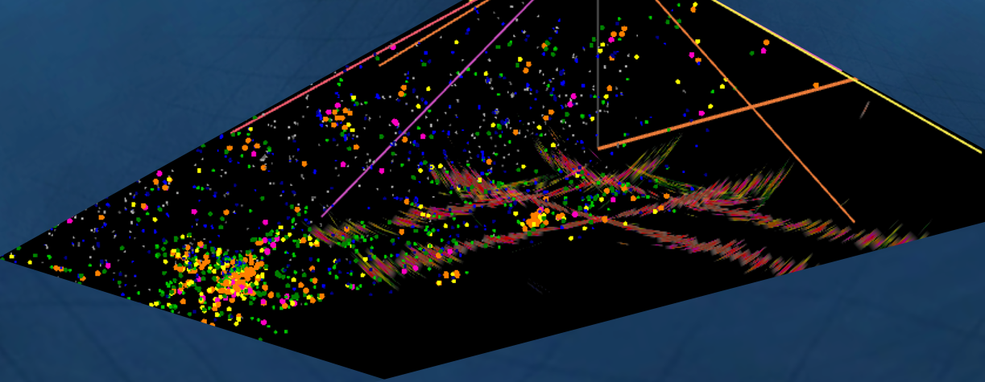
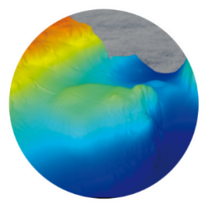
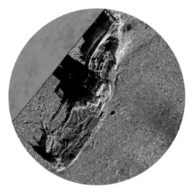
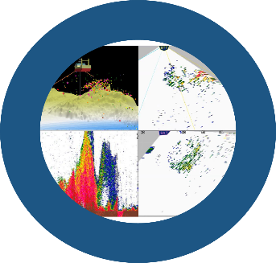
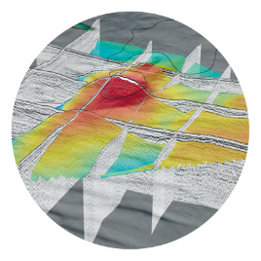
Sonar Imaging at iXblue : from near surface to subbottom
WATER COLUMN
MONITORING
SEABED
MAPPING
BOTTOM
IMAGING
SUB-BOTTOM
PROFILING

Slide 6
Seapix
  Multibeam/Multiswath Echosounder
2

Slide 7
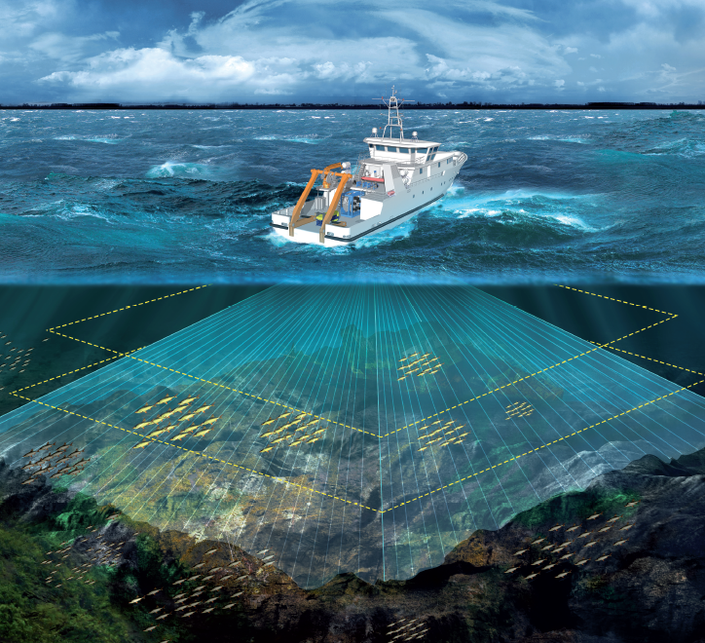
Seapix
Project Specifications, Development
Requirement Specifications
  Volumetric scanning of the water column
  Bathymetry up to 400m
  Target detection -35dB up to 200m
  Limited size (Φ< 50cm)
  Bathymetry IHO 1a
  Market
  Fisheries
  Context : Sustainable Policy and Selectivity
  Evaluation of fisheries resources in collaboration with scientific (vessel of opportunity )
  Challenges
  Tradeoff hardware cost / level of performances
  from single beam to multibeam interpretation
SEAPIX Research&Development
  start in 2008
  2 FUI (Optipêche/Tactipêche, Ifremer)
  1 RAPID (MUSE, Ensta)

Slide 8
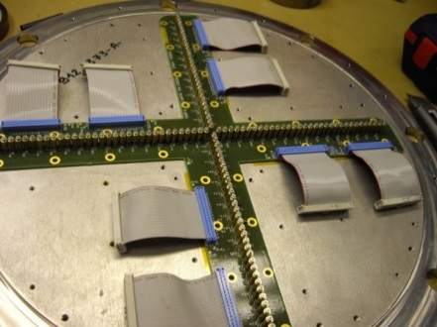
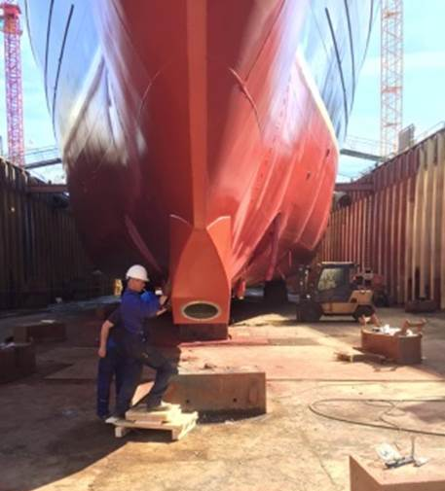
Seapix
Specifications
Size | 480mmx180mm
Weight | 60/40 kg
Power consumption | 200W (500W Peak)
Number of transducers | 2x 64 Rx and Tx
Max Depth | 20m
Beam Stabilization | On transmit and receive
Frequency | 150khz
Bandwith | 10khz (7.5cm res.)
Modulation | CW or FM
Beam number | 64 beams
Transmit Power | 1kW
Beam Steering | +/-60° for/aft port/starboard
Transmit Swath width | 120 °x 1.6°
System Specifications

Slide 9
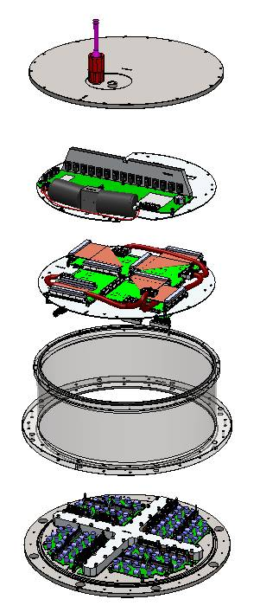
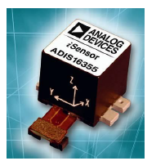
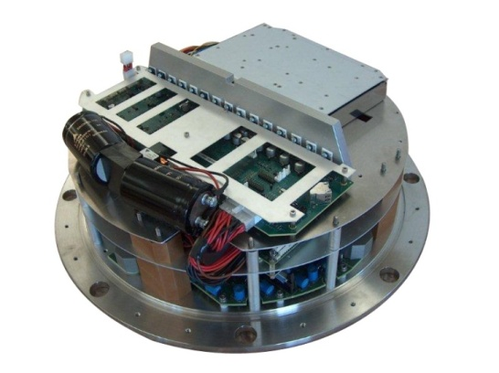
Seapix
Sonar Head
Ethernet
Communication, configuration and Power Supply management, Gyrostabilization
MEMS
Digital
Emission and reception Digital signal processing
Receiver Analog Filters
Emission Power
Analogic
Impedance Matching
Transducers
Acoustic

Slide 10
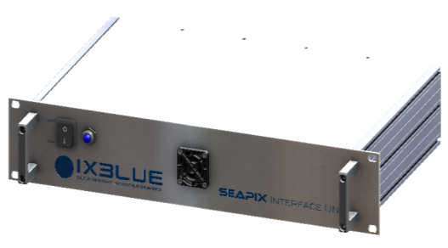


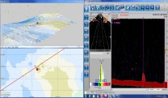
Seapix
System Architecture
Sonar Room
Navigation data and external MRU (optional)
Onboard Power Supply
(230Vac/ 24Vdc )
NMEA
Power
Deck
Ethernet and command
Ethernet
Underwater Cable (Ethernet + Power)
Sonar
Head
Interface Unit
Beam Former Processor Unit
Viewer Processor Unit

Slide 11
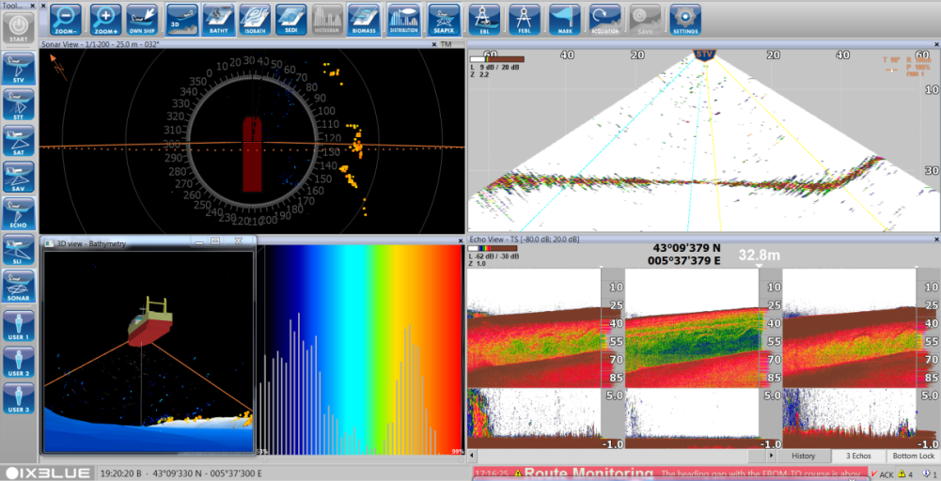
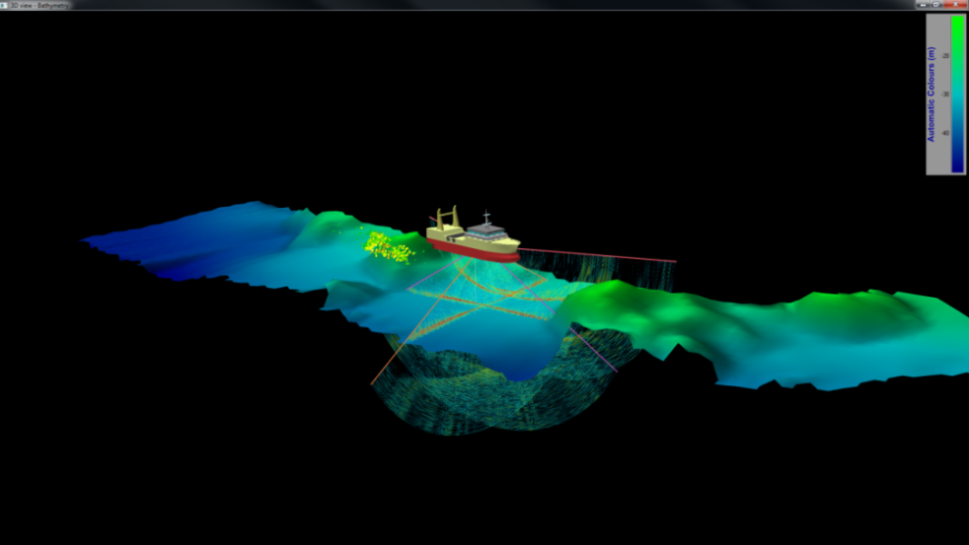
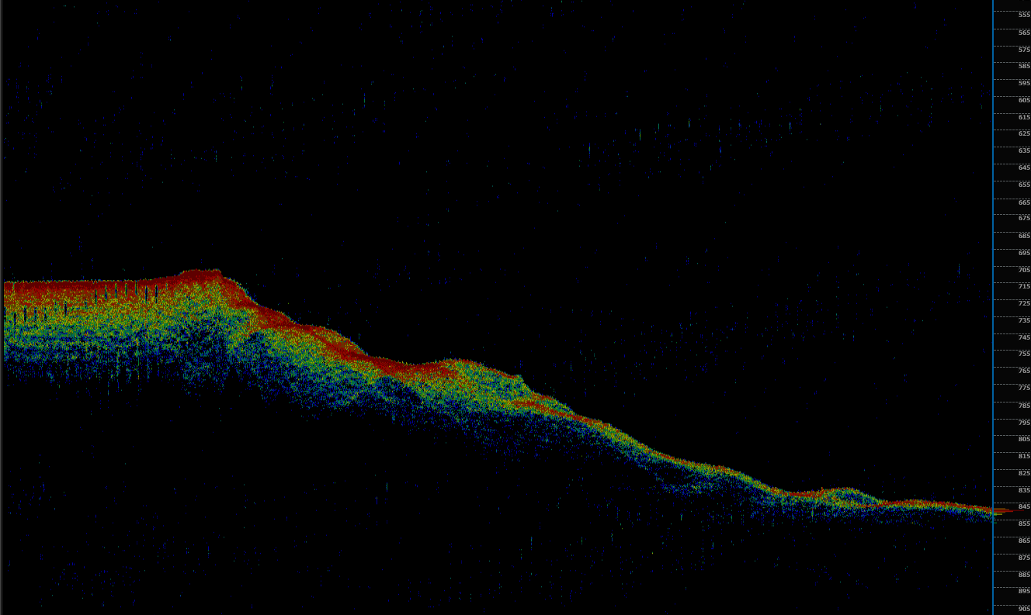
Seapix
Software
Key features
  2D/3D Bathy
  2D/3D Backscatter
  2D/3D Echograms
  Multiple Echogram
  TS/SV Analysis
  HAC format (EchoView,Movies3D)
845 m !

Slide 12
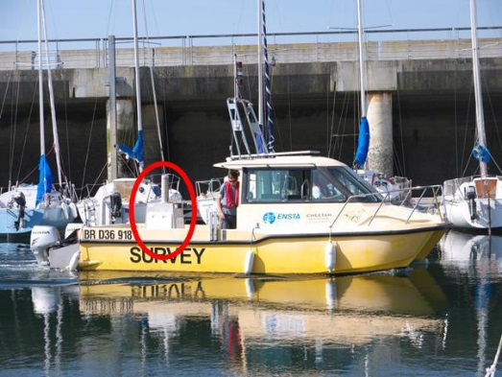
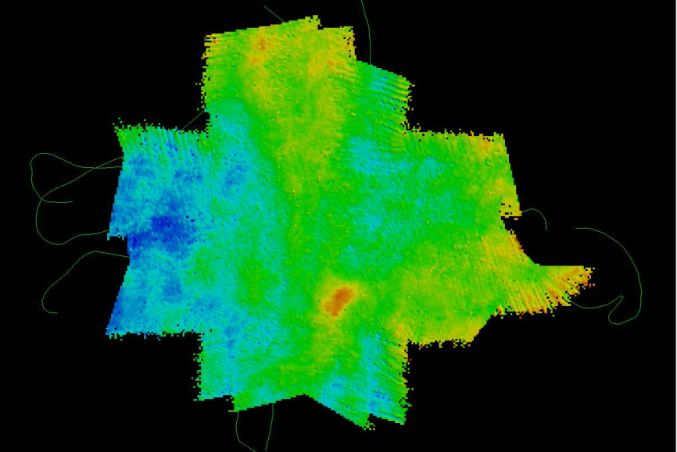
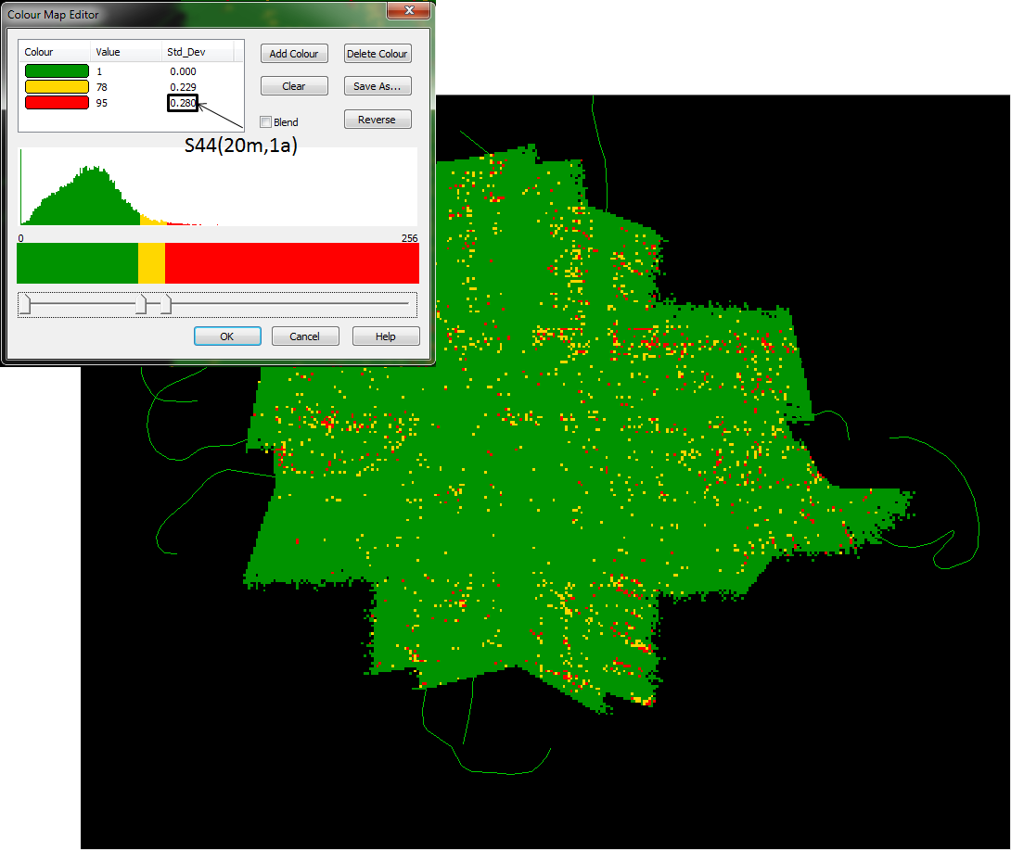
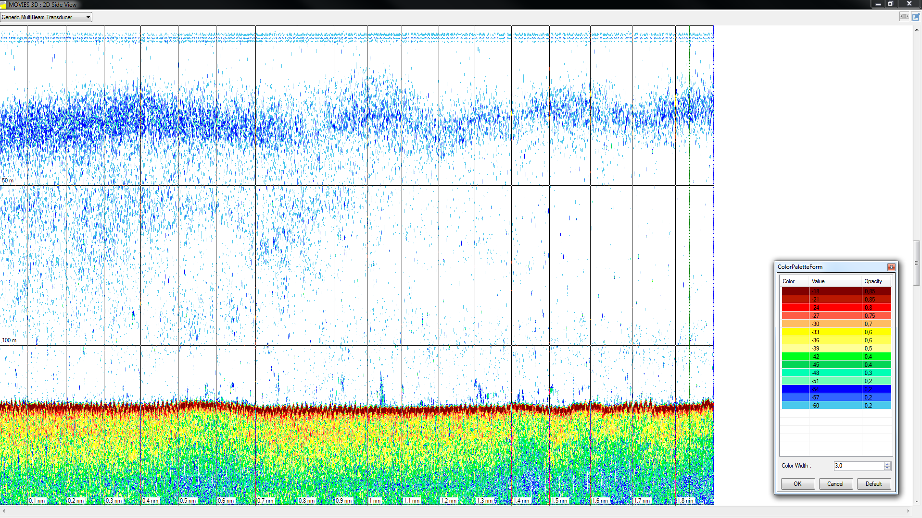
Seapix
Performances
Bathymetry , ENSTA (2015) :
  IHO order 1a with MEMS
BaraPemdez, June 2014, scale SV [-60dB,-18dB], central beam
Detection Level
  Noise Level , 24 dB re 1μPa/Hz
  SV -60dB , 200m

Slide 13
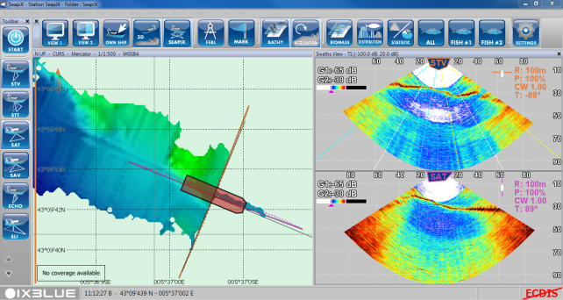
Seapix
Multiple Swath Imaging
Versatile Configuration
User defined insonification
scenario
CW/FM
Switch Rx/Tx antenna
Steering angle interval
and increment

Slide 14
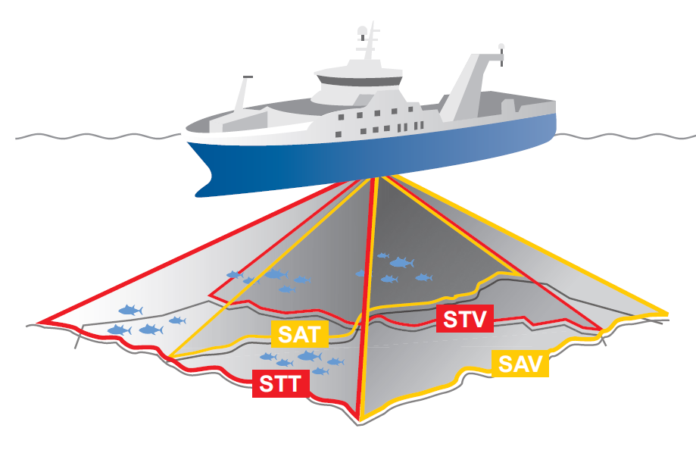
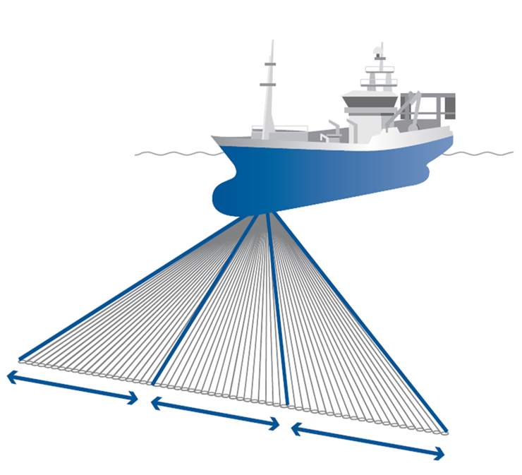
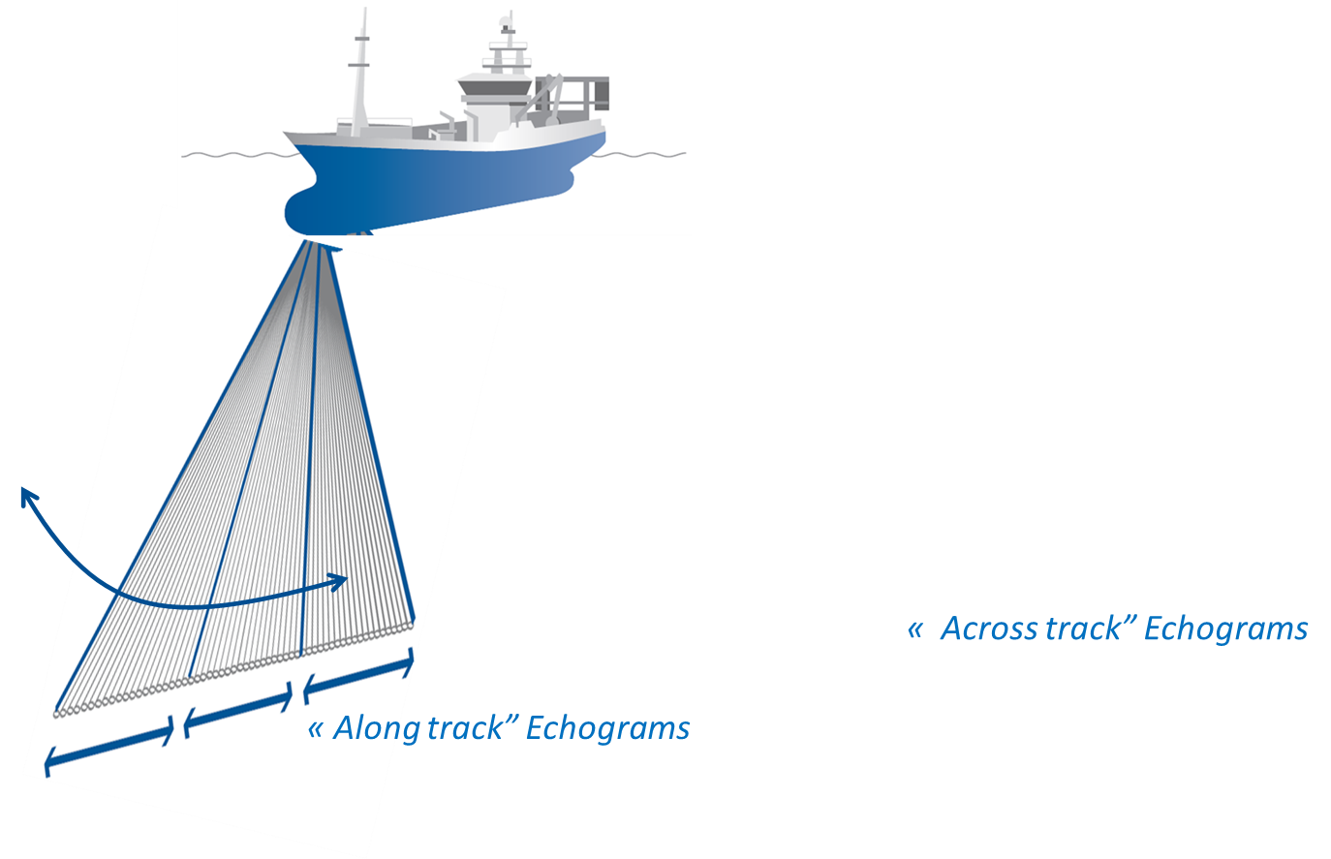
Seapix
Downward Looking Configuration
Port/Starboard
scanning
Fore/Aft
scanning
Volume 120° x 120°
7cm radial resolution
1.6°x1.6° up to 1.6°x3.2° angle resolution

Slide 15
3
Station Based Imaging

Slide 16
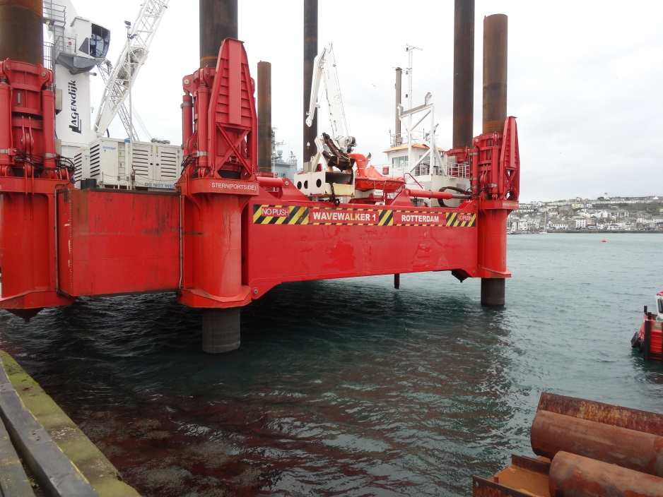
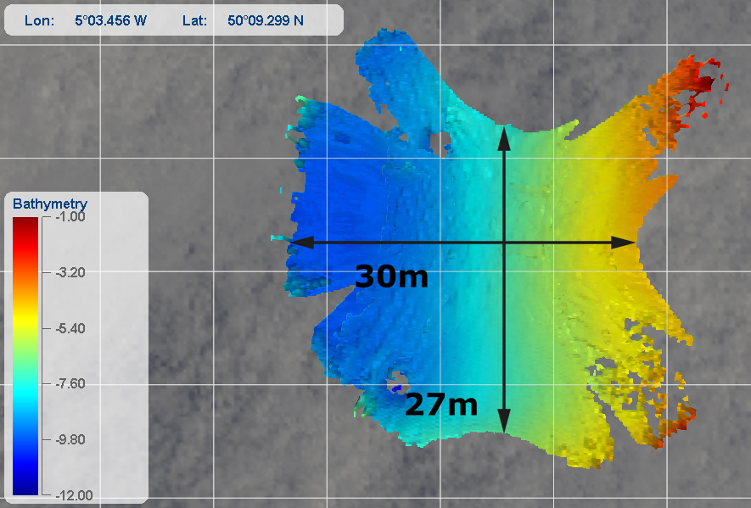

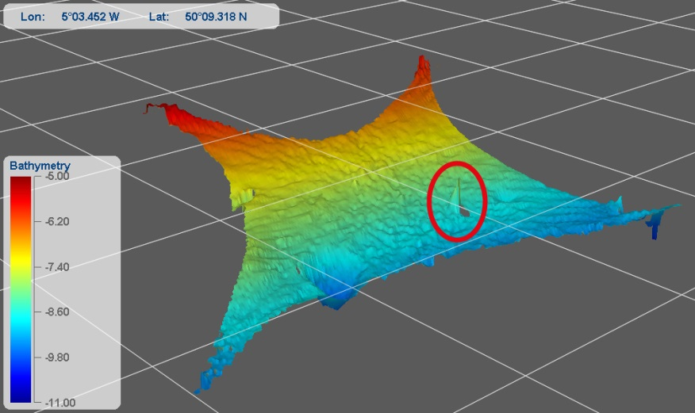
Station Based Imaging
Bathymetry
Seapix is fixed on barge
Bathymetry area ~ 1200m² at 10m depth
Seapix
deployed leg

Slide 17
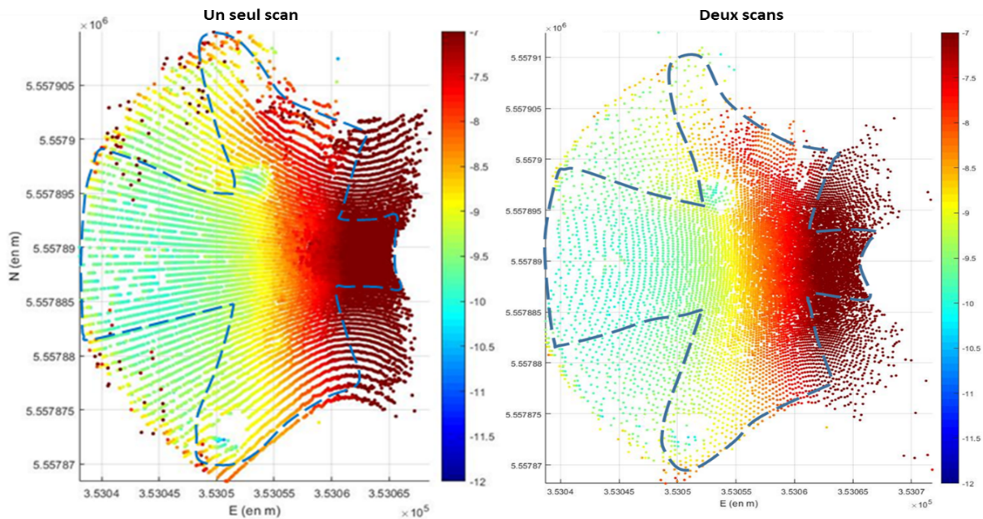
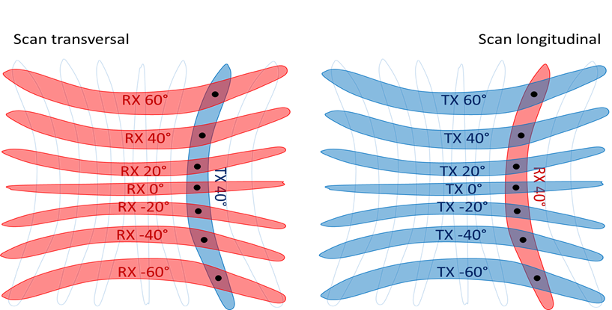
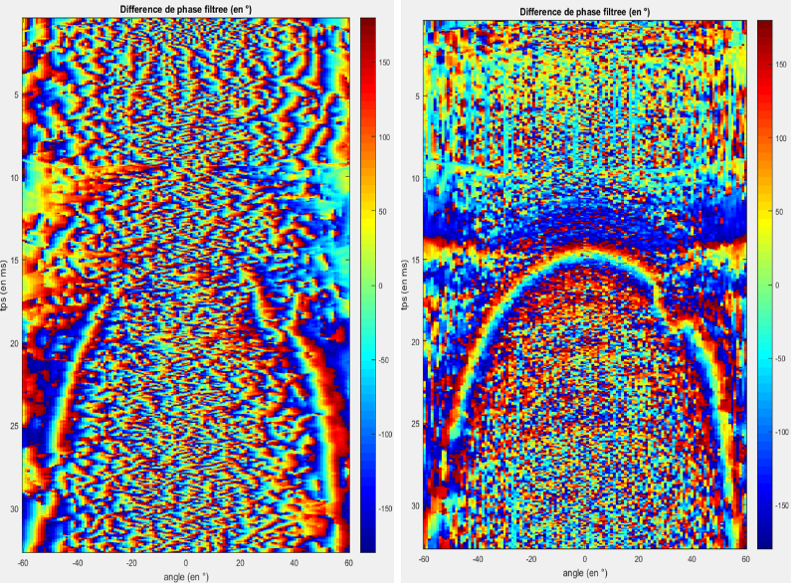
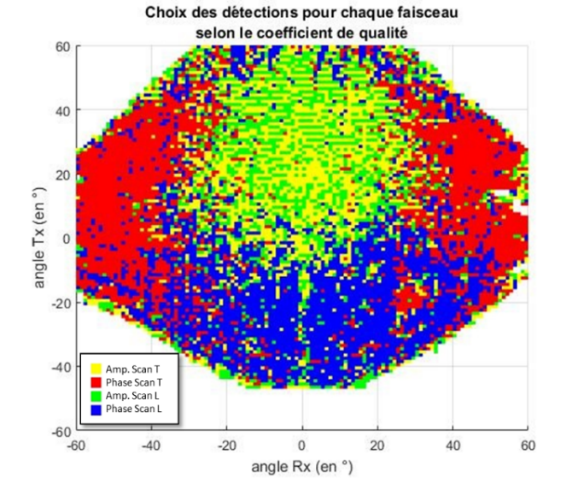
Station based imaging
Bathymetry
Exploiting antenna reversibility to improve the reliability of bottom detections. Artefacts are removed by using virtual phases

Slide 18
4
Backscatter Imaging

Slide 19
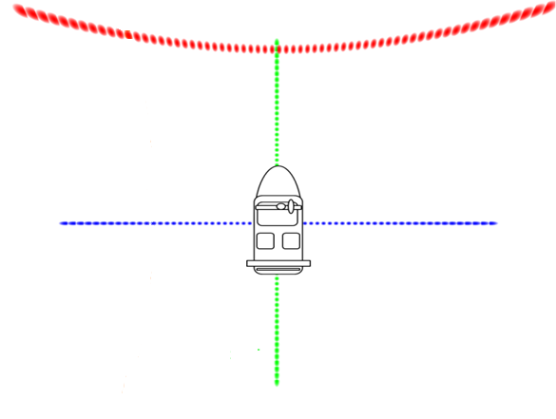
Backscatter Imaging
Multiple Imaging Modes
Horizontal Forward Looking
Conventional Bathymetry&Imagery
Longitudinal

Slide 20
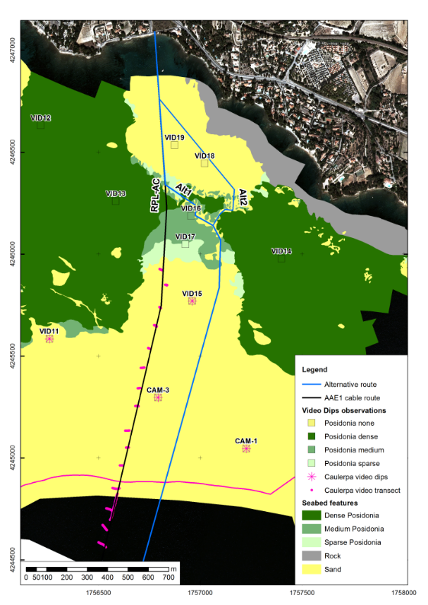
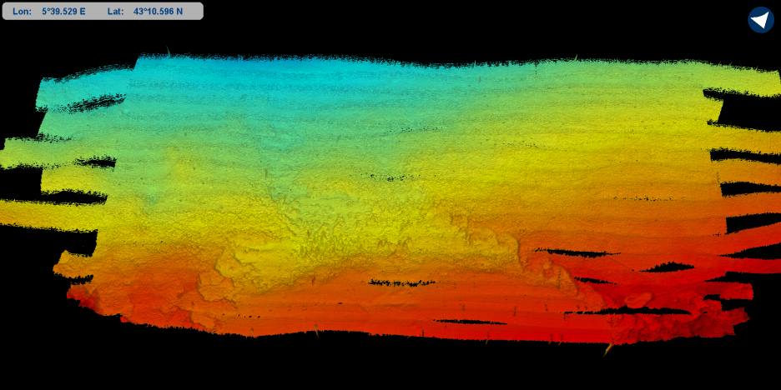
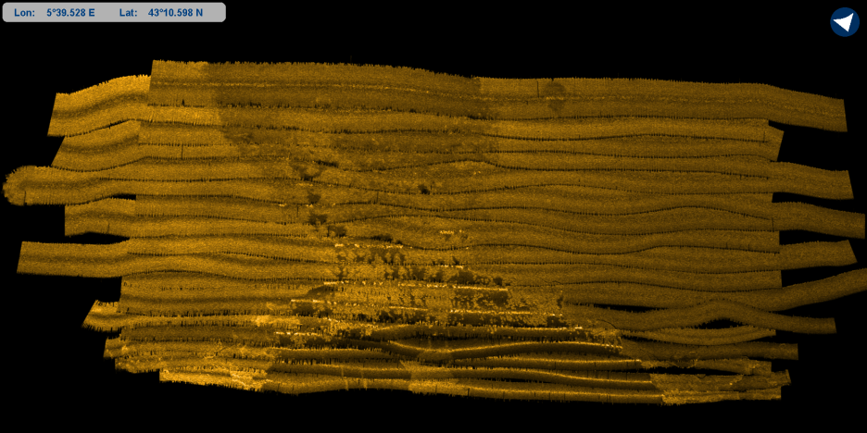
Backscatter Imaging
Conventional Imagery Mode

Slide 21
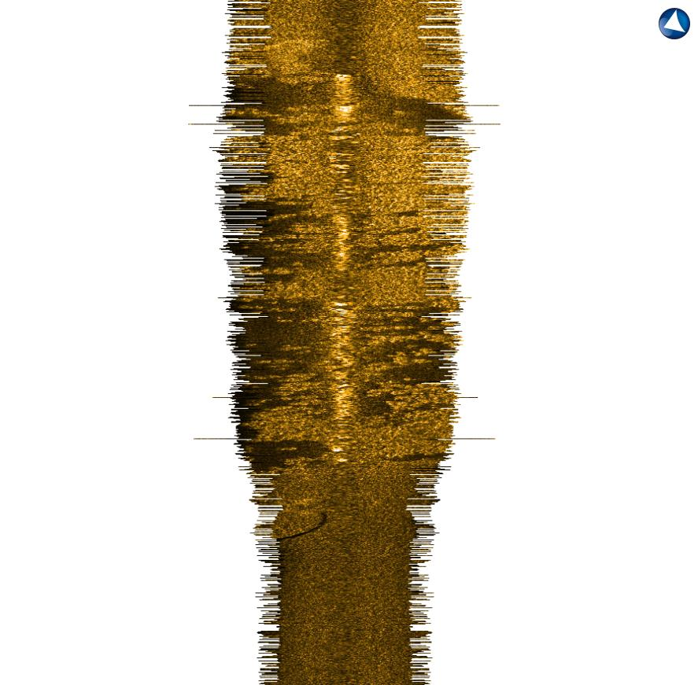
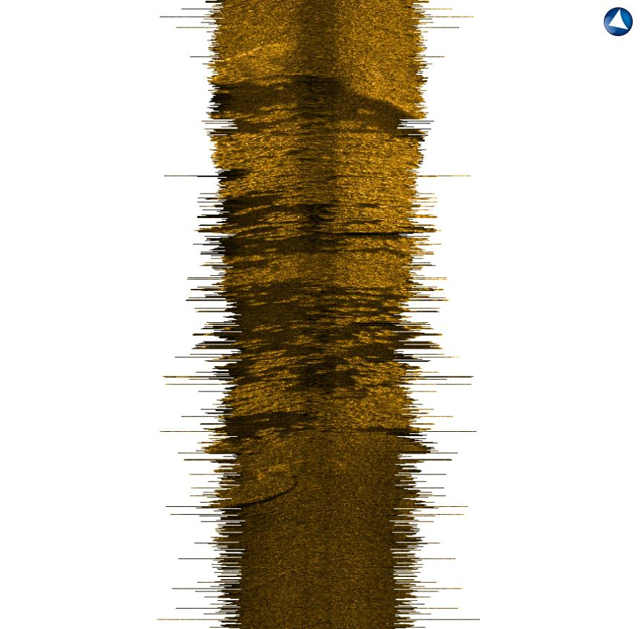
Backscatter Imaging
Forward Looking Imaging
Forward Looking Imaging:
→Specular reflection suppressed
→Higher shadows contrast
.
Vertical Imaging:
Specular reflection
Bad contrast at nadir
.

Slide 22
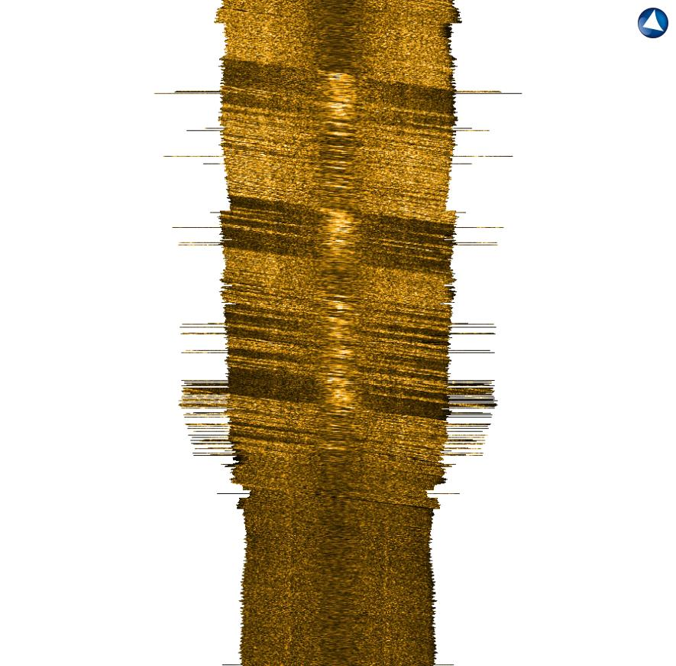
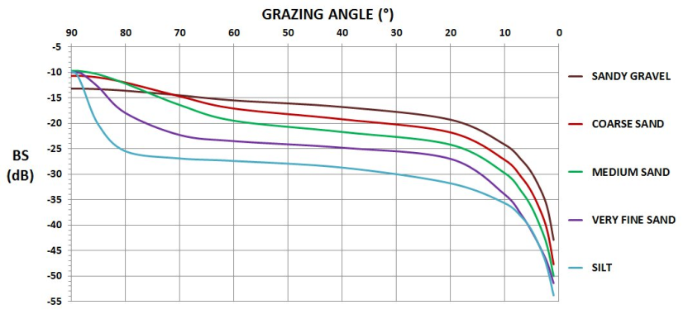
Backcatter Imaging
Longitudinal Mode
Longitudinal Imaging Mode:
→ Full BS profil vs Incidence Angle

Slide 23
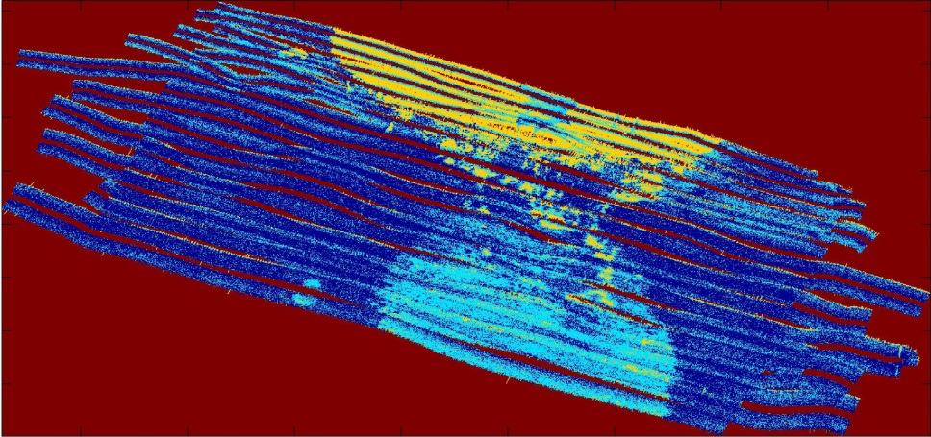
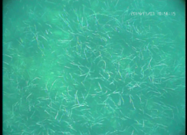
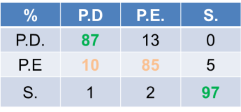
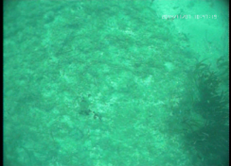
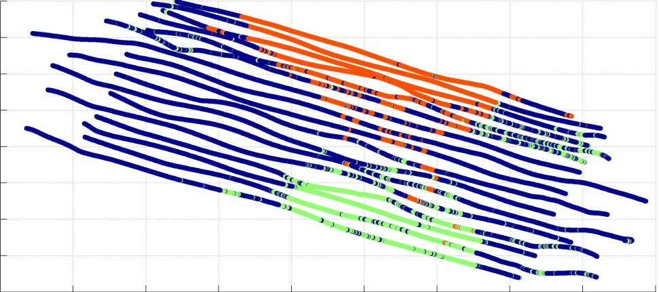
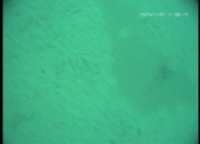

Backscatter Imaging
Seafloor Classification Results
Mode Transversal
PosidoniaDense
Posidonia sparse
Mode Longitudinal
Sand

Slide 24
5
Conclusion

Slide 25
Conclusion
MultiBeam/MultiSwath System
Seapix reversible mills cross configuration enables an innovative use of signals recorded from perpendicular and tilted swathes
The first application example presented was the ability to build a bathymetry from a static position without the need of pan-and-tilt mechanical interface
The second application example concerned a unique bottom classification method using both longitudinal and transversal swathes.

