Slide 1
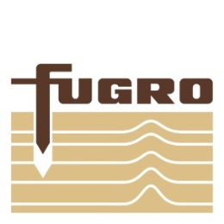
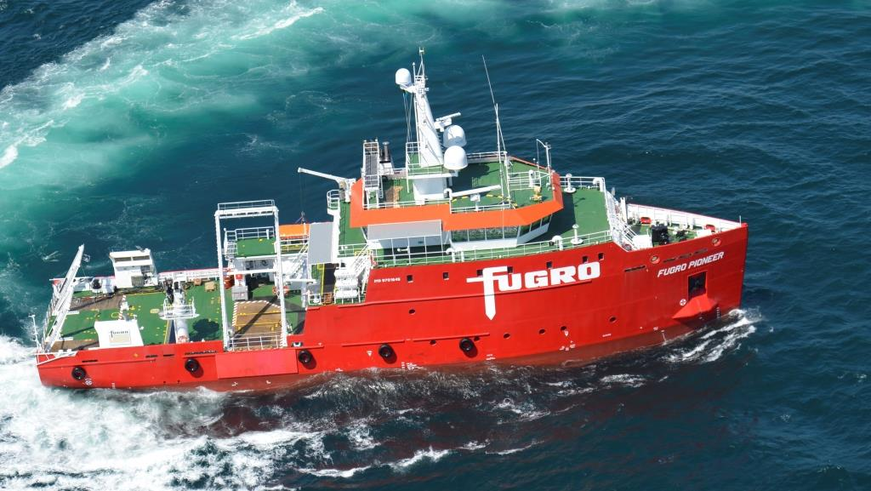
Use of Kongsberg Extra Detections to Support Pipeline Inspection Surveys
Bart-Jan Tijmes Hydro 2017 November 2017

Slide 2
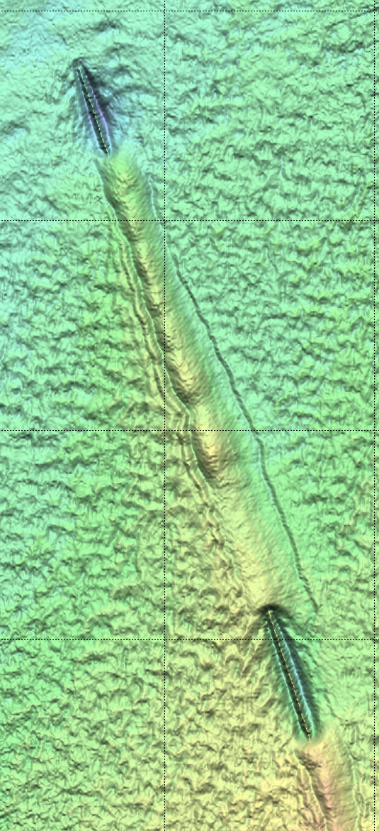
Content
Fugro Marine Site Characterization
Pipeline Inspection Surveys & Requirements
M.V. Fugro Pioneer
Pipeline Detection Performance
Kongsberg Extra Detections
Extra Detections Trial & Results
Extra Detection Processing
Questions
Use of Kongsberg Extra Detections to Support Pipeline Inspection Surveys

Slide 3
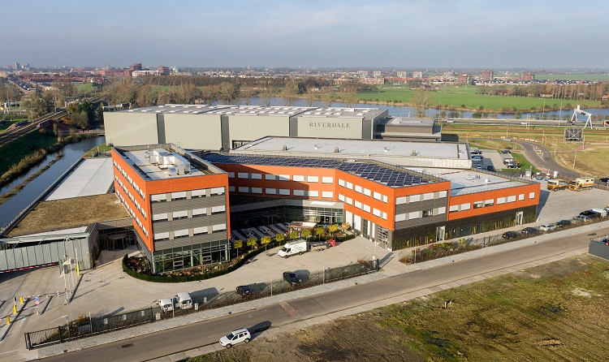
Fugro Marine Netherlands Site Characterization
Fugro Marine Netherlands
Office location: Nootdrop, The Netherlands
Geophysical Surveys:
Offshore Windfarm Site;
Offshore Windfarm Clearance (UXO);
Pipeline Route;
Cable Route;
Pipeline Inspection.
Active in:
North Sea;
Baltic Sea;
The English Channel.
Use of Kongsberg Extra Detections to Support Pipeline Inspection Surveys

Slide 4
Pipeline Inspection Surveys & Requirements
Fugro hold overall majority of Dutch annual pipeline inspection contracts:
3 - 4 months of survey work per year.
Pipeline inspection survey lines:
Centre line + One (1) wing line (25 / 35 m offset);
Two (2) wing lines (25 / 35 m offset);
Centre line + two (2) wing lines (25 / 35 m offset).
Inspection focus on pipeline status:
Freespans;
Exposures;
Debris.
Survey info:
Average water depths: 0 – 60 metres;
Logging sessions length: 30 – 45 minutes;
Pipeline diameters: 2.5 – 36 inch.
Client deliverables:
Reports;
Listings;
Alignment charts;
Gridded MBES data;
Ungridded MBES data.
Risk assessment models
Use of Kongsberg Extra Detections to Support Pipeline Inspection Surveys

Slide 5
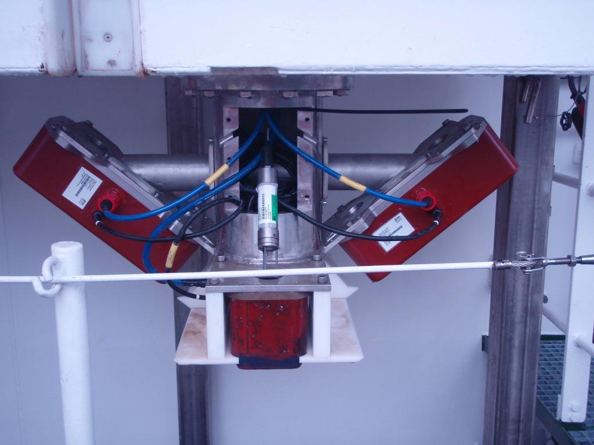
M.V. Fugro Pioneer
New build Geophysical survey vessel
Operational since October 2014
Multibeam Echo Sounder:
Model: Kongsberg EM2040-04, Single Tx, Dual Rx;
Mounted: Moonpool, close to CRP in fixed frame;
Mounting angles:± 40 deg;
Draft: 3.5 m.
Use of Kongsberg Extra Detections to Support Pipeline Inspection Surveys

Slide 6
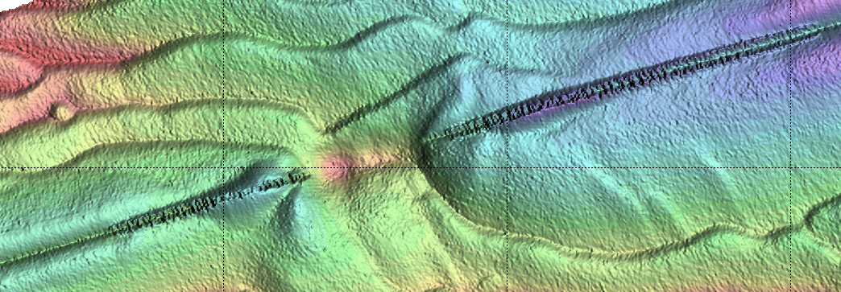
Pipeline Inspection Surveys Performance
B
Rock dump
A
Freespan
A
B
Use of Kongsberg Extra Detections to Support Pipeline Inspection Surveys

Slide 7
Impact
Client comments:
Missing (long) freespan section is unacceptable;
Validation required on ‘Seabed detections’ underneath the pipeline;
Severe difficulties for risk assessment models;
Improvements need to be shown before contract renewal.
Pipe supported or in freespan?
Validation required
Use of Kongsberg Extra Detections to Support Pipeline Inspection Surveys

Slide 8
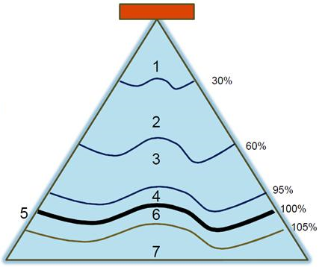
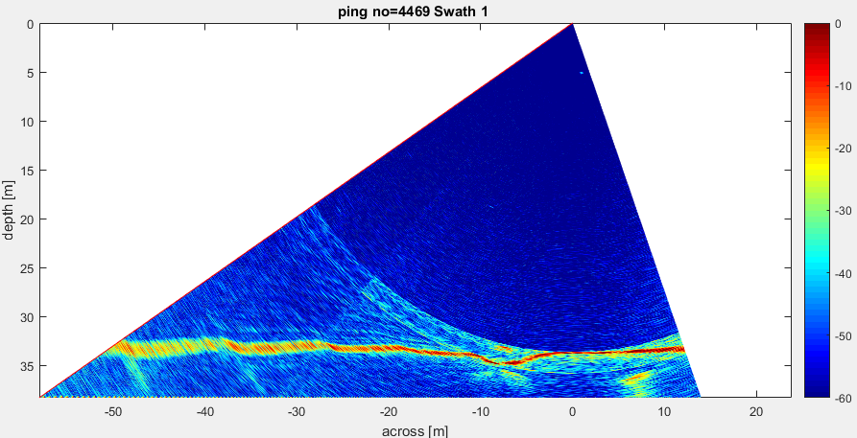
Kongsberg Extra Detections
Solution: Extra Detections
New MBES feature developed by Kongsberg;
Installed on Fugro Pioneer in October 2015;
How does it work?
Water column data but…. different;
Water column divided in classes;
Implemented in Starfix VBAProc (2015);
Pipeline
MBES Port head
First return noise
Noise from Starboard
MBES head
First return
Seabed
Seabed
Noise
Use of Kongsberg Extra Detections to Support Pipeline Inspection Surveys

Slide 9
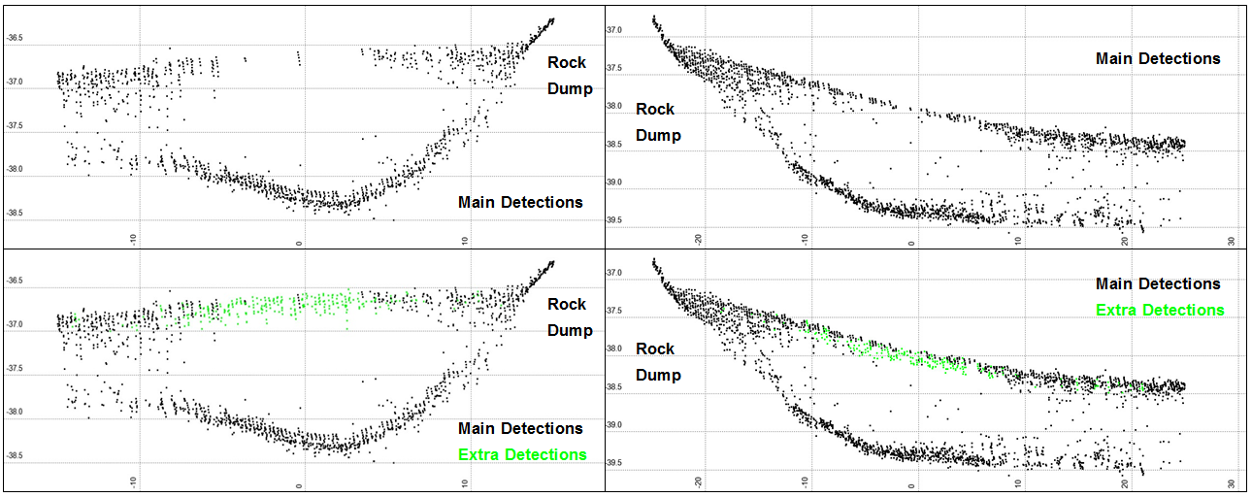
Kongsberg Extra Detections
Positive results:
Extra detections capture the top of pipe when / where the main detections fail.
Top of pipe can be reconstructed from the extra detections
Along-track results:
Use of Kongsberg Extra Detections to Support Pipeline Inspection Surveys

Slide 10
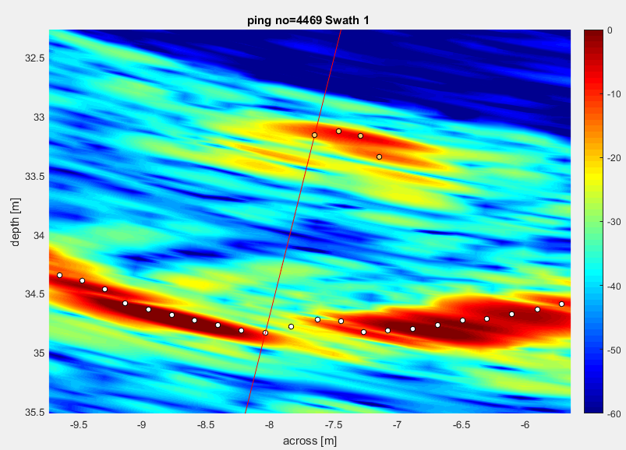
What Happens?!
Seabed adjacent to pipeline generates a more powerful return (return with higher score) than the pipeline.
This seabed appears in the outer part of the -10 dB limit and is projected to the centre of the beam.
Thus: Seabed detections underneath the pipeline are not real!
Use of Kongsberg Extra Detections to Support Pipeline Inspection Surveys

Slide 11
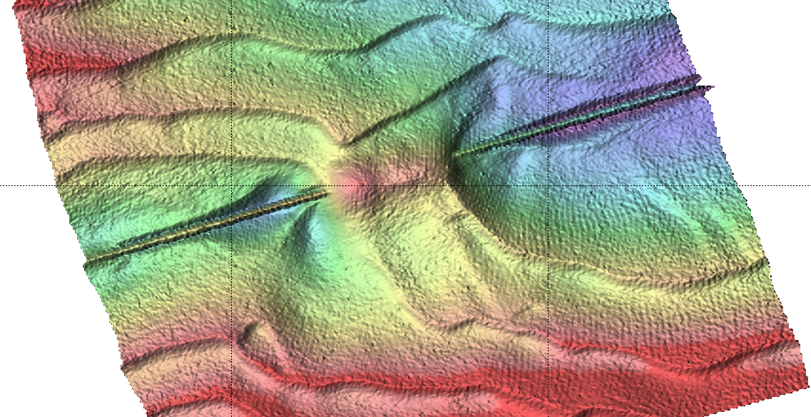
Cross Line Performance
Very good data quality thought the swath
Embedded in procedures to sail cross line(s) covering critical freespan areas
Use of Kongsberg Extra Detections to Support Pipeline Inspection Surveys

Slide 12
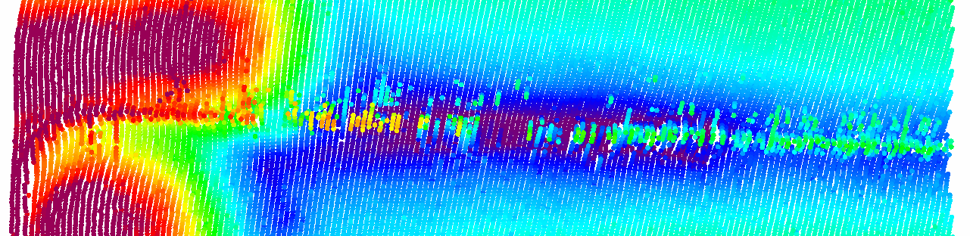
Extra Detection Processing
Detection failure of main beams
Use of Kongsberg Extra Detections to Support Pipeline Inspection Surveys

Slide 13
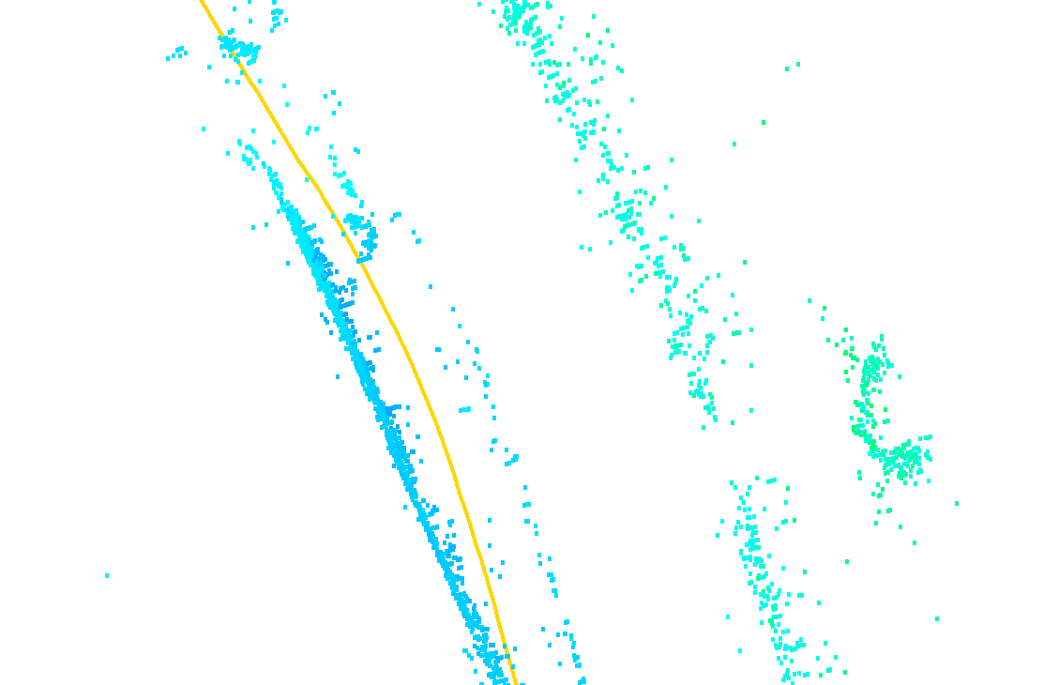
Extra Detection Processing
Kongsberg Extra Detection Class 5 (Caris Multiple Detections Class 4)
Processing Workflow
Determining freespan sections;
Load Extra Detections;
Reject unwanted Extra Detections;
Clean ‘fake soundings’ manually;
Create final surface / deliverables.
Use of Kongsberg Extra Detections to Support Pipeline Inspection Surveys

Slide 14
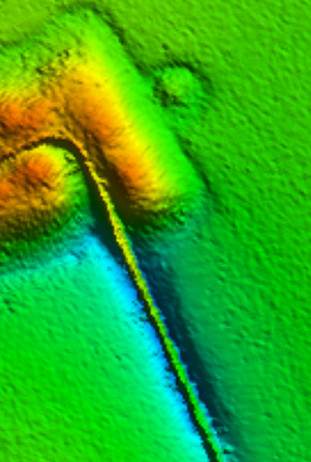
Conclusions
Extra Detections:
Successful solution to cover detection gaps on TOP;
Cross lines provide a good backup;
Default enabled during pipeline inspections;
Manual & time consuming processing.
Clients:
Satisfied with explanation and solution;
Contract renewal.
Caris Multi Detect Processing:
Single integrated solution;
Fine tuning in cooperation with Kongsberg and Fugro.
Use of Kongsberg Extra Detections to Support Pipeline Inspection Surveys

Slide 15
Questions?

