Slide 1
Data Driven Decision Making
Reenu Toodesh¹, Sandra Verhagen²
Department of Geoscience and Remote Sensing
Delft University of Technology
Notes:
SMARTSEA
Safe navigation by optimizing sea bed monitoring and waterway maintenance using fundamental knowledge of sea bed dynamics

Slide 2
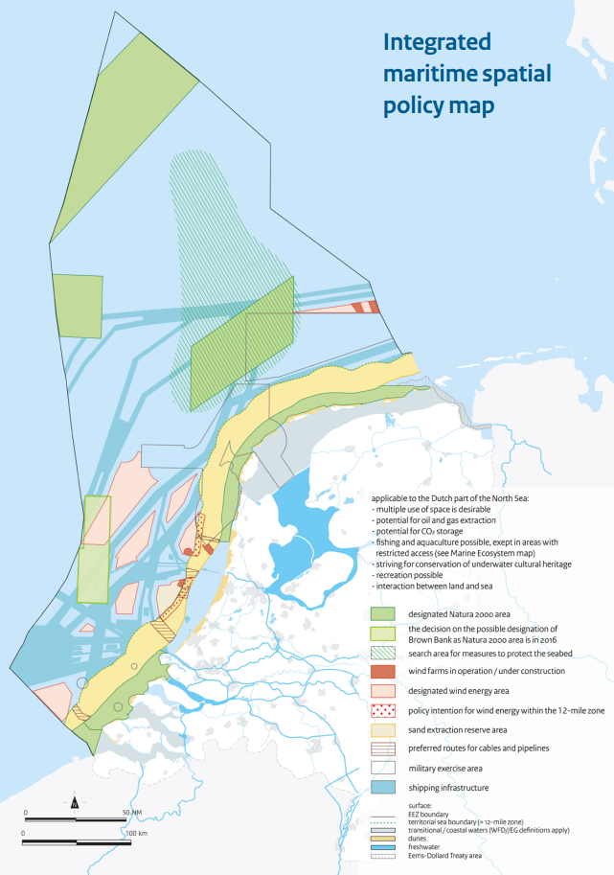
National Policy document on the North Sea 2016-2021
Increasing pressure on the NCS
Notes:
Stems from the increasing pressure of the NCS in the context of the Dutch Economy
Which heavily relies on activities in ports of Rotterdam and Amsterdam; but also not excluding the oil and gas industry, mining, sand extraction sites, points at which cables and pipelines come ashore(Van Oord) etc

Slide 3
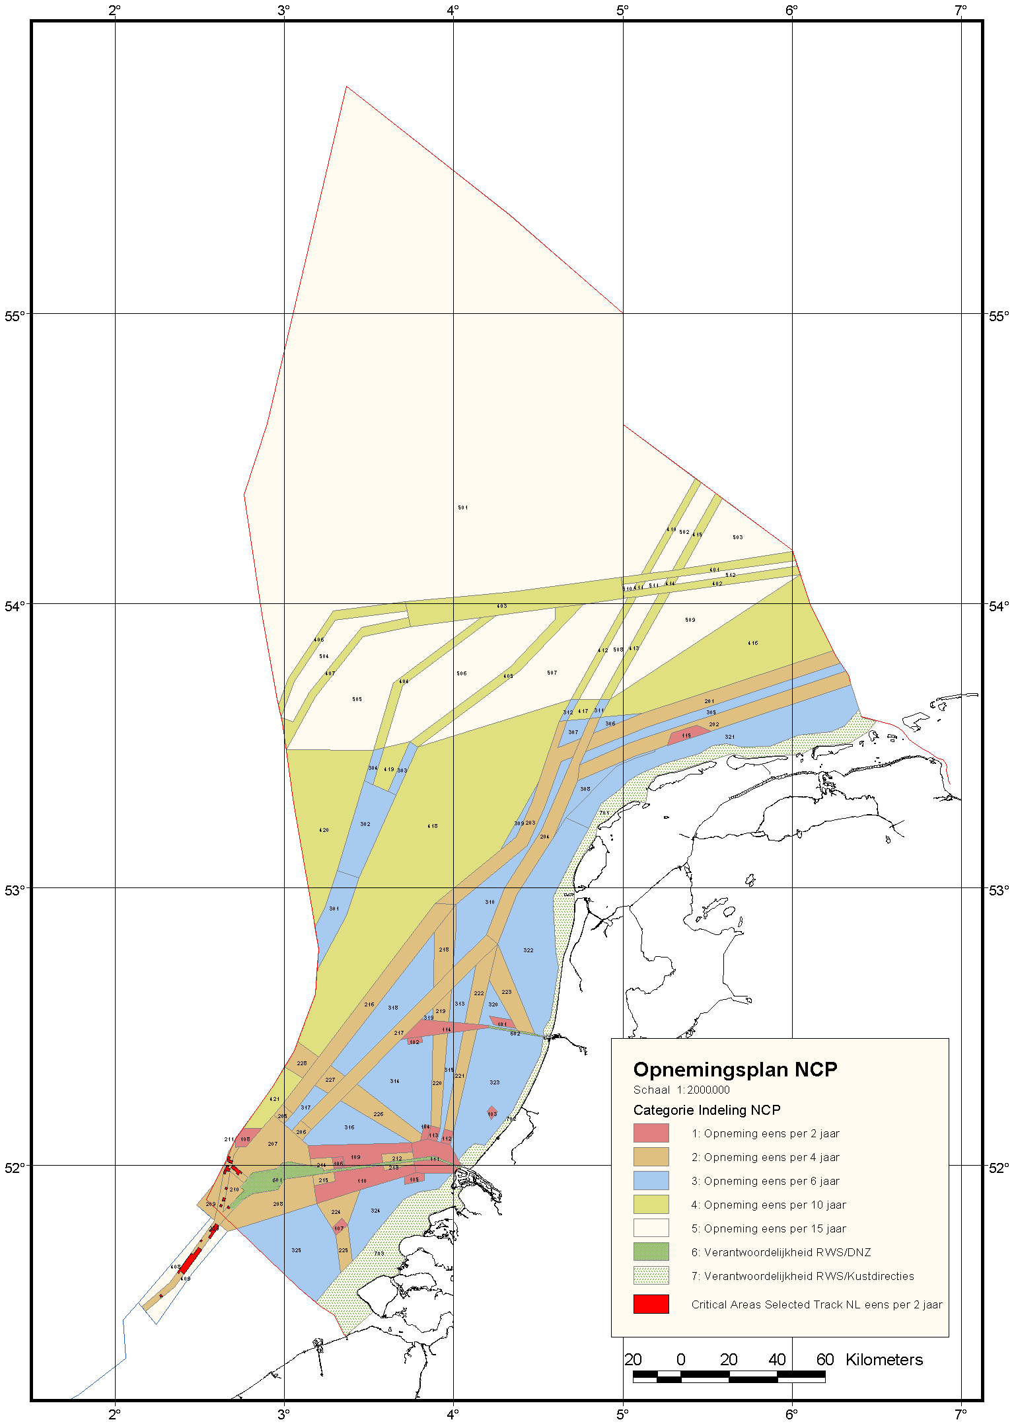
National Responsibility
SOLAS developed by IMO
Governmental agencies responsible for hydrographic surveys:
NLHO
RWS
IHO S44 hydrographic survey standards
Dutch Survey Policy
Current Dutch Survey Policy:
Requires a comprehensive adaptive, risk-based approach to optimizing survey frequencies.
ValHyd 2011
Notes:
P3: developing a tool used to optimise the maintenance strategy
-Dutch economy relies on the activities of the ports of Rotterdam and Amsterdam and so safe navigation is crucial
- Resources are not unlimited and so they need to perform these surveys in a more efficient manner

Slide 4
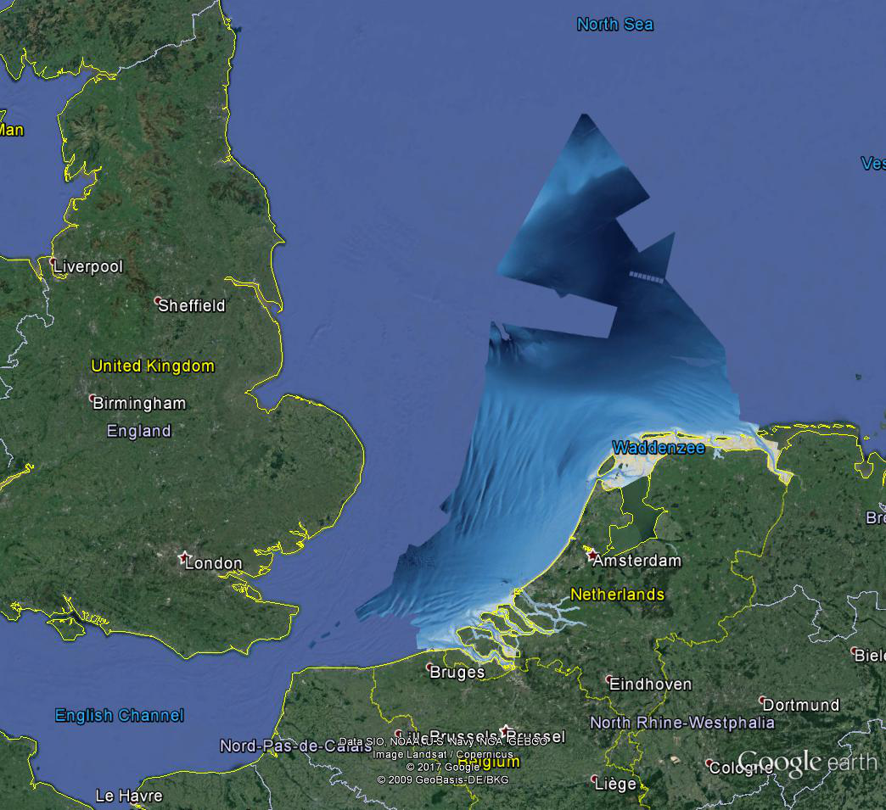
Notes:
Select the characterization E{d} = m
Compose the dispersion matrix D{d} = Cd
Calculate the final estimates u and their uncertainty Cu
What is the basics of the hypothesis testing
-We have to ensure that the right model is being used for the estimation and prediction
DATA driven models

Slide 5
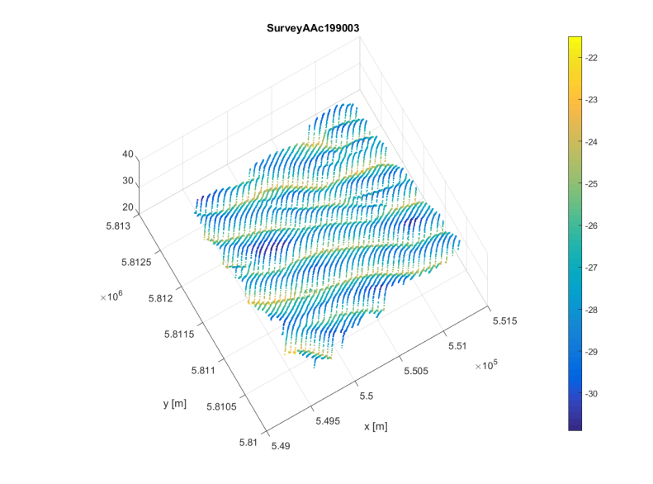
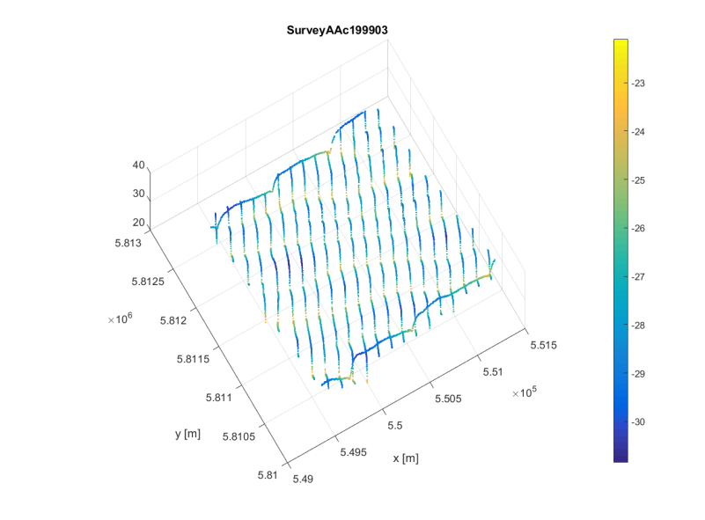
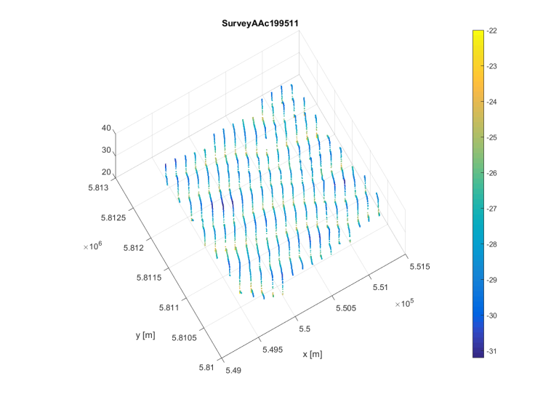
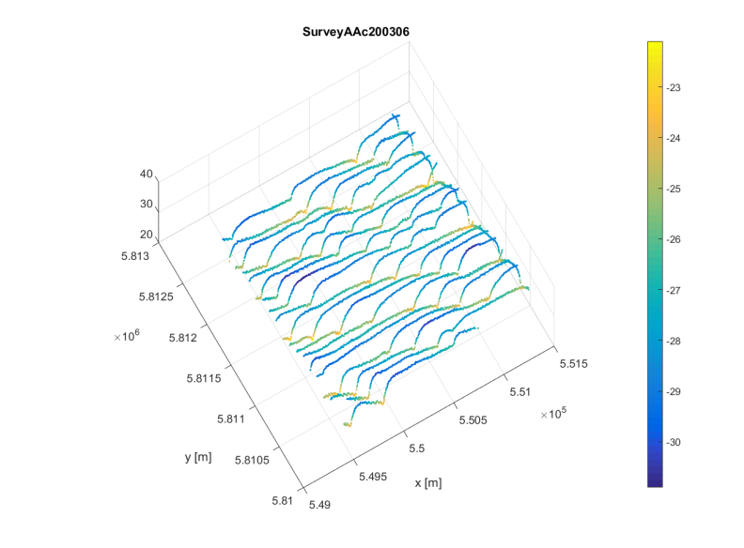
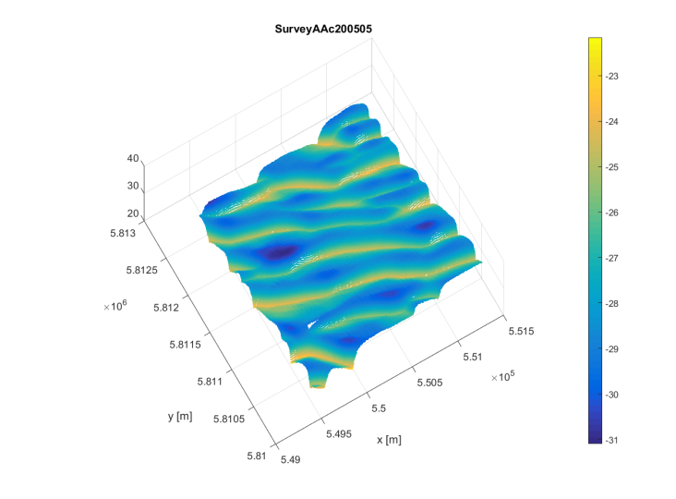
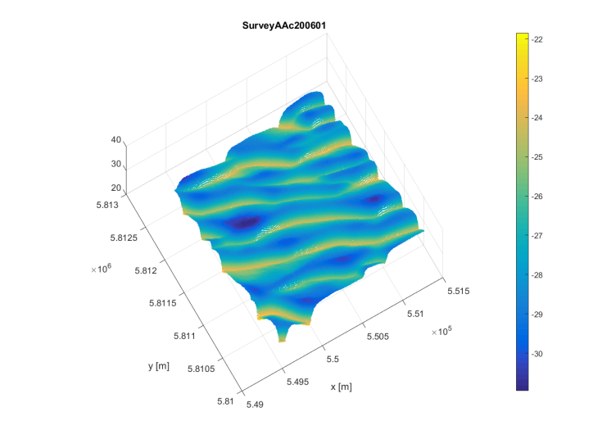
1990
1995
Today
2003
2003
Survey 5
1/1/2005
Survey 1
Survey 2
Survey 3
Survey 4
Survey 6
1/1/1990
1/1/1995
1/1/1999
1/1/2003
1/1/2006
1990
1990
1992
1994
1996
1998
2000
2002
2004
2006
2006
Notes:
Long time series ensures validity and generalizability
Variable data - Heterogeneous data consists of SBES and MBES. Full coverage MBES and SBES with line spacing that varies from 100m to 50m
Time – longer time series 1967-2013
Series of SBES data vs MBES data
There are several characteristics here to think about
-Volume of data - density of the observations
-Variety of the data – irregular sampling rates, both in the spatial and temporal
-Frequency at which the data is being collected
-Value of this data
Move from data sparse to data rich leading to inconsistent (variability) and varacity(variable quality in the data), however the phenomenon of the sandwaves are still the feature to be described.
Combining the data for space -time domain analysis, then the spatial indexing of the water depths are important.
Think about the handling of accurate estimation and prediction for driverless cars or unmanned vehicles. This is the future and this requires small inaccuracies. Can maintain its processing performance in real-time also.

Slide 6
NLHO
model validation
AIS, objects, events
Mathematical models
survey data
predict depth and grounding risk + quality indicators
prediction realistic?
resurvey at time T
yes: T = now
no
determine time T of next survey

Slide 7
RWS
model validation
AIS, objects, events
Mathematical Models
survey data
predict depth and grounding risk + quality indicators
prediction realistic?
resurvey at time T
yes: T = now
T = now
intervention needed?
dredging
yes
no
determine time T of next survey

Slide 8
Identifying the optimal model or relationships in data?
Functional Model – refers to the linear relationship between the bathymetry observations and the unknown parameters of interest.
Stochastic Model – uncertainty of the observations.
Finding a generic approach to find the most probable model description.

Slide 9
Functional Models

Slide 10
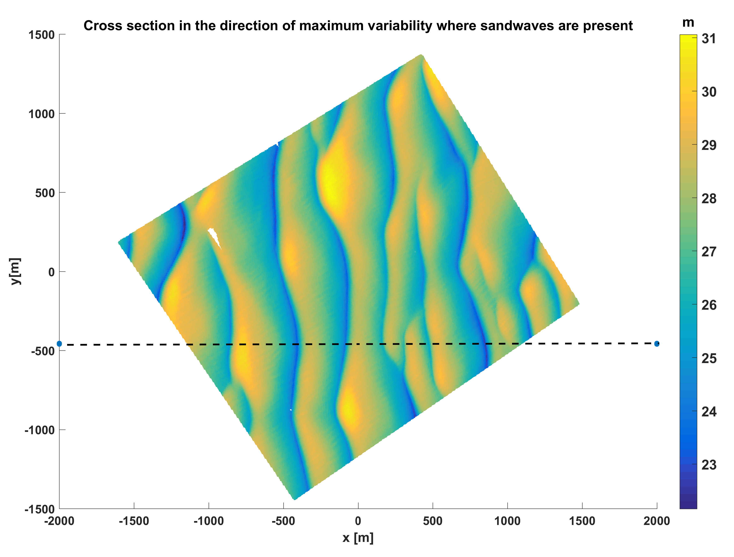
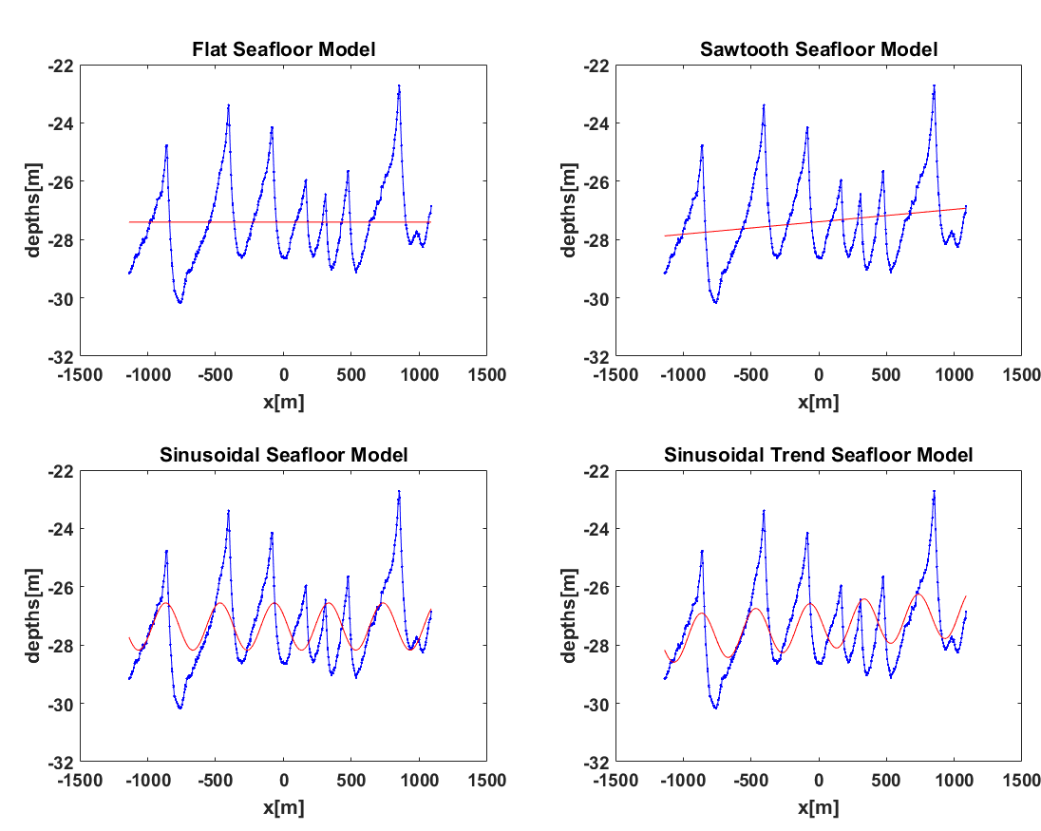
Models considered, Dorst(2009)
H1: Flat Seafloor
H2: Sloping seafloor
H3: Sinusoidal
H4: Sloping Sinusoidal
H1
H2
H3
H4

Slide 11
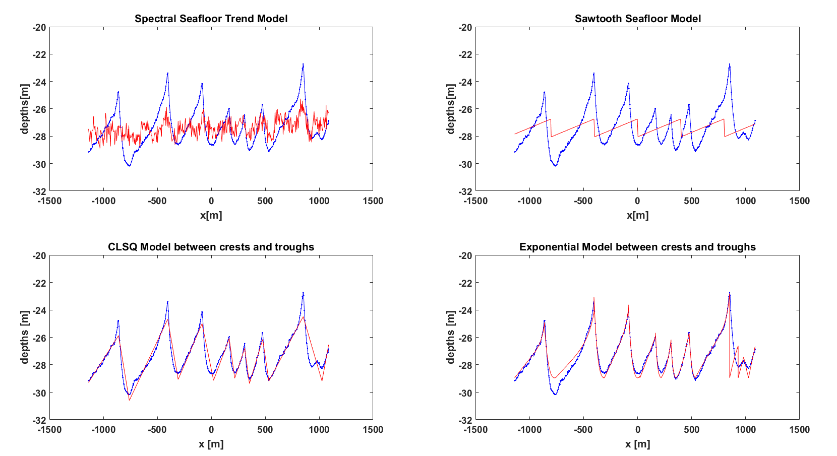
Additional Models
H5: Spectral model
H6: Sawtooth model
H7: CLSQ fit model between peaks and troughs
H8: Exponential fit model between peaks and troughs
H5
H6
H7
H8
Notes:
Wrong order fix
How suitable are the models for TS analysis
Combination of H7 + H8

Slide 12
Does H provide a good model?
Is the data consistent with the model?

Slide 13
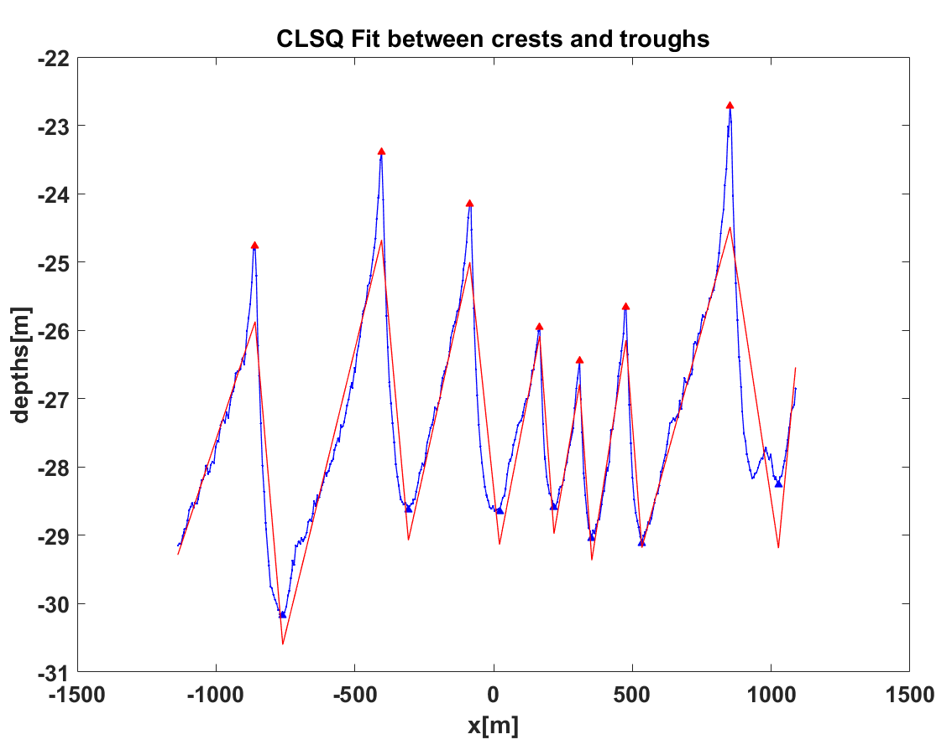
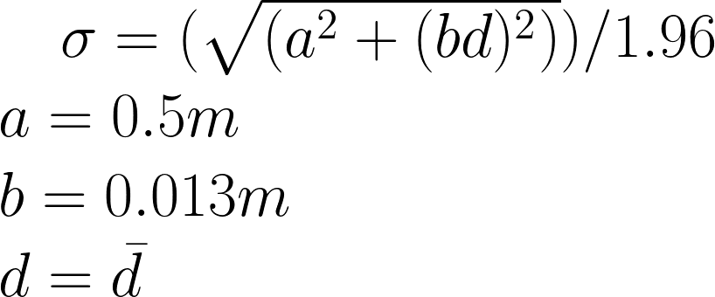
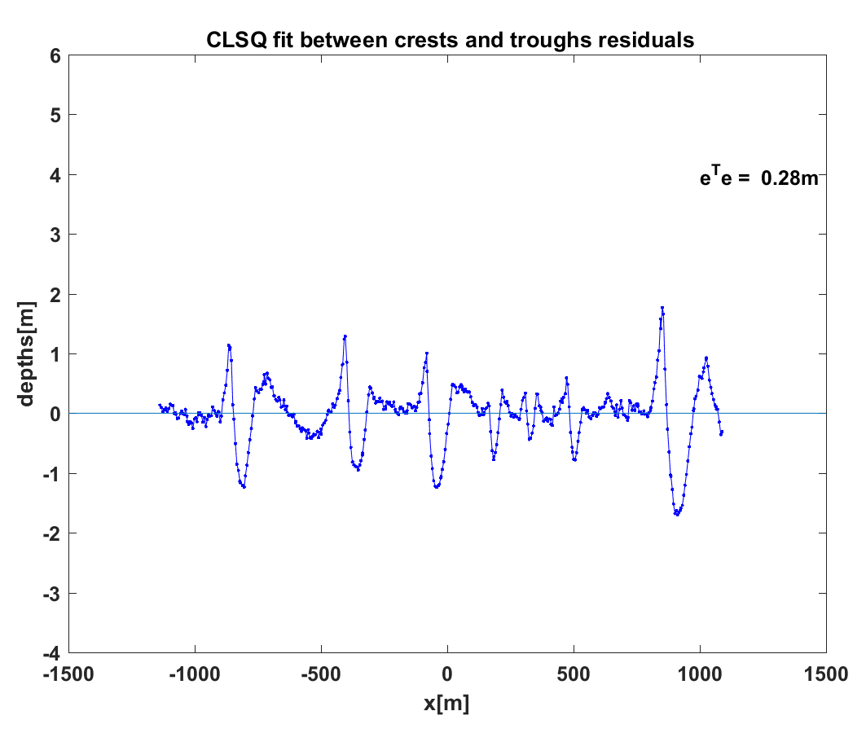
Squared residuals compared to the precision of observations
Order 1 IHO specs

Slide 14
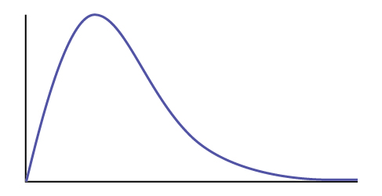
Squared residuals compared to the precision of observations
Define a test statistic
Probability of false alarm
Do not reject H
Reject H

Slide 15
Conclusions
Hypothesis testing in linear models to decide between competing models
Optimal choice of model to describe the observed seafloor dynamics
To compute the estimated dynamics of interest and quality indicators.
Basis for recommended action for sustainable decision-making for hydrographic surveying.

Slide 16
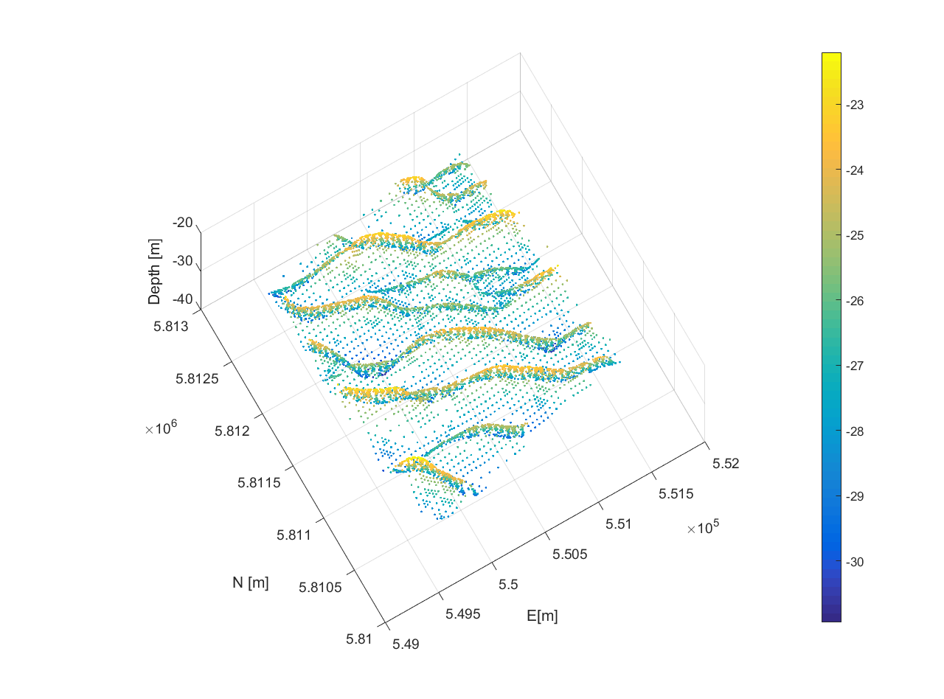
Outlook
Spatial and Temporal Analysis using variable grid resolution

