Slide 1
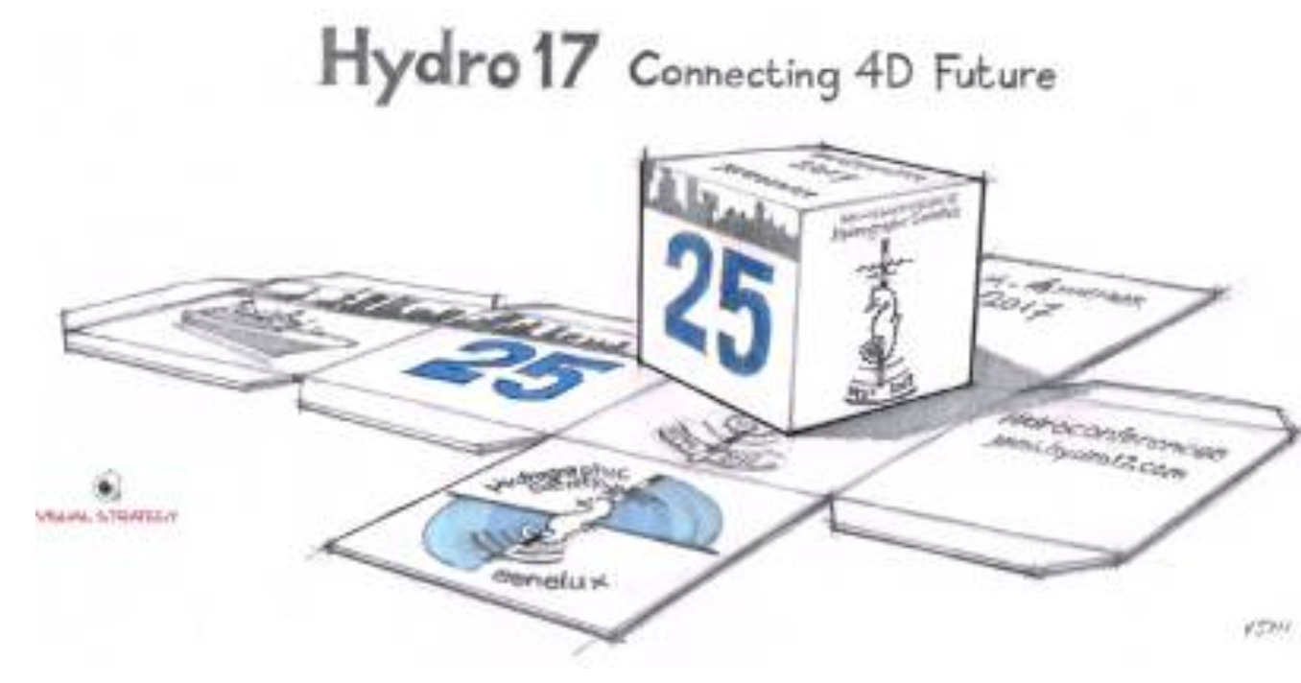
Development of a low-cost multi-sensor platform for recording shallow water dephts
By sarah Diederichs
Wednesday 15.11.2017
HYDRO 17 Rotterdam

Slide 2
Motivation

Slide 3
Table of content
Basic Information
Theoretical Work-flow – From Measurement to Map
Market Analysis
System Assembly
Test run
Conclusion and Outlook

Slide 4
Basic Information
OpenSeaMap
The free natical chart, launched 2009
Close cooperation with GEBCO (water depths between 100 and 10.000 meters)
Definition shallow water area
Purpose for hobbyist or smaller vessels
Range: 1 and 20 meters
International Hydrographic Organization
Shallower than 100 metres
→ Accuracy specifications for this depth range (IHO Special Order)
 | 1 meter depth | 10 meter depth | 20 meter deoth
Maximum allowable THU 95% Conficence level | 2 m | 2 m | 2 m
Maximum allowable TVU 95% Conficence level | +- 0.25 m | +- 0.26 | +- 0.29

Slide 5
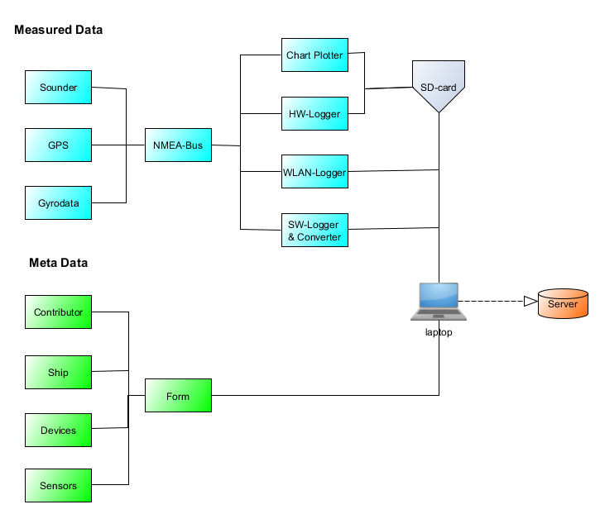
Theoretical Work-flow (1#3)
Instrumentation

Slide 6
Theoretical Work-flow (2#3)
The measurement – Data acquisition
Normally the data is logged during a sailing trip or during work on a vessel
Autonomously working sensor platform
Without a great expense by chance
Only towing the system to the vessel
Data transmission OpenSeaMap
Account creation (Email address and password)
Input Meta data
Raw data upload

Slide 7
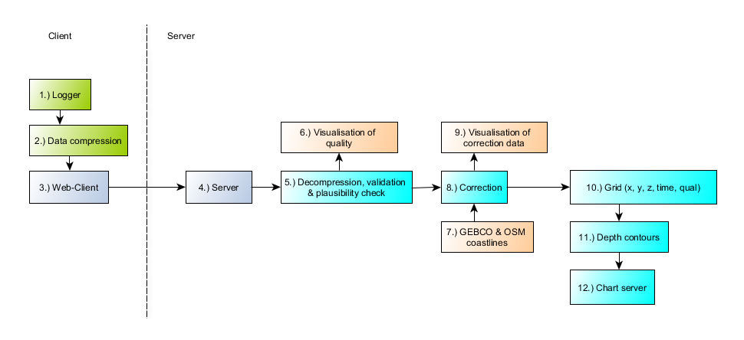
Theoretical Work-flow (1#2)
Postprocessing steps by OpenSeaMap

Slide 8
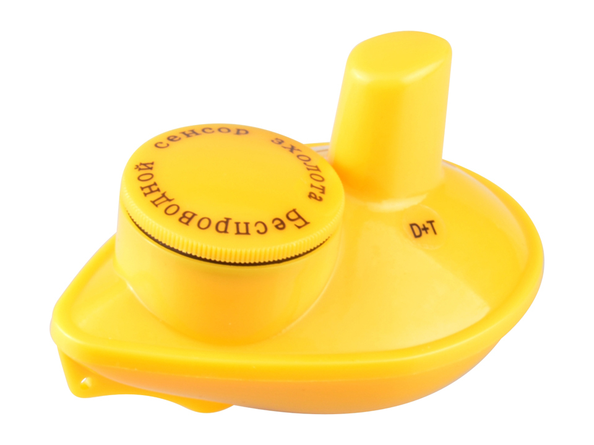
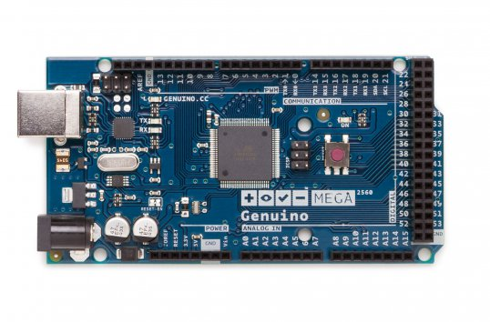
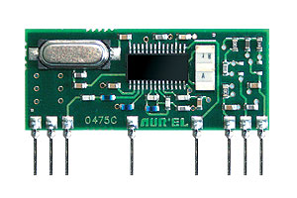
Market Analysis (1#2)
Wireless „Fish Finder“ as echo sounder
Arduino board Mega 2560 as Microcontroller
Bodyboard as sensor platform
High Selectivity Super Het Receiver receivies the signals

Slide 9
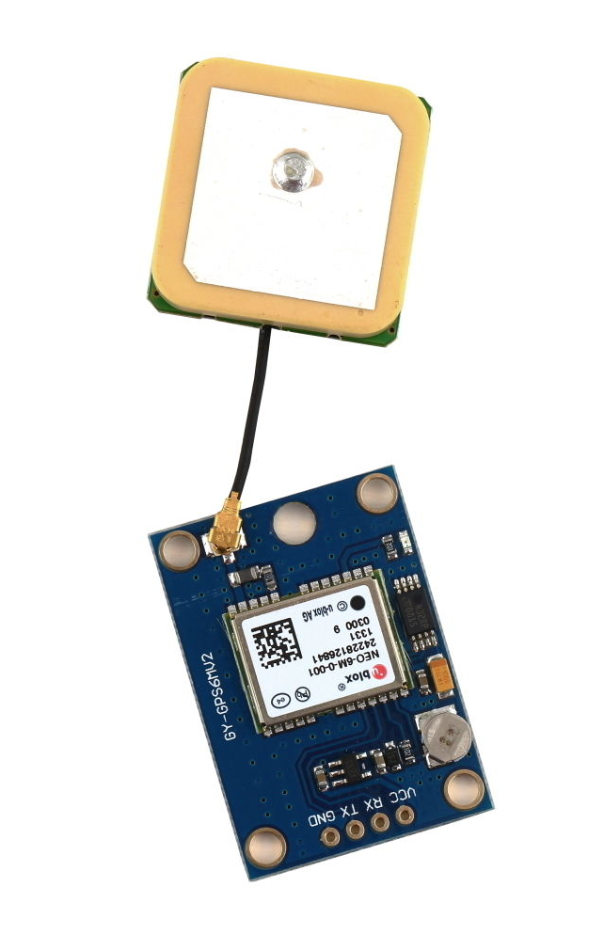
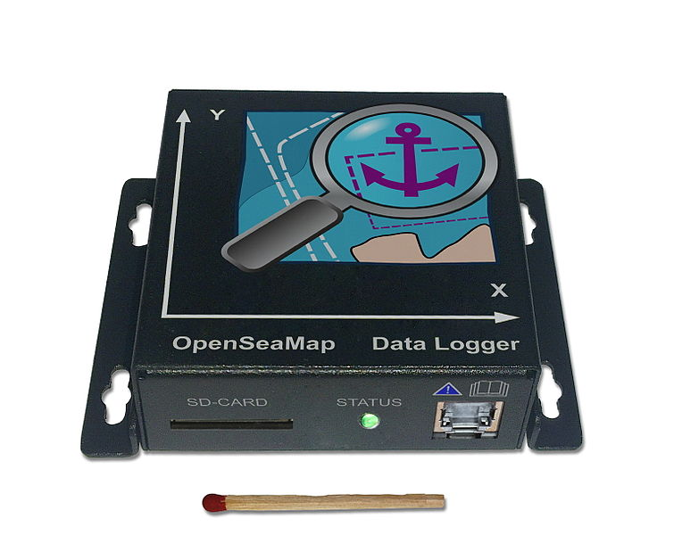
Market Analysis (2#2)
Neo-6M GPS receiver
OpenSeaMap Hardware: Data Logger

Slide 10
System Assembly (1#6)
Interfaces and level standards
Used protocols: TTL, RS232 and RS422
→ need of converters
GPS module (Neo–6M)
Configuration with „u-center – GNSS evaluation software for Windows“ from U-blox company:
Baud rate: 4800 Bd
NMEA-0183 format

Slide 11
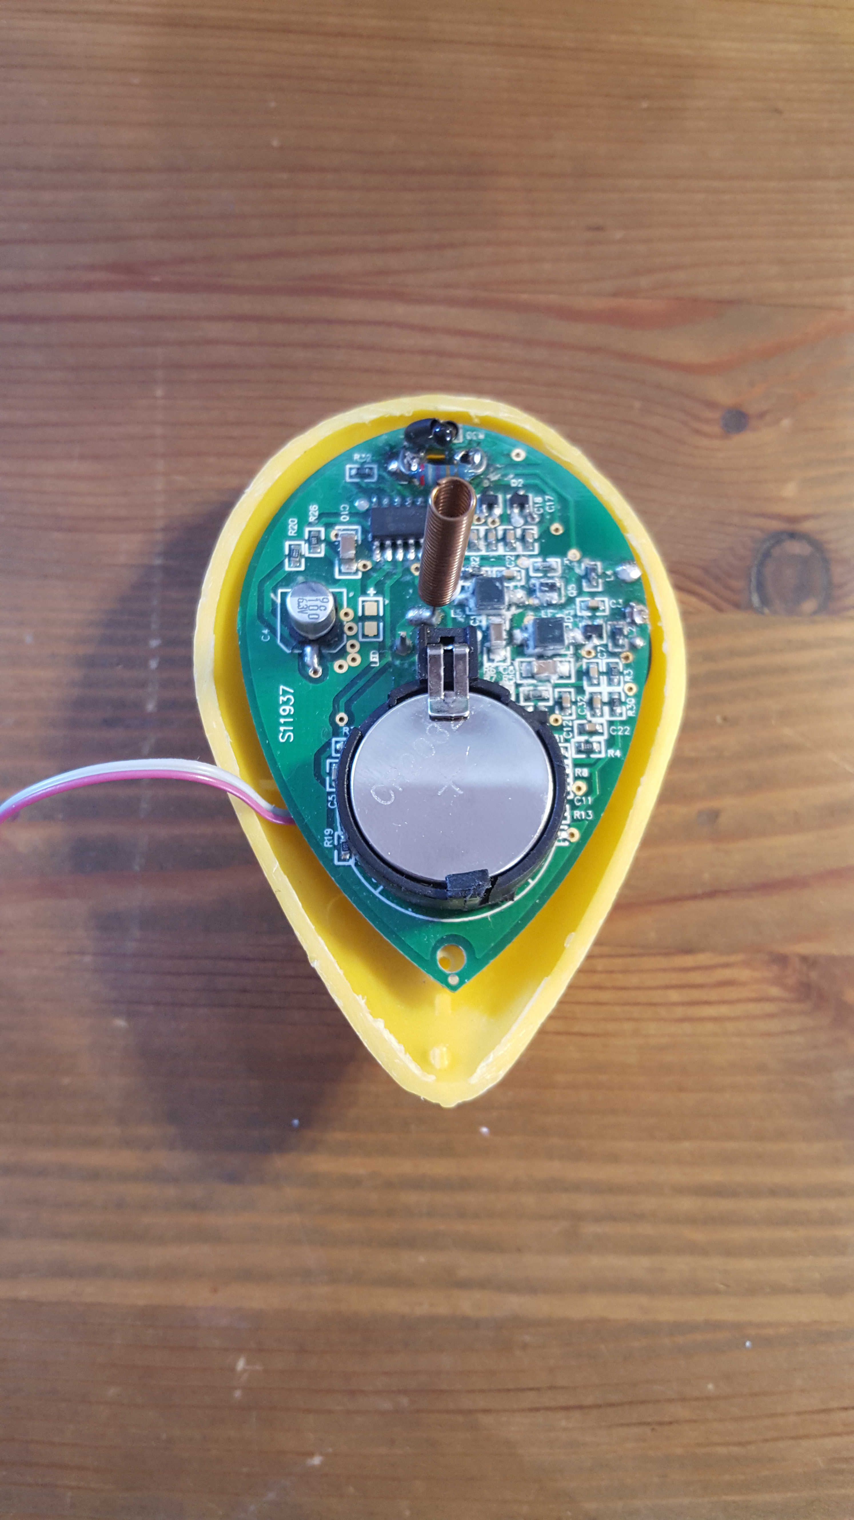
System Assembly (2#6)
Sonar Sensor Investigation - Fish Finder
Decoding and transmission of the data
Oscilloscope and the software Saleae Logic 1.2.11 is used to determine the structure of the received signals

Slide 12
System Assembly (3#6)
Sonar Sensor Investigation - Fish finder

Slide 13
System Assembly (4#6)
Fish Finder – decoding
Two possibilities to decode the signal and to filter out the depth
1) Depth value decoded in the first 16 bit block (Manchester)
2) Reflection time analogue to signal duration after the synchronisation pulse
Time of the low signal after synchronisation pulse → analogue to the time of the acoustic pulse in water
Depth equation $D=v ∗\frac{t}{2}$
Programming with an Arduino and the IDE interface software (PC)
Scanning for synchonisation pulse (fixed duration
Check if the pulse appeared inside the time frame for sonar returns
Timer usage → low signal duration till first rising edge
Depth calculation
Serial Output NMEA-0183 depth data string

Slide 14
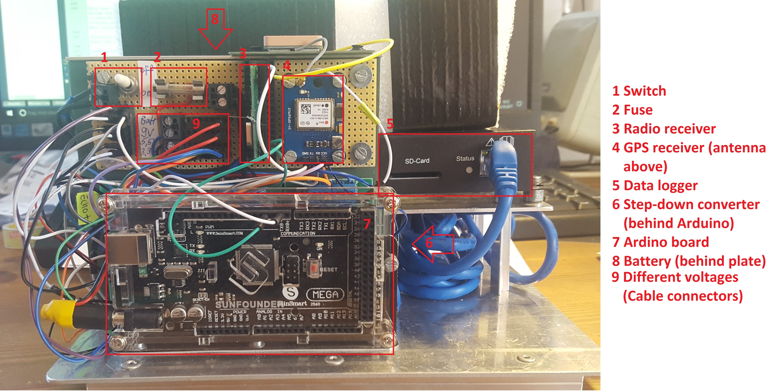
System Assembly (5#6)
Connection to the OpenSeaMap Data Logger
Via patch cable (network cable)
Wire configuration
Connection link: converter (from TTL to RS232) between GPS and Sonar and the data logger

Slide 15
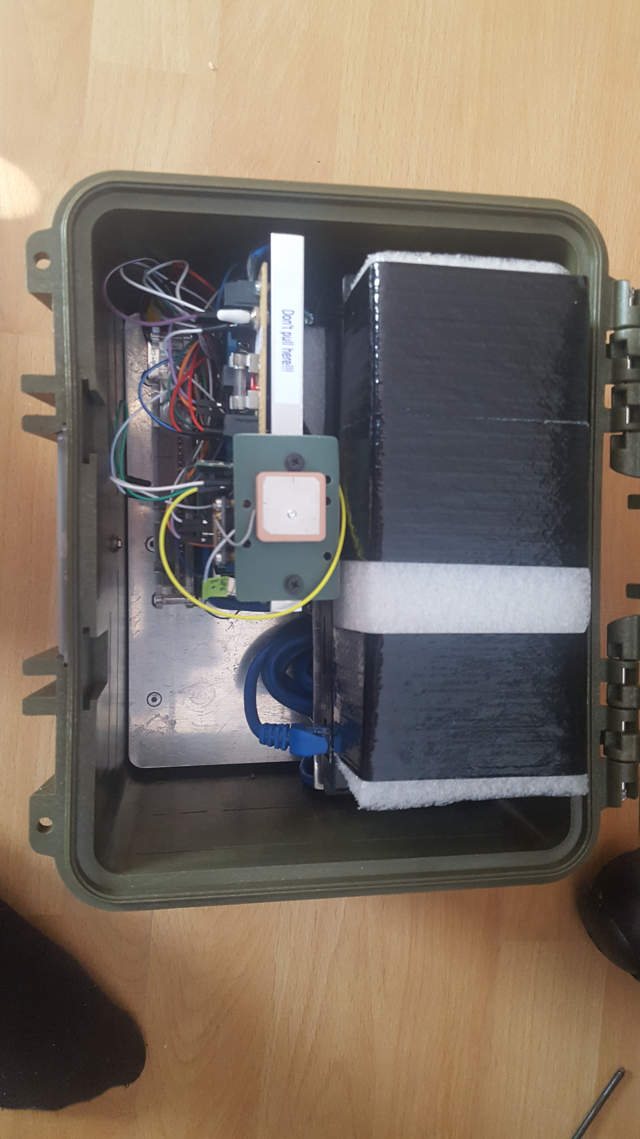
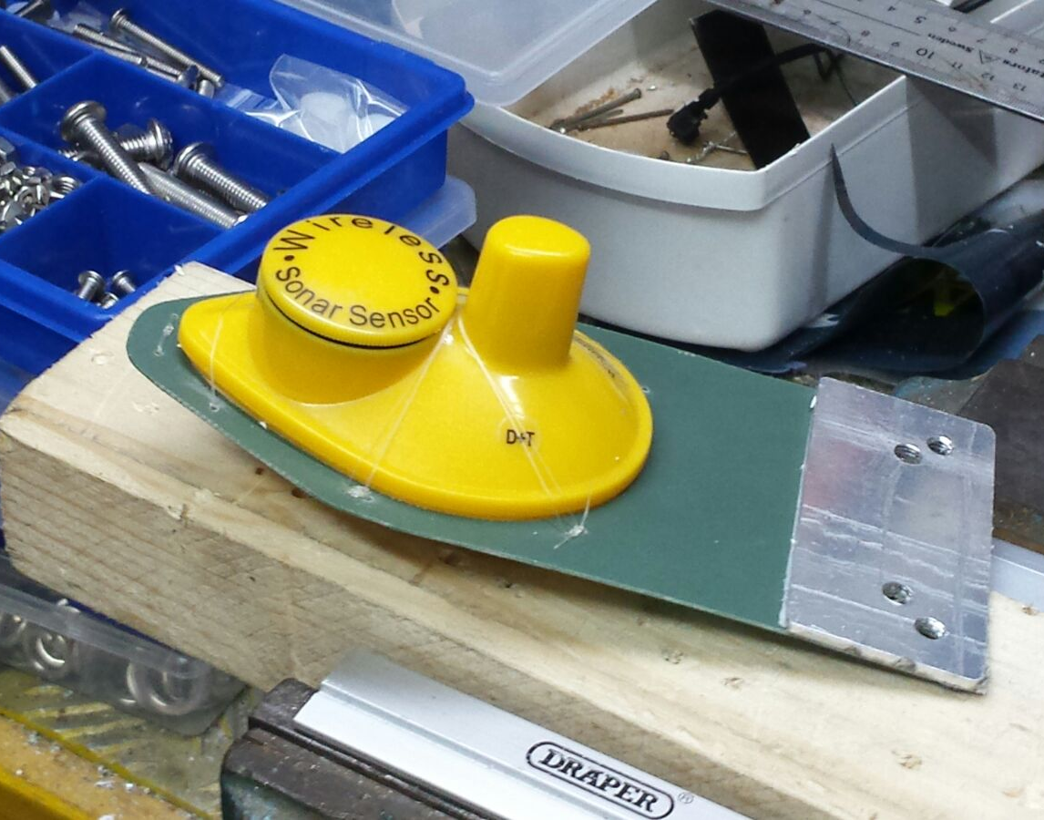
System Assembly (6#6)
Fish Finder fixed to the board with same orientation as the Data Logger, having identical movements

Slide 16
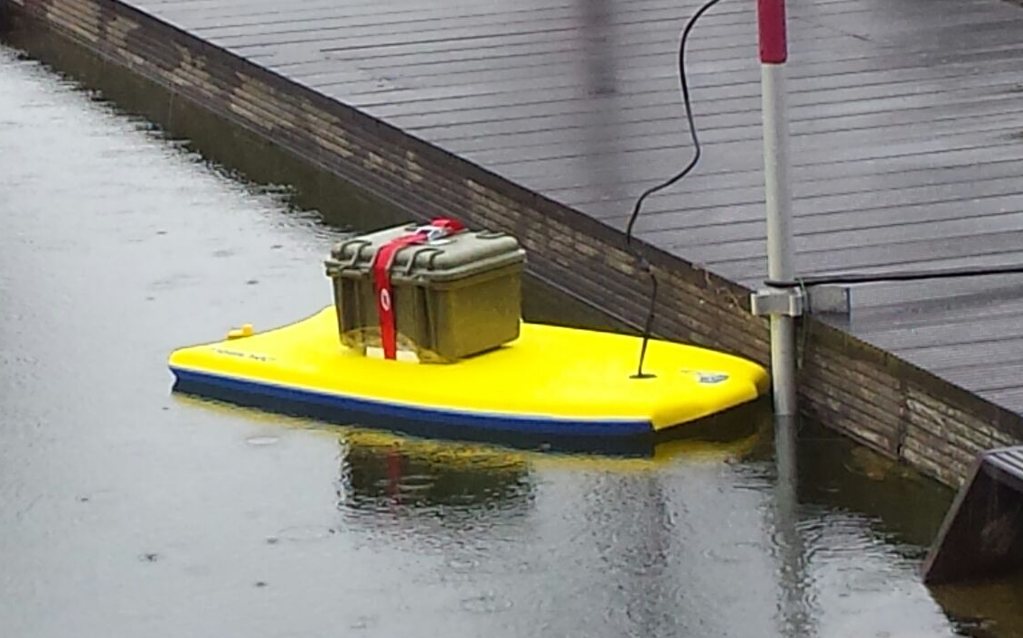
Test case scenario
Test area: pond with 2 meters water depth
The System has been dragged over the water surface for 2 ¹/₂ hours
Results:
Sufficient sampling of depths & GPS postions)
Data written in correct NMEA-0183 format to SD card
Depths mainly measured correctly
But also errors reg. water depths exist:
No depth data
Multiple depths caused by reflections
Open SeaMap data uploads without any issue

Slide 17
Conclusion and Outlook
Conclusion
Bad accuracies of the Fish Finder → Advise of using another sonar sensor
Also not quite clear how a hobbyist should assemble such system without suffcient prior knowledge
Nevertheless, it has to be said that the task which was to develop a multi-sensor platform with low-cost components has been fulfilled.
Outlook
Great potential: further processing and improvement by plausibility checks and suppressing of worse measures
Improving of the build up and programming part
Better sensors
Test run (up to 20 m depth) → possible better accuracies.

Slide 18
Thank you for your attention!

