Slide 1
“Optimization of the bathymetry module within a rip current prediction system, operating in the area of Egmond aan Zee”
Roman Schotten
Hydro17 conference, 15.11.2017
Supervised by: Bast Stengs, Giorgio Santinelli, Roderik Hoekstra (Deltares); Torsten Heyer (TU Dresden)

Slide 2
Application of cBathy in Egmond aan Zee, Jan van Speijk
Objective
“Optimization of the bathymetry module within a rip current prediction system, operating in the area of Egmond aan Zee”
(http://www.egmond-holidays.com)
(van Duin, et al., 2004)
Popular beach destination in Holland
Increasing number of drownings (Sembiring, 2016)
Notes:
Introduction by breaking down title

Slide 3
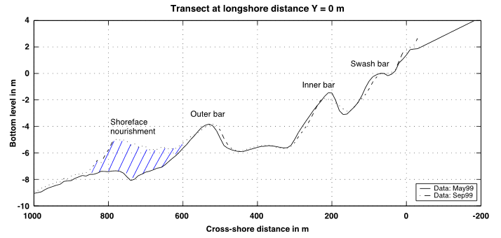
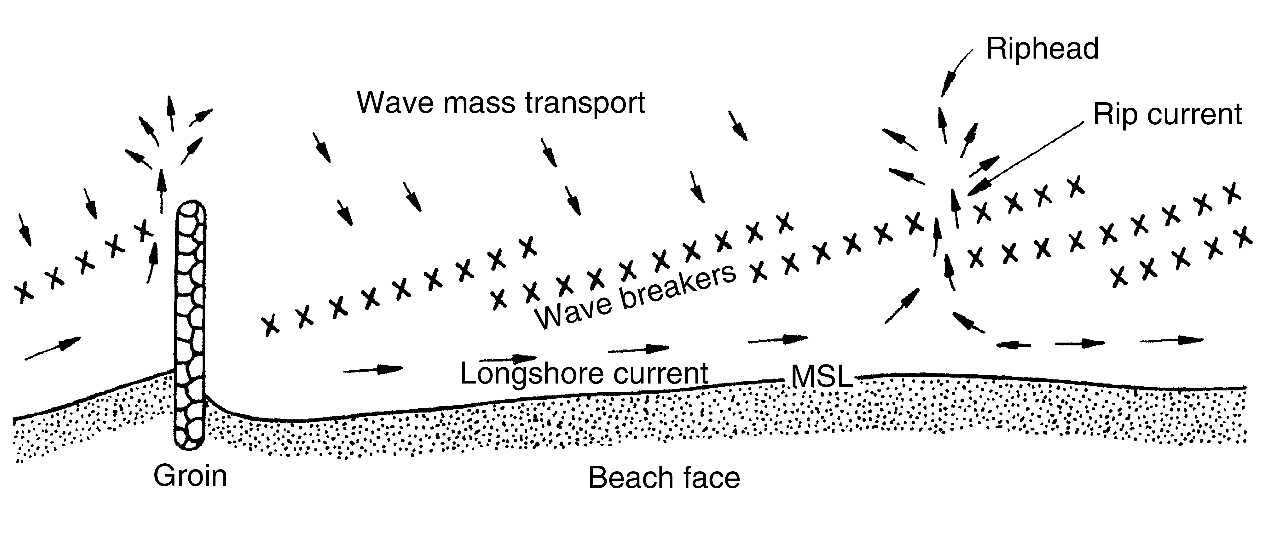
Application of cBathy in Egmond aan Zee, Jan van Speijk
Objective
“Optimization of the bathymetry module within a rip current prediction system, operating in the area of Egmond aan Zee”
Objective
Bathymetry in Egmond dominated by three sand bars
Dynamic morphologic behavior
(van Duin, et al., 2004)
Wind-, Infragravity waves, tidal currents, wave breaking etc. = landward directed mass transport
Rip current = back haul of water mass
High current velocities effect bathymetry
(Sorensen, 2006)
(Sorensen, 2006)
“Rip Currents: The Ocean’s Deadliest Trick”
Live Science, 05.03.15

Slide 4
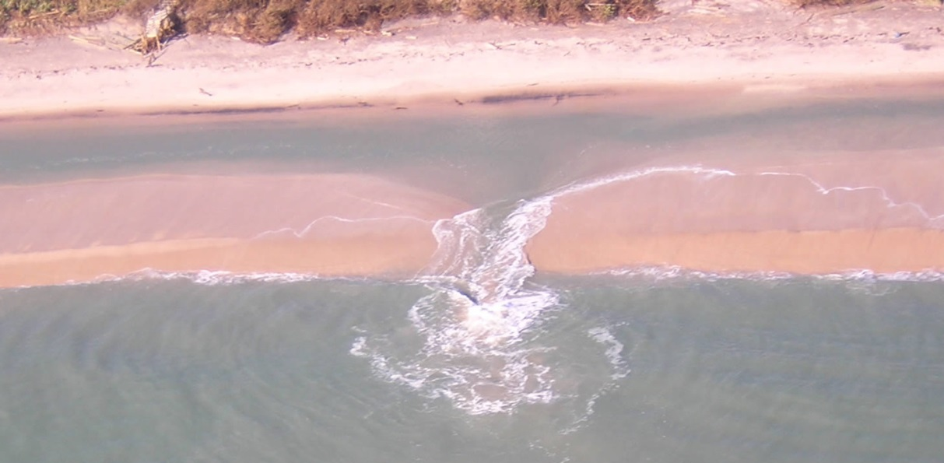
Application of cBathy in Egmond aan Zee, Jan van Speijk
Objective
“Optimization of the bathymetry module within a rip current prediction system, operating in the area of Egmond aan Zee”
Objective
Bathymetry in Egmond dominated by three sand bars
Dynamic morphologic behaviour
Rip currents and bathymetry interact!
(van Duin, et al., 2004)
Wind-, Infragravitywaves, tidal currents, wave breaking etc. = landward directed mass transport
Ripcurrent = back haul of water mass
High current velocities effect bathymetry
(Sorensen, 2006)
(Melina, 2017)
(Sorensen, 2006)
“Rip Currents: The Ocean’s Deadliest Trick”
Live Science, 05.03.15

Slide 5
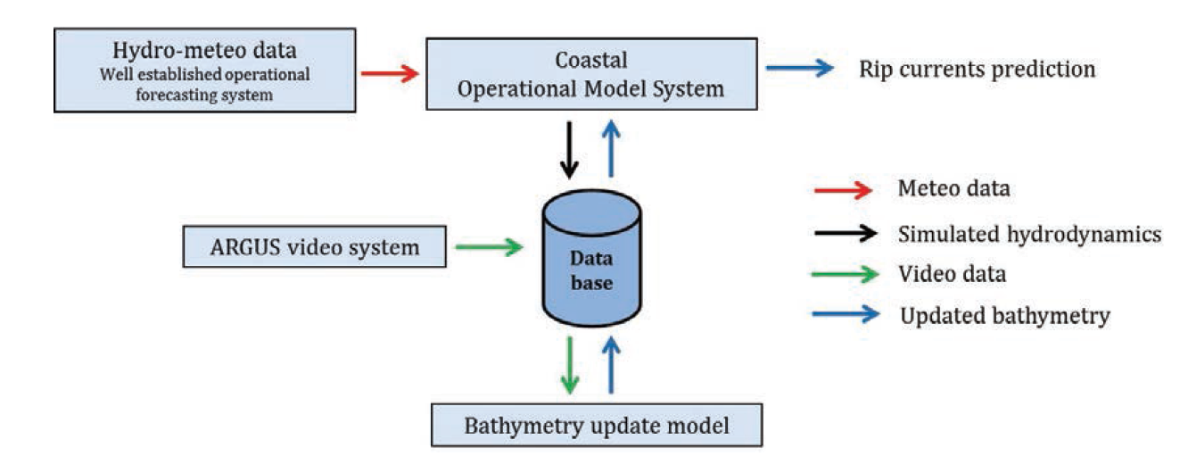
Application of cBathy in Egmond aan Zee, Jan van Speijk
Objective
“Optimization of the bathymetry module within a rip current prediction system, operating in the area of Egmond aan Zee”
Objective
(Sembiring, 2015)

Slide 6
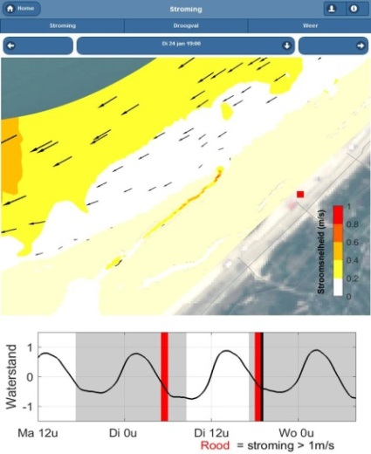
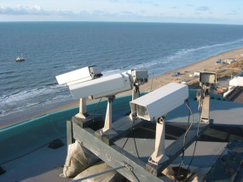
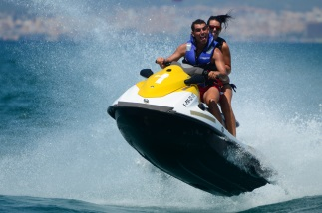
Application of cBathy in Egmond aan Zee, Jan van Speijk
Objective
“Optimization of the bathymetry module within a rip current prediction system, operating in the area of Egmond aan Zee”
Objective
(Sembiring, 2015)
Argus + cBathy
In-situ measurements on regular basis: weekly, monthly or after storm events
(zandmotorapp.deltares.nl)
Replacement of in-situ-measurements with computer based analysis
Live-bathymetry
(argus.deltares.nl)
Notes:
Replacing in-situ, more expensive, not valid after storm…
Live-bathymetry

Slide 7
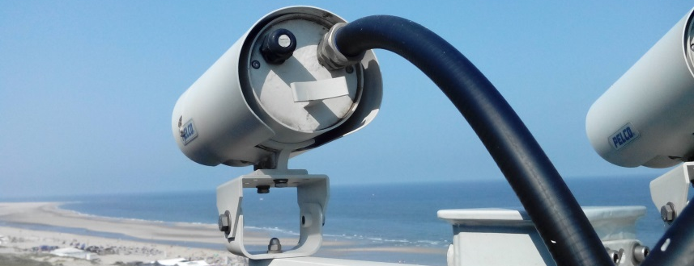
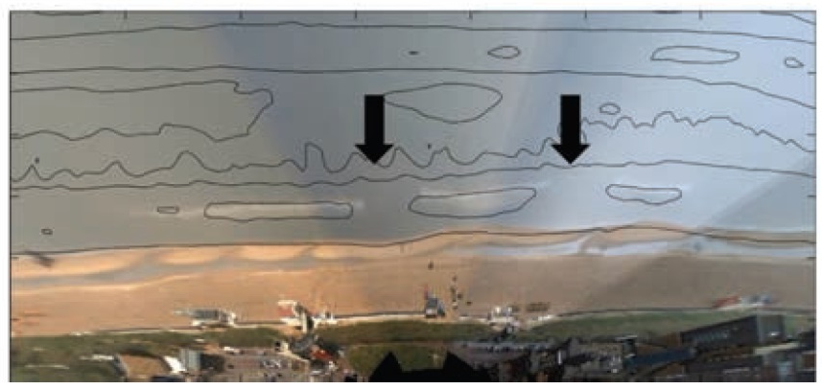
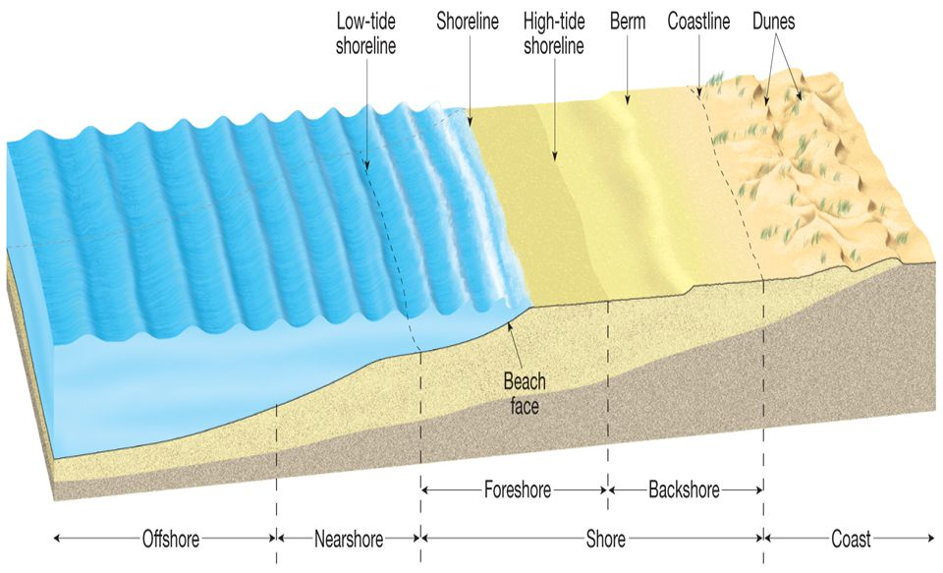
Application of cBathy in Egmond aan Zee, Jan van Speijk
Argus
Video monitoring system to support coastal management issues
30 stations worldwide with extroverted user community
Hardware: Computer and setup with multiple cameras
monitoring morph dynamics of the foreshore zone with established software
Automates Shoreline Mapper (ASM)
monitoring morph dynamics of the nearshore zone not established yet
cBathy
Other functions: Beach user counting, wave analysis, current analysis
Objective
Material/ background
(View from Argus station in Kijkduin; Radermacher 2014; Pearson Prentice Hall 2009)
Notes:
Argus, multiple cameras view fields, Shoreline-detection

Slide 8
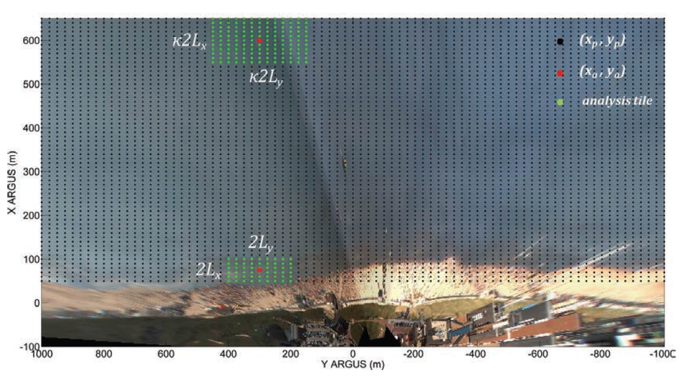
Application of cBathy in Egmond aan Zee, Jan van Speijk
cbathy
Theoretical background
Objective
Material/ background
distinct relation between water depth, wave length and wave period
ω = 2π/T (angular frequency)
k = 2π/L (angular wavenumber)
ω² = gk tanh(kh)
(dispersion relation for airy waves)
pixel reads optical signal of wave
localization and relation to time enable the monitoring of wave length (number) and wave period (frequency)
(Holman, 2013)

Slide 9
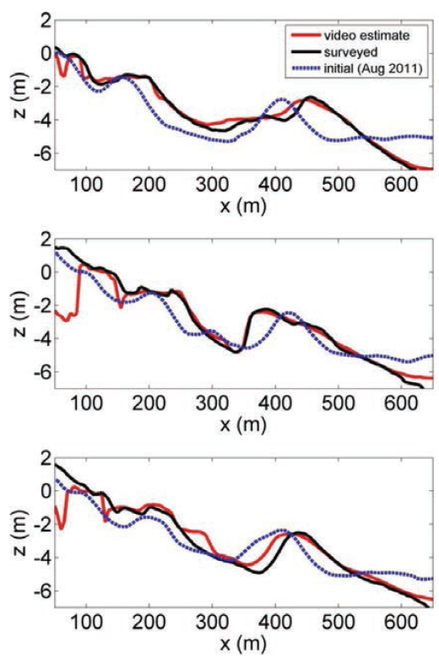
Application of cBathy in Egmond aan Zee, Jan van Speijk
cBathy
Error 1: Underestimation in shore zone
Objective
Material/ background
Error I
Error: Underestimation close to the shoreline
Possible reason: Unclear optical signal of wave
(Sembiring 2016)

Slide 10
Application of cBathy in Egmond aan Zee, Jan van Speijk
cBathy
Improvement I: Cutting low tide data
Objective
Material/ background
Error
Improvement I
cBathy
Ground Truth
Difference
Cutting input in areas with water level below 0.5 m from consideration in cBathy
Reconditioned for future combination with intertidal data from ASM
(L.Sembiring, 2016)
(Leo Sembiring 2016: Left: cBathy estimate for 7 June 2013 14:00 GMT; Middle: surveyed bathymetry 8 June 2013; Right: Difference plot cBathy minus survey; )
Improved results with good coverage in main area

Slide 11
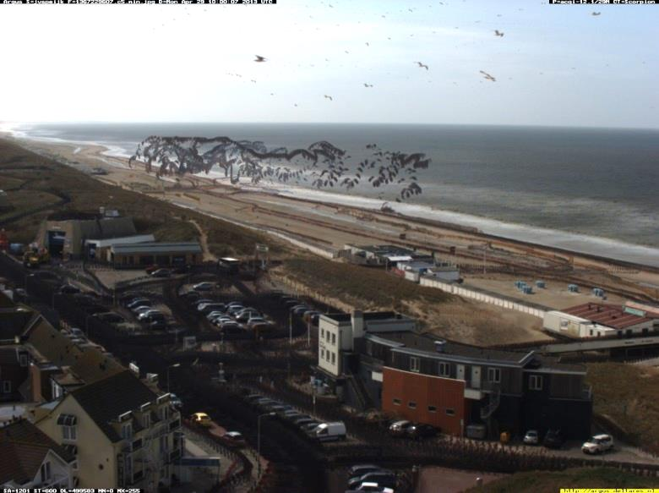
Application of cBathy in Egmond aan Zee, Jan van Speijk
cBathy
Error 2: Disturbances at upper boundary
cBathy
Objective
Material/ background
Error II
Improvement
(Jan van Speijk, Camera 5, minimal pixel colour, 29.04.2013)
Error at boundaries
Checking input to determine possible sources for errors!

Slide 12
Application of cBathy in Egmond aan Zee, Jan van Speijk
cBathy
Improvement II: Process error factor Q and introduction of a maximum Δh
cBathy
Ground Truth
Difference
Objective
Material/ background
Error
Improvement II
Exclusion of results with difference Δh > 1.5 m
Raising of process Error Q
(M.Radermacher , 2016)
Improved results with good coverage in main area including the boundaries

Slide 13
Application of cBathy in Egmond aan Zee, Jan van Speijk
Discussion
…on the results
The quality of calibration values could not be assessed in the term of this work
The application of cBathy is not generic
Parameters like the exclusion factor, process error etc. not given
…on the interpretation of results
How precise must a bathymetry be to benefit other coastal management issues?
Objective
Material/ background
Error
Improvement
Discussion

Slide 14
Application of cBathy in Egmond aan Zee, Jan van Speijk
Conclusion
The modification of cBathy delivers very good results compared to in situ measurements
The combination of cutting the input data at a specific tidal level and the exclusion of results with Δh > 1.5 m improves results significantly
cBathy is site specific and needs to be adjusted to the necessary needs
User conclusion: Good enough for rip current detection
(L.Sembiring, 2016)
Objective
Material/ background
Error
Improvement
Discussion
Conclusion
(http://www.egmond-holidays.com)

Slide 15
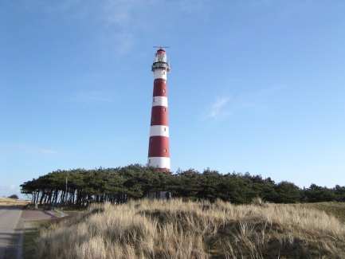
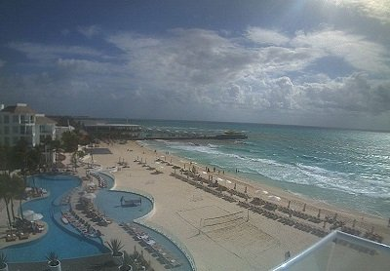
Application of cBathy in Egmond aan Zee, Jan van Speijk
Objective
Material/ background
Improvements
Result
Discussion
Conclusion
Outlook
Outlook
(View from Argus station in Kijkduin with Camera in the front and shoreline in the background)
The combination of intertidal bathymetries (ASM) and subtidal bathymetries (cBathy) …
…connects land boundaries and offshore boundaries
…delivers an integrated bathymetry profile
The cBathy algorithm can be applied on other input data e.g. radar images, webcams and drones
The ongoing application and open community continues to improve cBathy’s results (open source: https://github.com/Coastal-Imaging-Research-Network)
(www.amelandermusea.eu)
(playacar-palace-webcam)

Slide 16
Thank you for your attention!
Summary:
Rip currents are a threat to swimmers
Prediction of rip currents relies on bathymetry data
Monitoring of intertidal and subtidal bathymetries possible with Argus system
Application not generic but site specific
Present need for further applications
(http://argus-public.deltares.nl/)

Slide 17
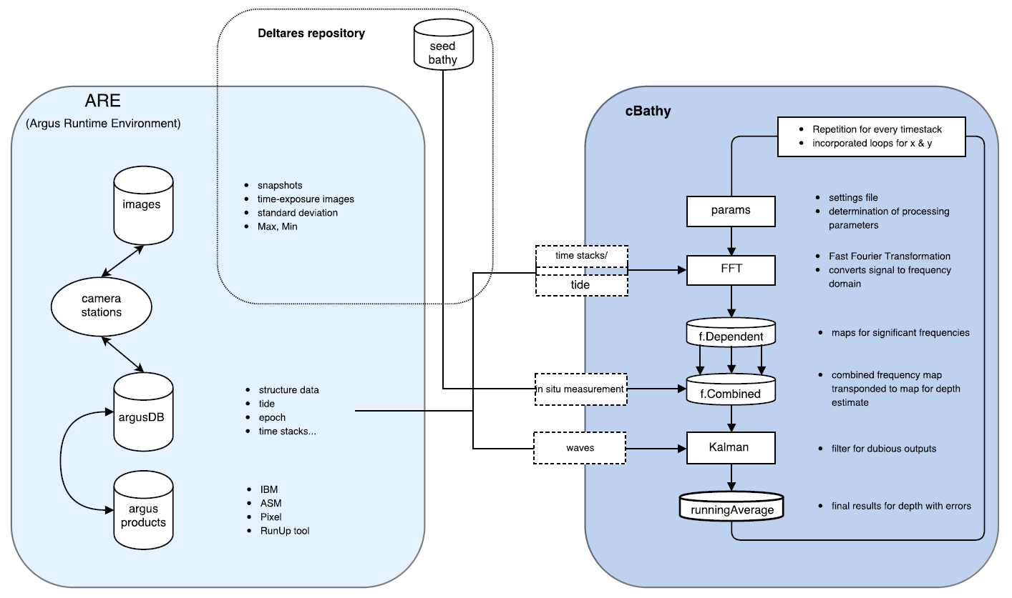
Application of cBathy in Egmond aan Zee, Jan van Speijk
Challenge II: Leo Sembirings’s cBathy Complication

Slide 18
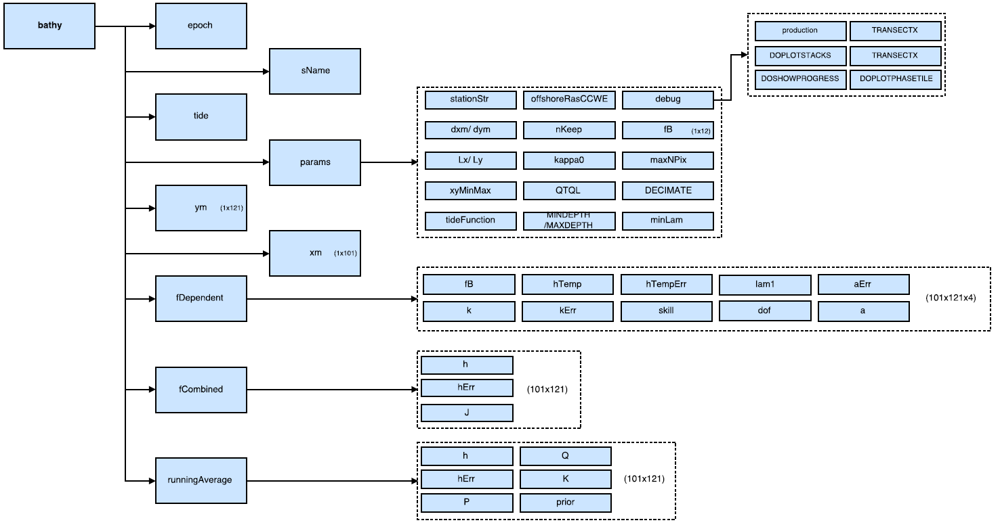
Application of cBathy in Egmond aan Zee, Jan van Speijk
Structure The variable ‘bathy’; Output of cBathy
Backup

Slide 19
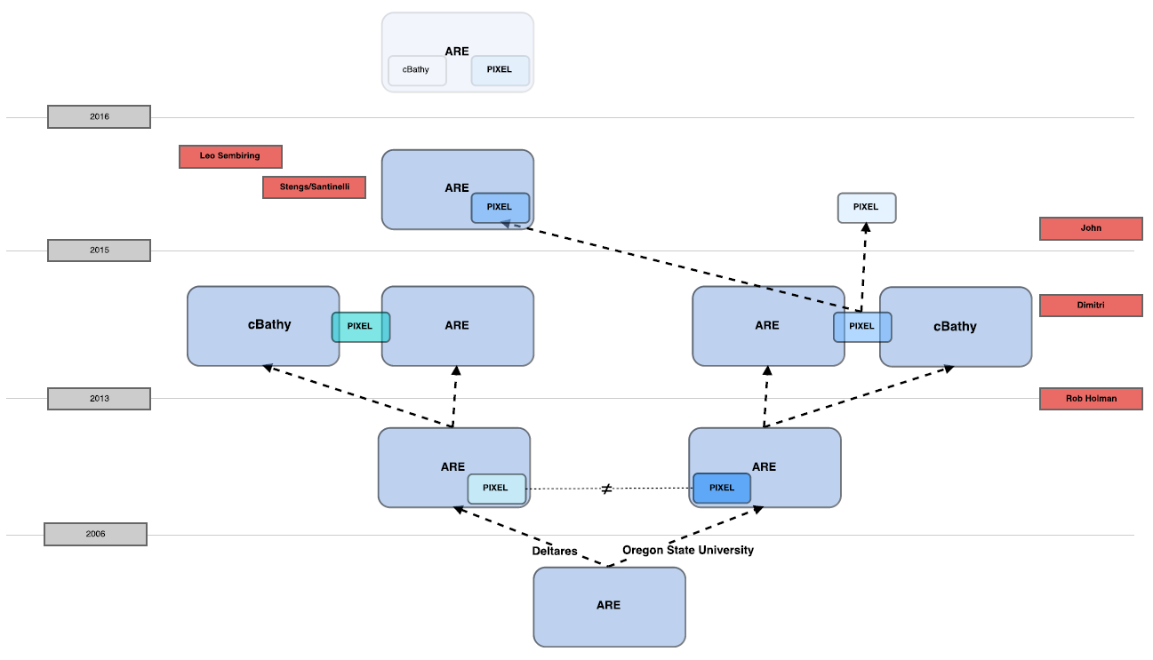
Application of cBathy in Egmond aan Zee, Jan van Speijk
Challenge:
History of the cBathy algorithm
Backup

Slide 20
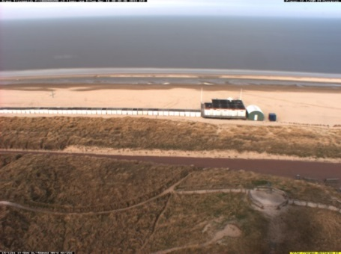
Application of cBathy in Egmond aan Zee, Jan van Speijk
Time-S=stacks: Input for cBathy
Tilft from right top to left bottom indicates wave propagation

Slide 21
Application of cBathy in Egmond aan Zee, Jan van Speijk
cBathy
Improvement 2: Max dh and process Error factor Q
Backup
Result for combined approach: Left: cBathy estimate for 7 June 2013 14:00 GMT; Middle: surveyed bathymetry 8 June 2013; Right: Difference plot cBathy minus survey;
Bathymetry is shaped along the seams of the field of view

