Slide 1
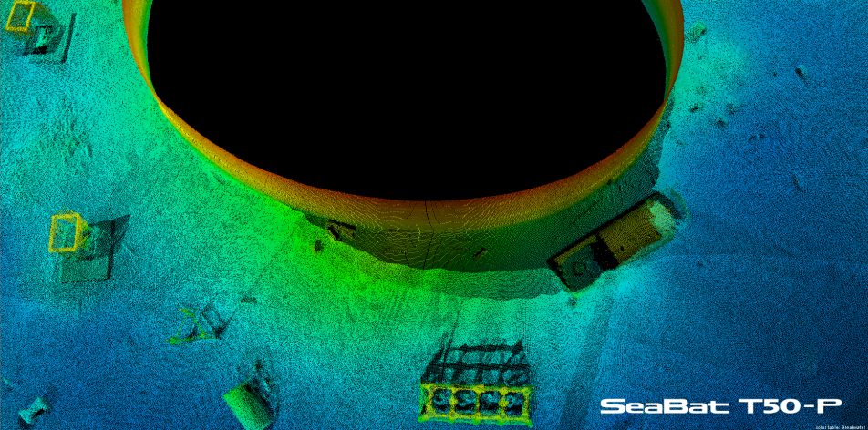
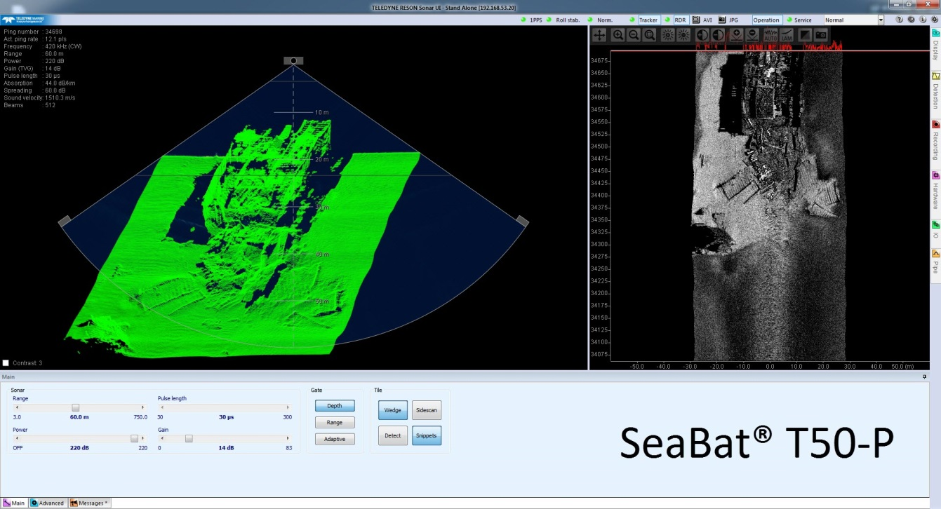
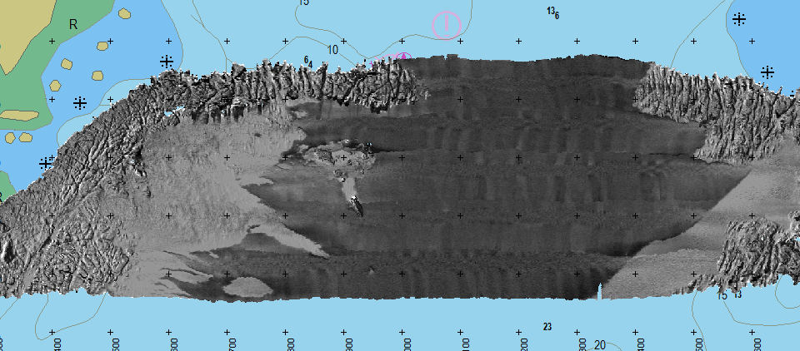
Multiple Data Deliveries from one Data Source the Multibeam System
Ellen Stuifbergen

Slide 2
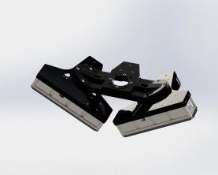
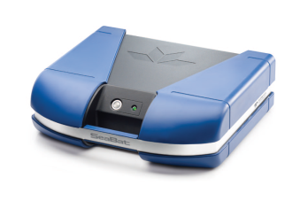
Multiple Deliverables from the MB
    Bathymetry data
    SSS data
    Snippet data
    Bottom Classification data
    Water Column data
    Multi detect data
    Pipeline data (5 points)

Slide 3
Multiple Deliverables
  Collect different data sets in one survey
  Saves boat and survey time
  Is this possible?

Slide 4
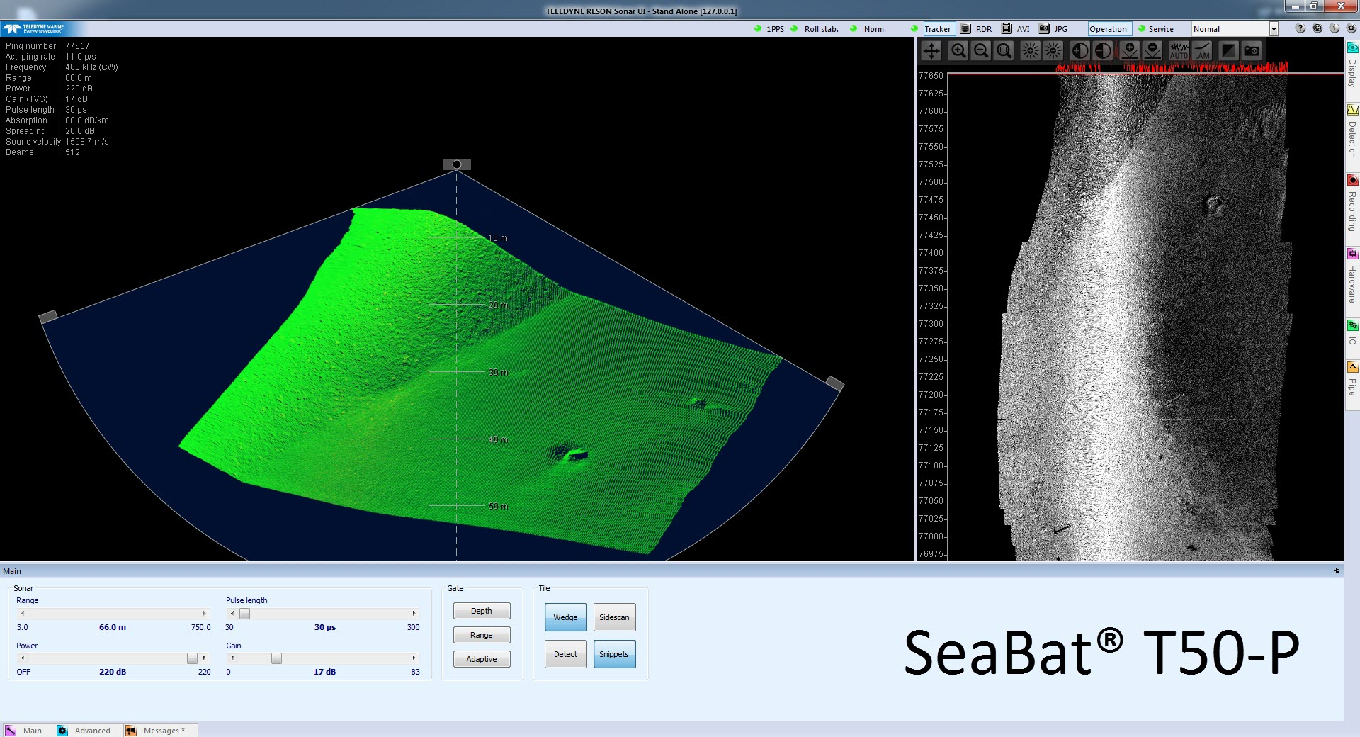
Bathymetry

Slide 5
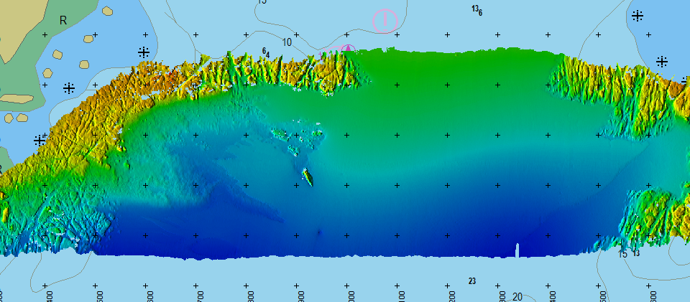
Depth information

Slide 6
Scattering
Sound striking bodies in the water and being reflected from:
  Surface, bottom and land
  Organic particles
  Marine life
  Bubbles
  Temperature variations

Slide 7
Backscatter
Of all energy scattered, only intensities registered by the receiver is coined as “backscatter”.
Specular reflection
Seabed Backscatter
scatter
scatter
Notes:
First let’s look at the phenomenon ‘Scatter’

Slide 8
Types of Backscatter
SeaBat creates 3 types of backscatter:
  Side Scan backscatter
  Snippets backscatter
  Water column backscatter
Water column Backscatter
Seabed Backscatter
Specular reflection
scatter
scatter
Volume scatter

Slide 9
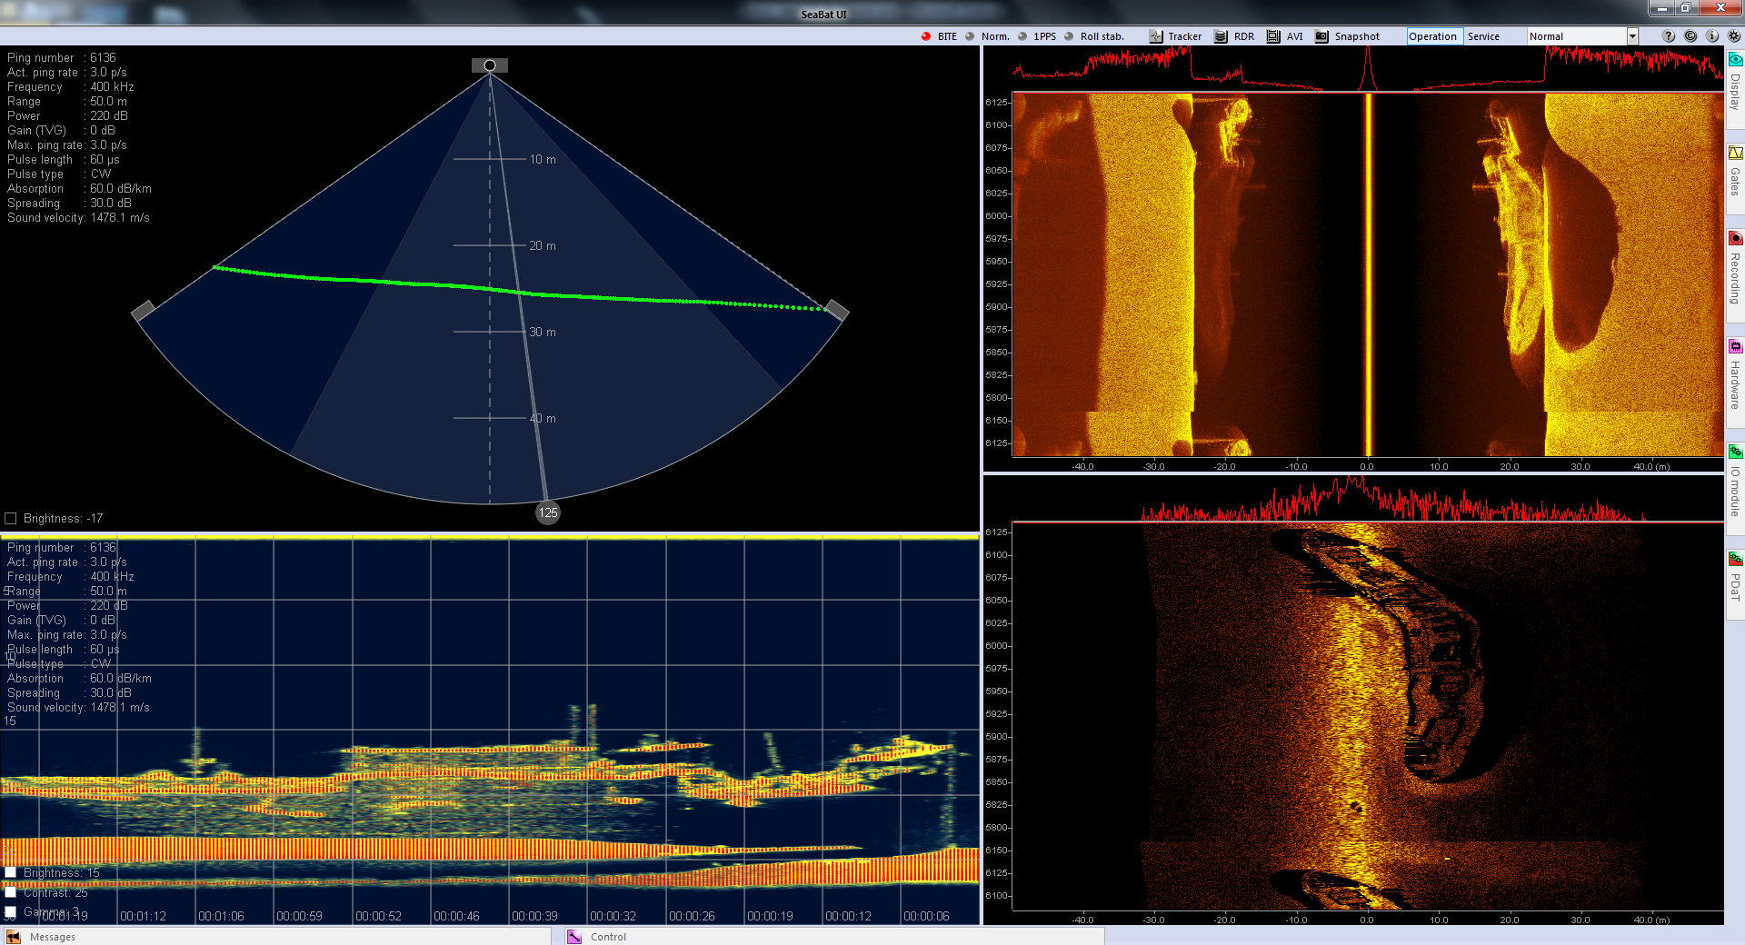
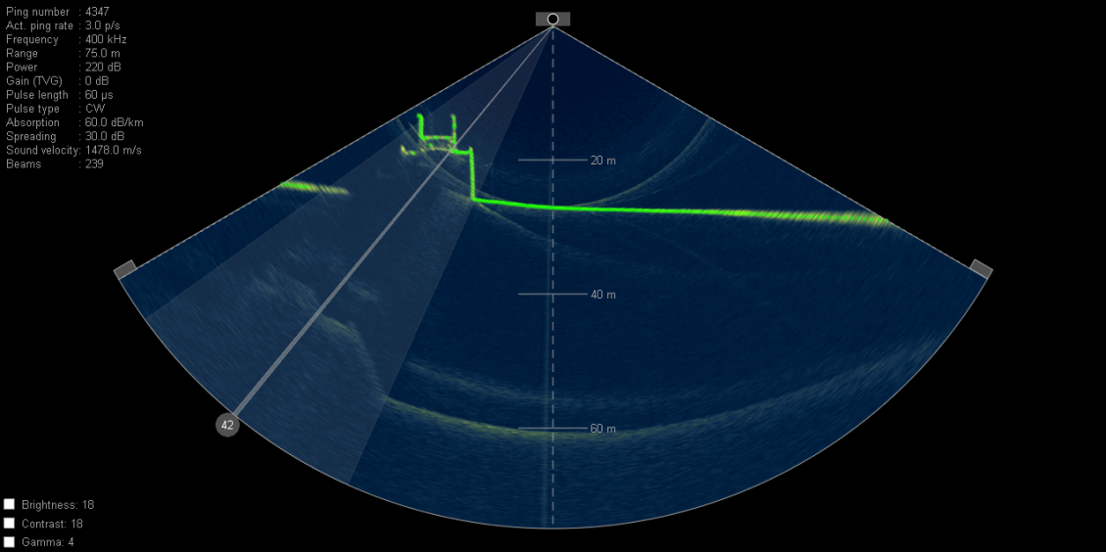
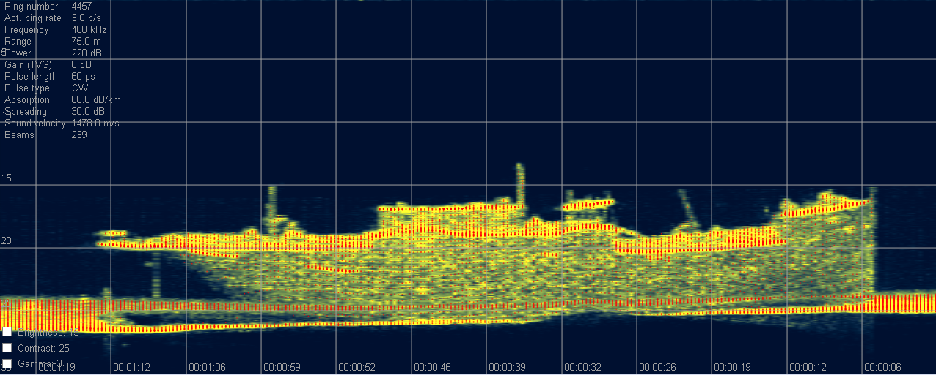
Backscatter types

Slide 10
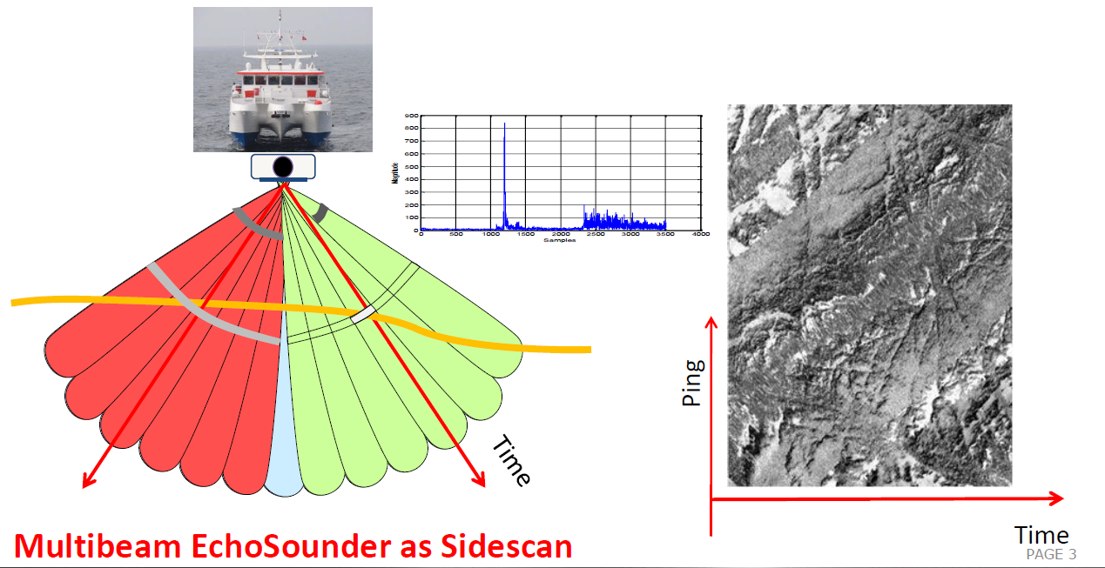
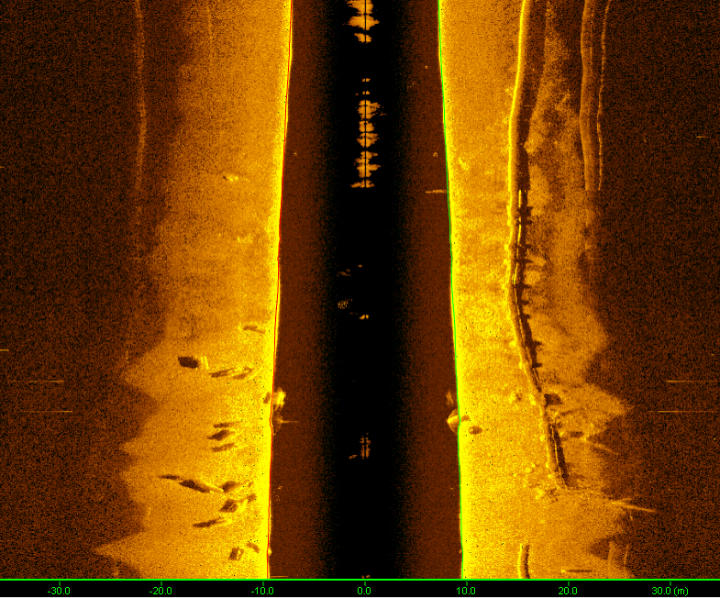

SeaBat Backscatter type 1): Side scan

Slide 11
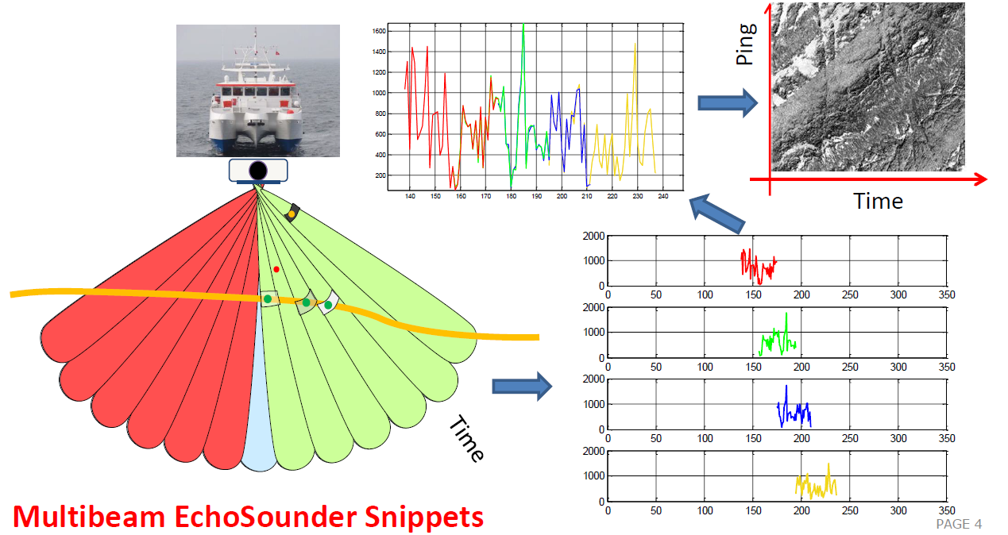
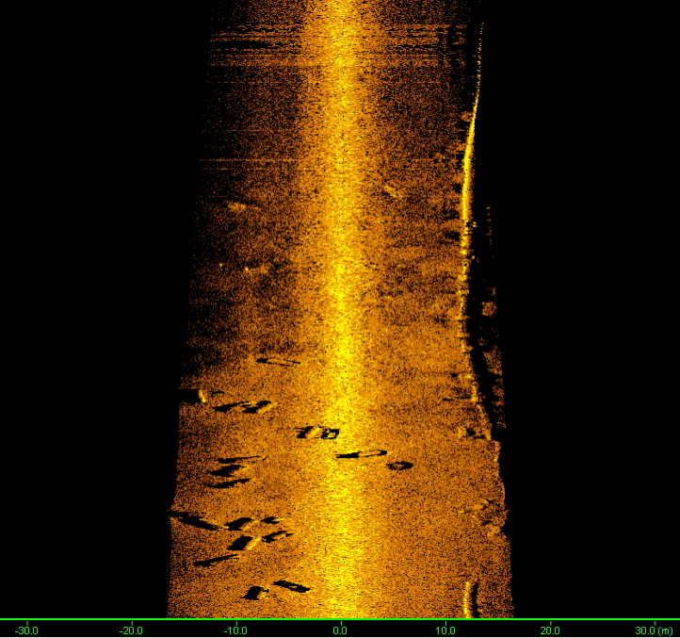
SeaBat Backscatter type 2): Snippets

Slide 12
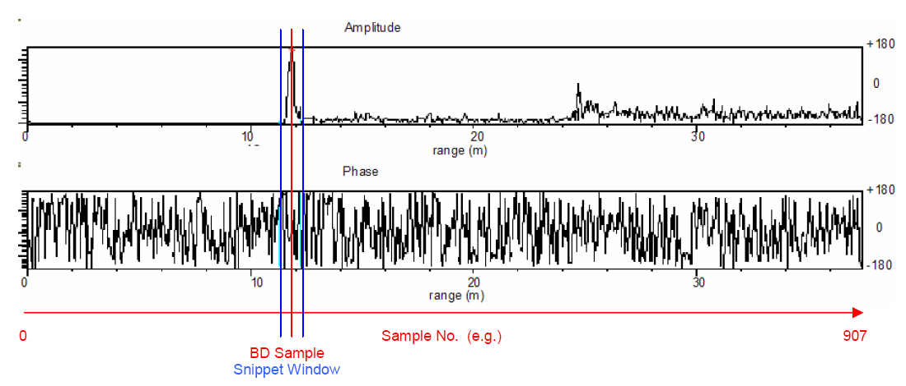
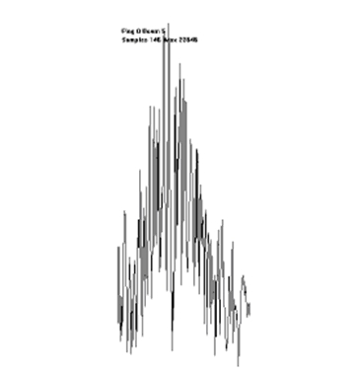
Snippets Data
A Snippet is the series of amplitude values in the signal reflected from a beam‘s footprint on the seafloor.

Slide 13
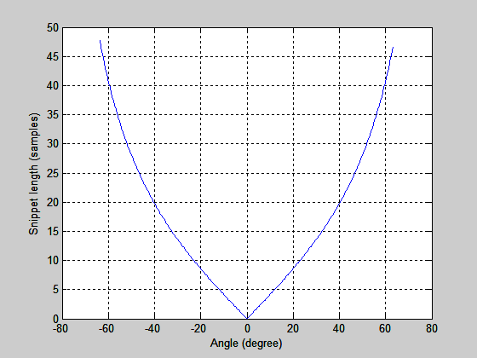
How are snippets (automatically) determined?
(very) old method: fixed snippet window
  Cannot cope with dynamic environments
  Larger data records (7008) with less added value
New method: automatic snippet window
  7k and T-series (7028 record)
  Aims 1) full bottom coverage across the swath and 2) smaller files sizes
?
samples against beam angle

Slide 14
Automatic snippet window – flat seabed
Beam (n)
Beam (n-1)
Beam (n+1)
time samples
Snippet window
Bottom detection @ sample (n+1)
Bottom detection @ sample (n-1)
Bottom detection @ sample (n)
Window = (S_{n+1} – S_{n}) + (S_{n} – S_{n-1})

Slide 15
Automatic snippet window – target on seabed
Beam (n)
Beam (n-1)
Beam (n+1)
time samples
Snippet window
Bottom detection @ sample (n+1)
Bottom detection @ sample (n-1)
Bottom detection @ sample (n)
Window = (S_{n+1} – S_{n}) + (S_{n+1} – S_{n})

Slide 16
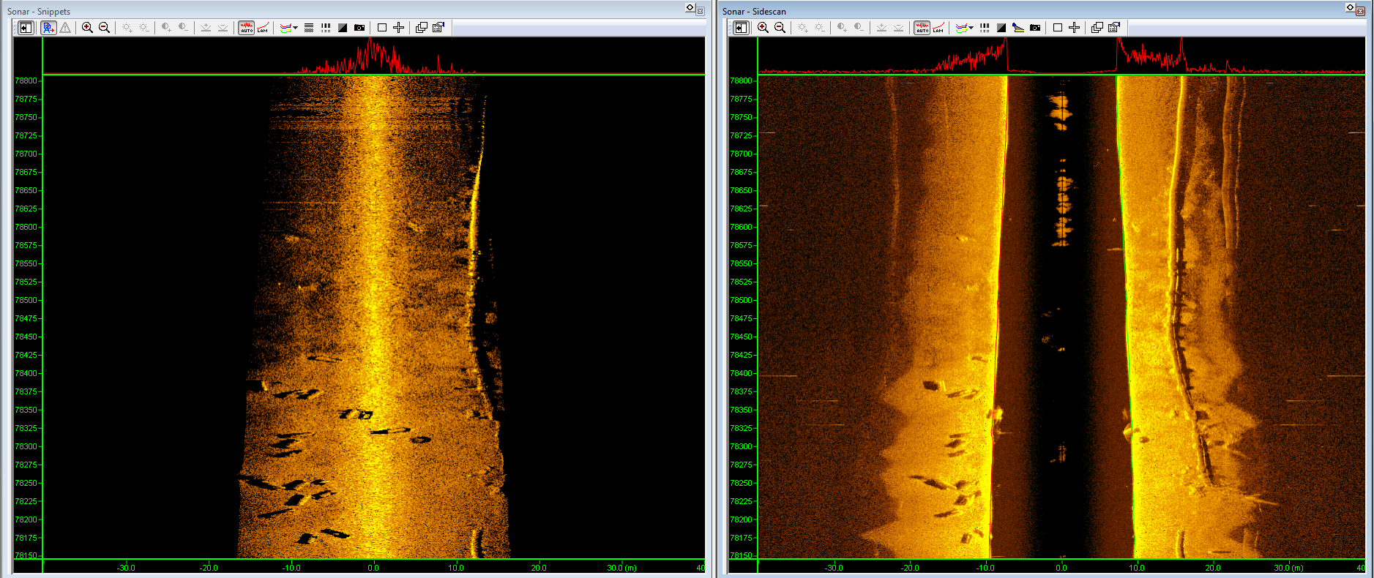
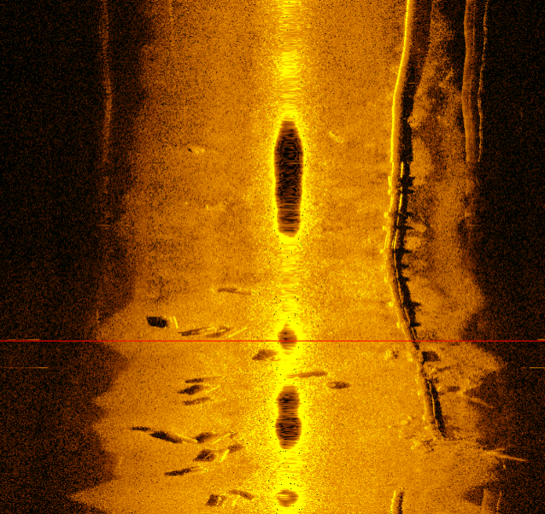
Differences Sidescan and Snippets
Snippets
Distance/Range same as Bathy data
Position of beam exactly known from Bathy data
No Bottom detection = No Snippets data
Sidescan
Watercolumn
Shadows show information

Slide 17
Snippets Backscatter
SeaBat 7101
Teledyne PDS

Slide 18
Depth information

Slide 19
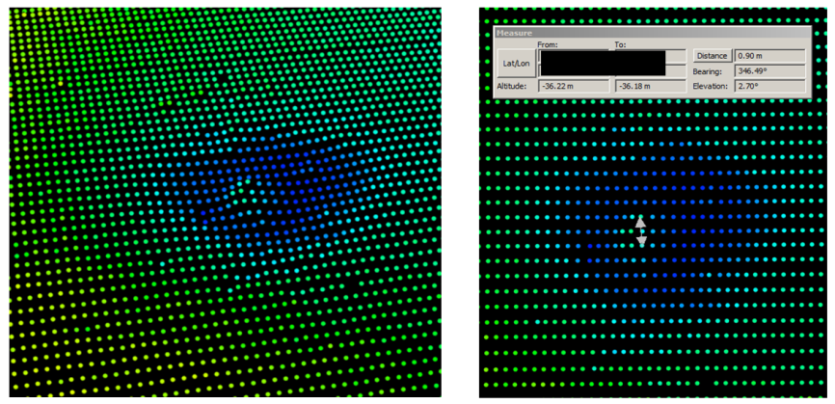
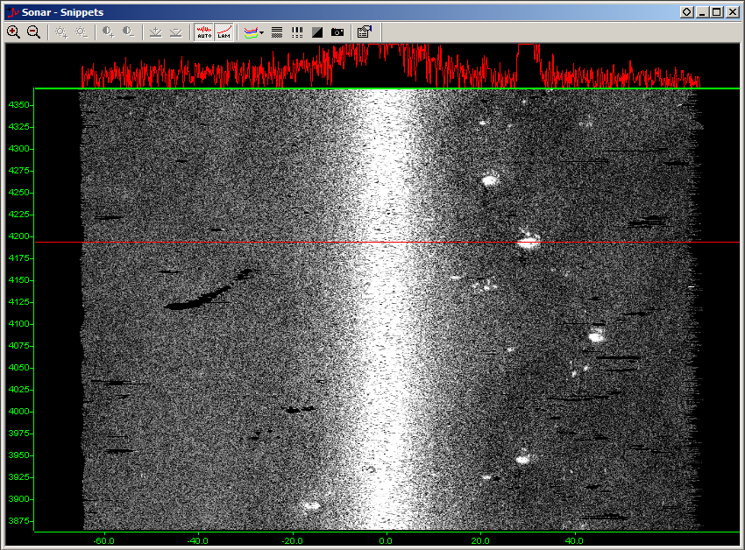
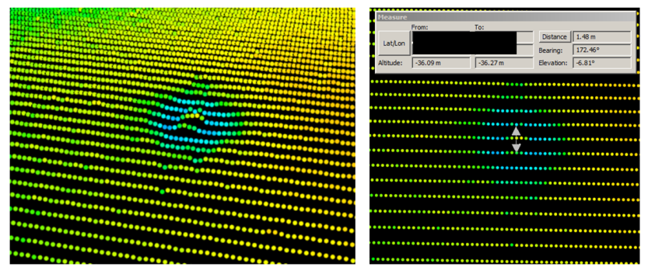
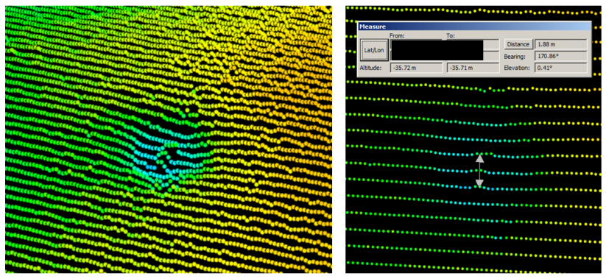
Snippets Backscatter for Feature Detection

Slide 20
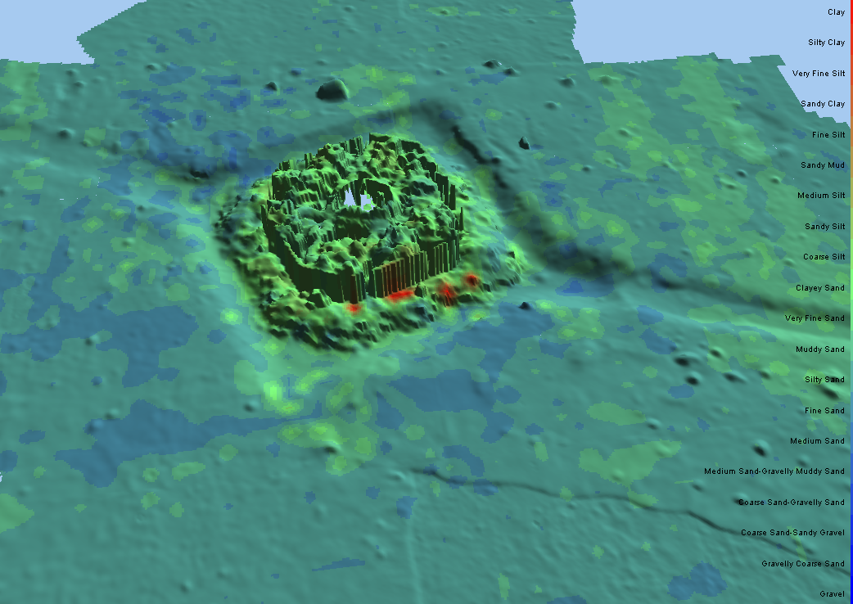
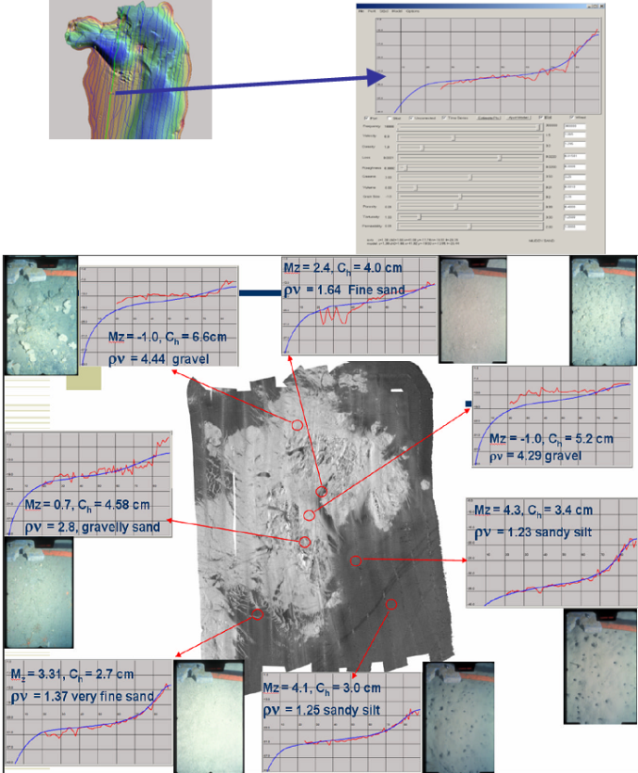
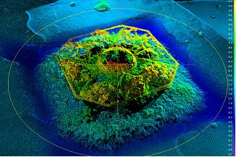
Bottom characterization using Snippets

Slide 21
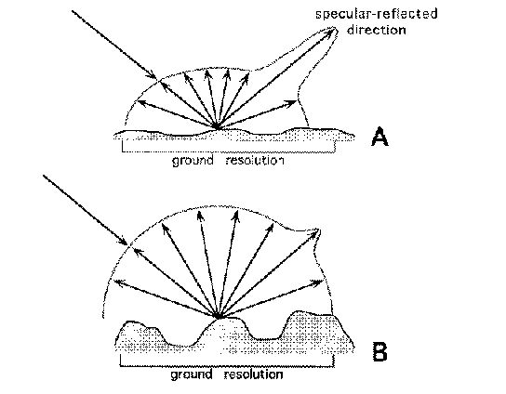
Influences to backscatter
Hardware:
Source level
Gain
Transmit and receive beam pattern
Ceramic sensitivity
Pulse Length/Type
Water column
Attenuation
Spreading
Objects in the water
Angular Response
-10
Specular reflection
gravel
Seabed Backscatter
sand
BS (dB)
scatter
scatter
mud
Seafloor
-50
90
Grazing Angle
0
Impedance
Sediment density and velocity
Large impedance contrast will give strong backscatter. E.g. air bubbles
Sub-bottom terms
Sediment attenuation
Biological life, bubbles
Roughness
Loss of energy
Require some chaotic scattering to return in the receive direction
Frequency dependent
Grain size, shells

Slide 22



Can we account for all this? We try ….
Hardware:
Source level
Gain
Transmit and receive beam pattern
Ceramic sensitivity
Pulse Length/Type
Normalized Backscatter
Attenuation
Spreading
Objects in the water
Angular Response
-10
Specular reflection
gravel
HW/SW gains
Seabed Backscatter
sand
BS (dB)
scatter
scatter
Correct for angular response in Software.
mud
-50
90
Grazing Angle
0
Impedance
Sediment density and velocity
Large impedance contrast will give strong backscatter. E.g. air bubbles
Sub-bottom terms
Sediment attenuation
Biological life, bubbles
Roughness
Loss of energy
Require some chaotic scattering to return in the receive direction
Frequency dependent
Grain size, shells
???

Slide 23

Conclusion: Not all Backscatter is created equal
The case for Normalized Backscatter

Slide 24
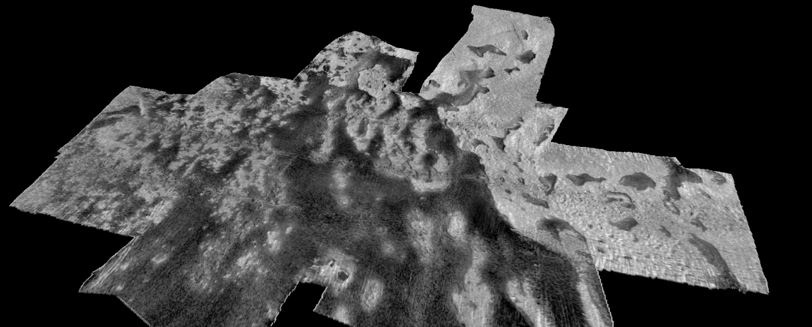
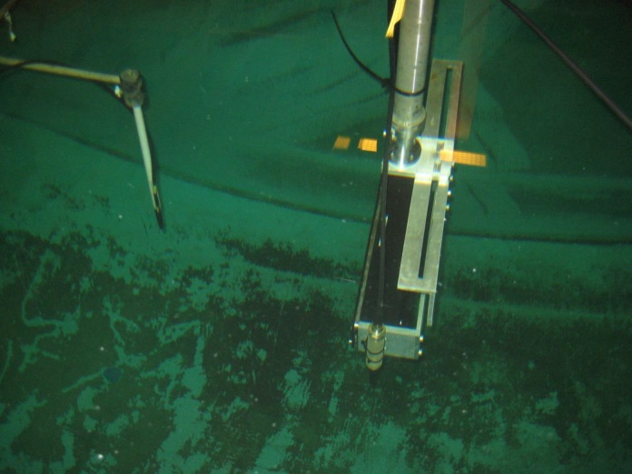
SeaBat T50 Normalized Backscatter (NBS)
Generic parameter sets established for the transmitter and receiver beam patterns, source level, ceramic sensitivity, and gain.
Backscatter is normalized to actual dB value so it can be used for repetitive mapping purposes or modelling.
Normalized backscatter is available for SeaBat T50

Slide 25
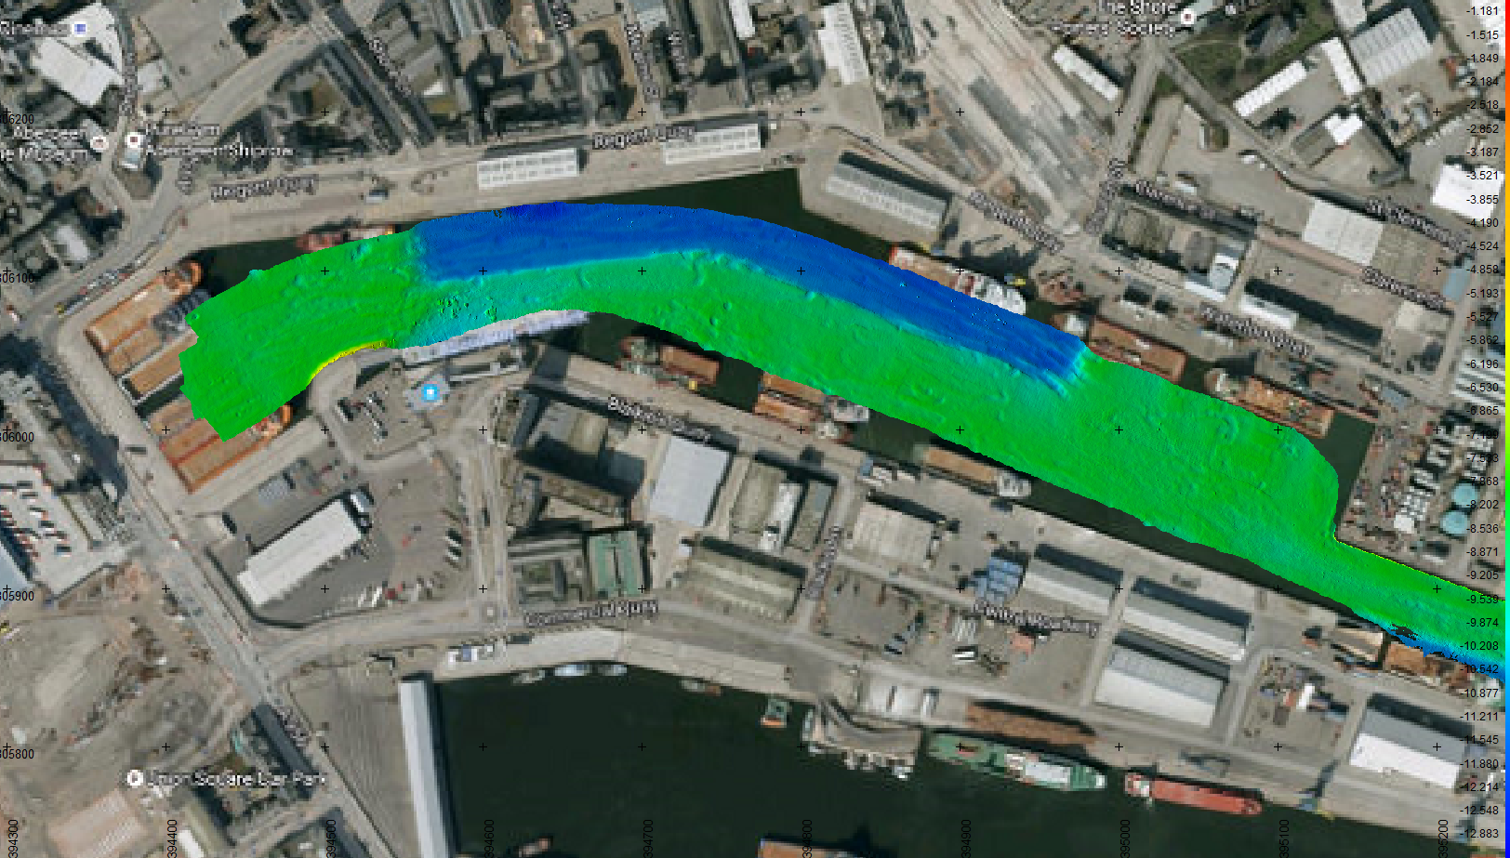
Harbour Survey

Slide 26
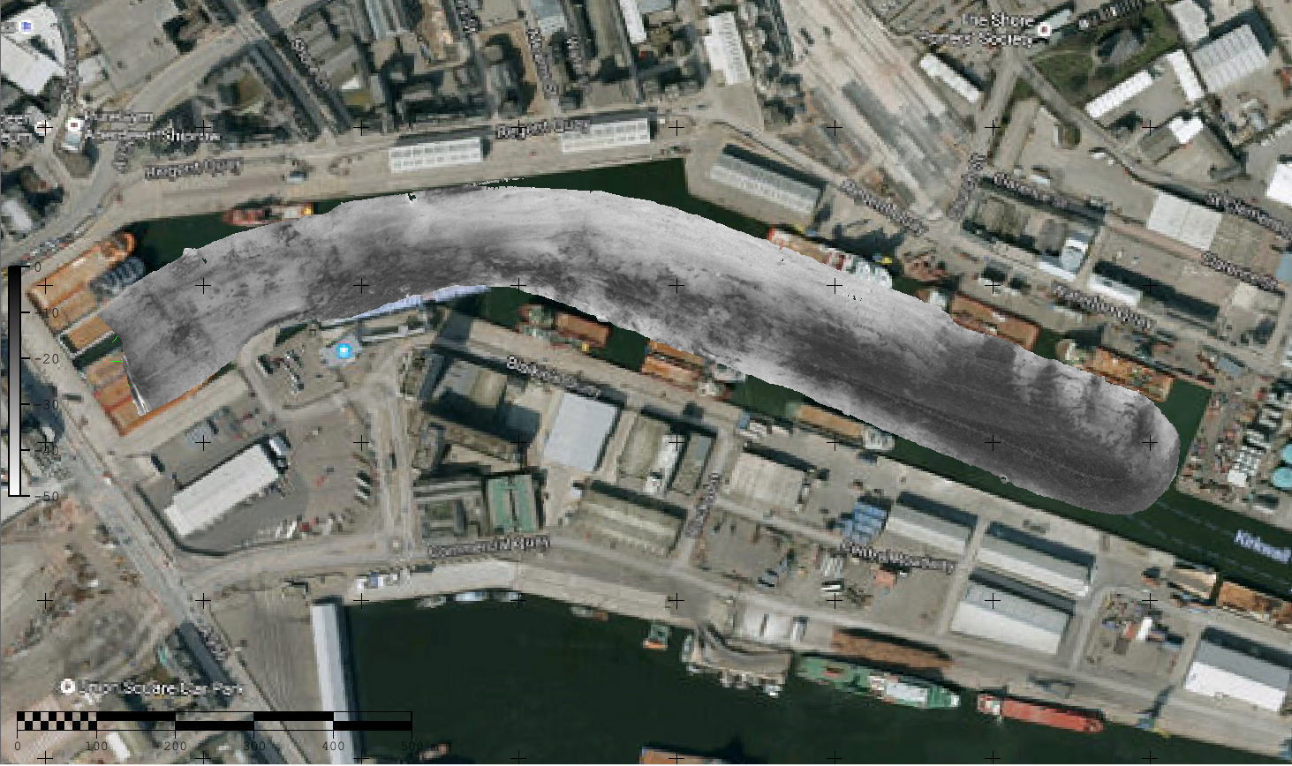
Harbour Survey
SeaBat T50-P Normalized Backscatter
Acquisition: Teledyne PDS
Processing: Teledyne CARIS

Slide 27
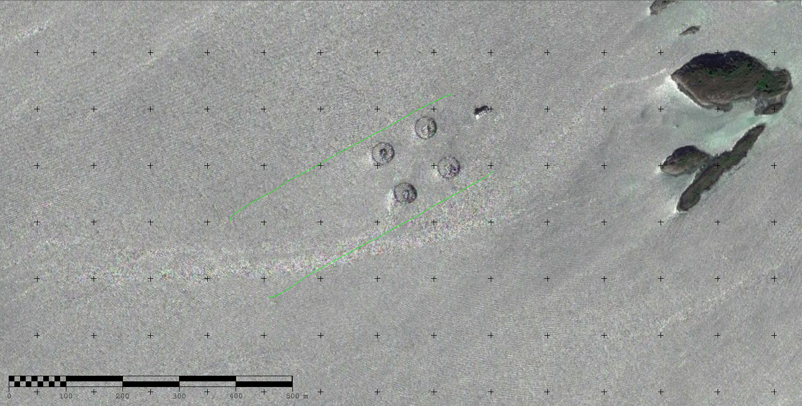
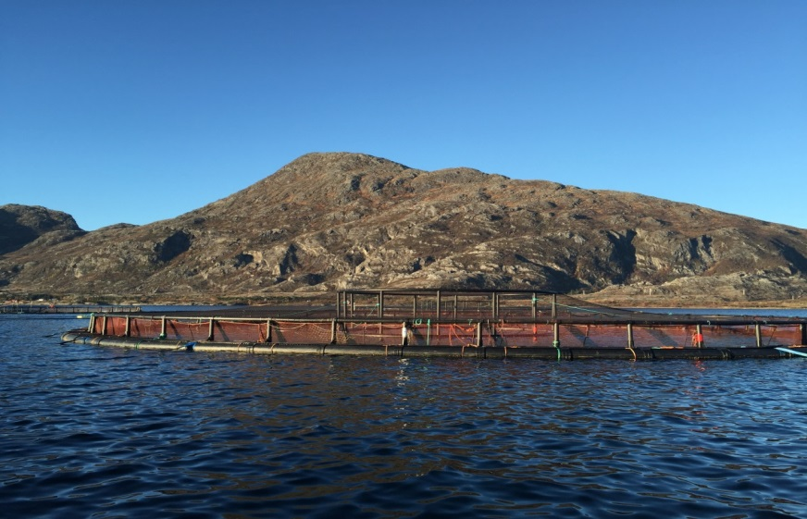
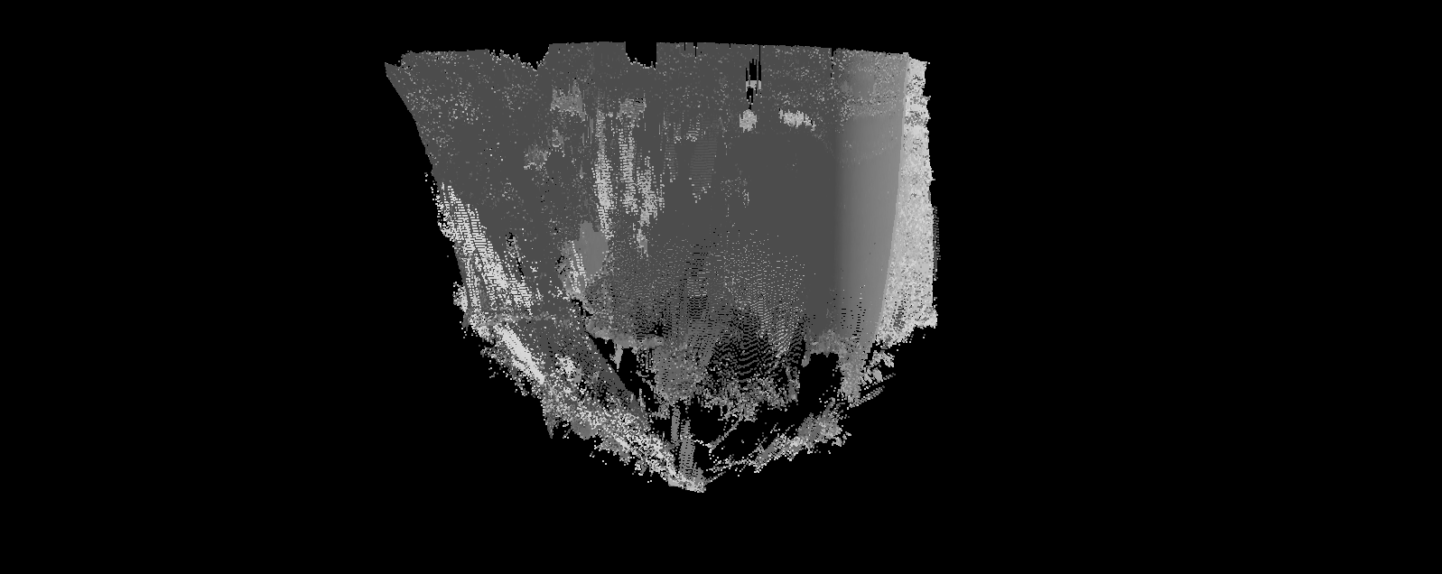
Salmon Fish farm
26 m
26 m
Satellite imagery

Slide 28
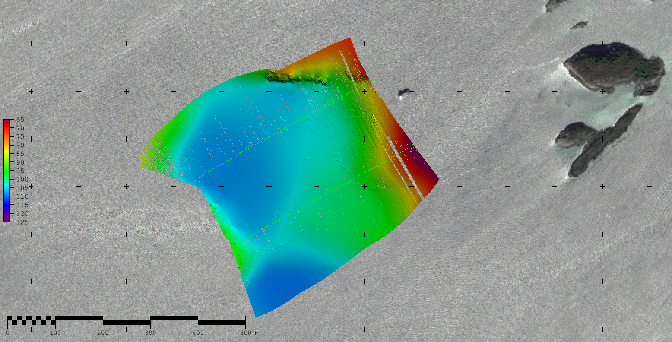
Salmon Fish farm - Bathymetry
SeaBat T50-P
Acquisition: Teledyne PDS
Processing: Teledyne CARIS

Slide 29
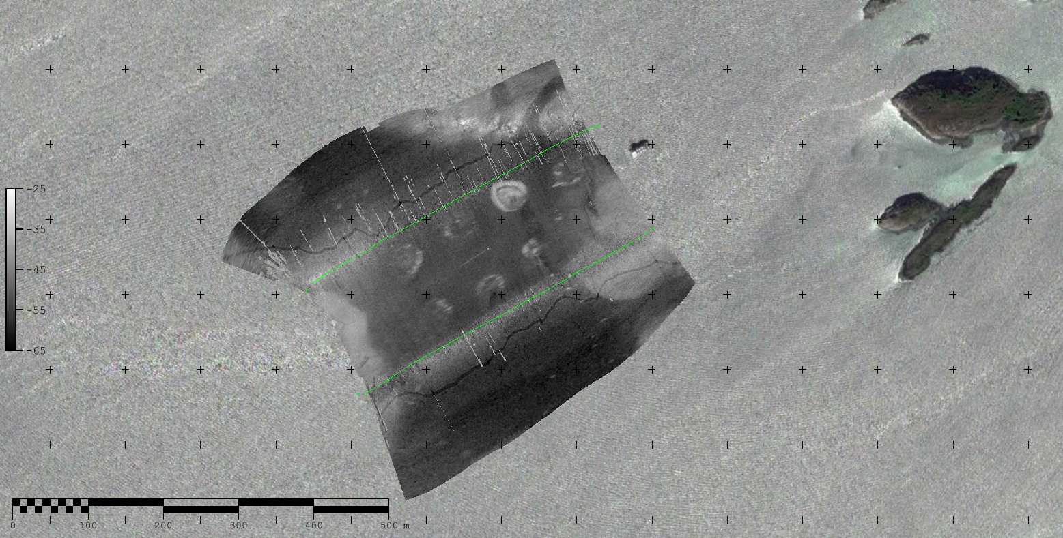
Salmon Fish farm - Backscatter
SeaBat T50-P
Acquisition: Teledyne PDS
Processing: Teledyne CARIS

Slide 30
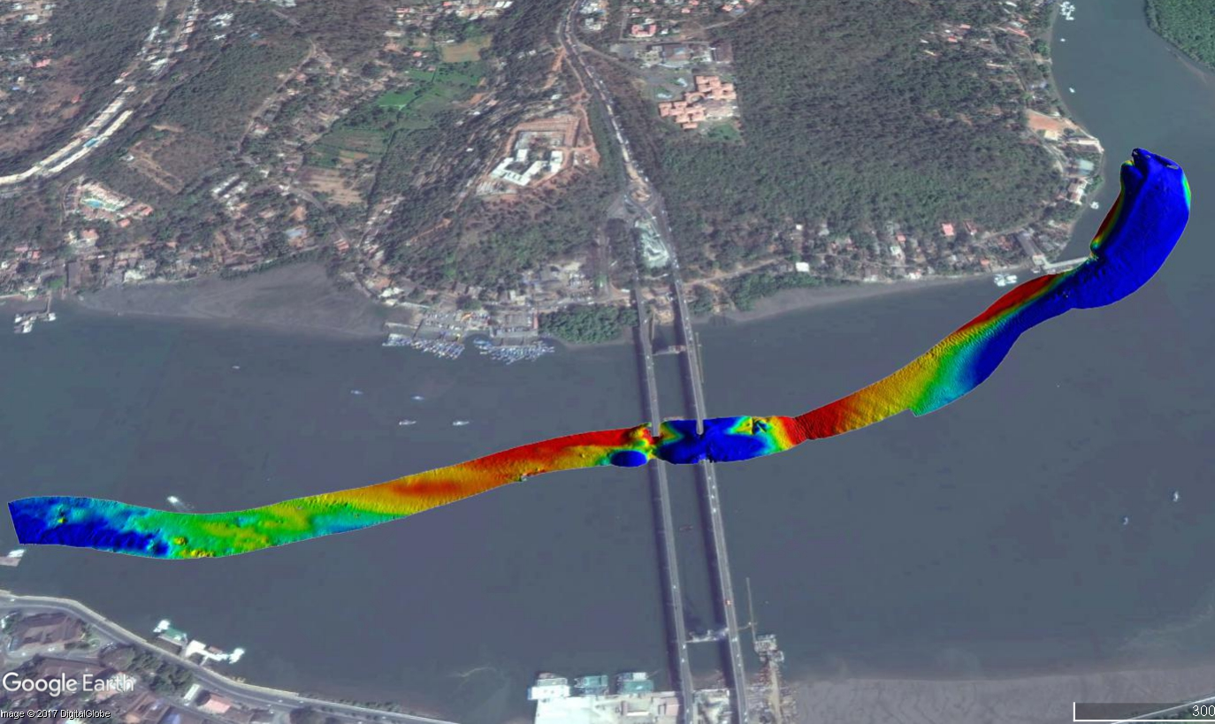
Goa, India – T50 Normalized Backscatter
SeaBat T50-P
Acquisition: Teledyne PDS
Processing: Teledyne PDS
SeaBat T50-P
Acquisition: Teledyne PDS

Slide 31
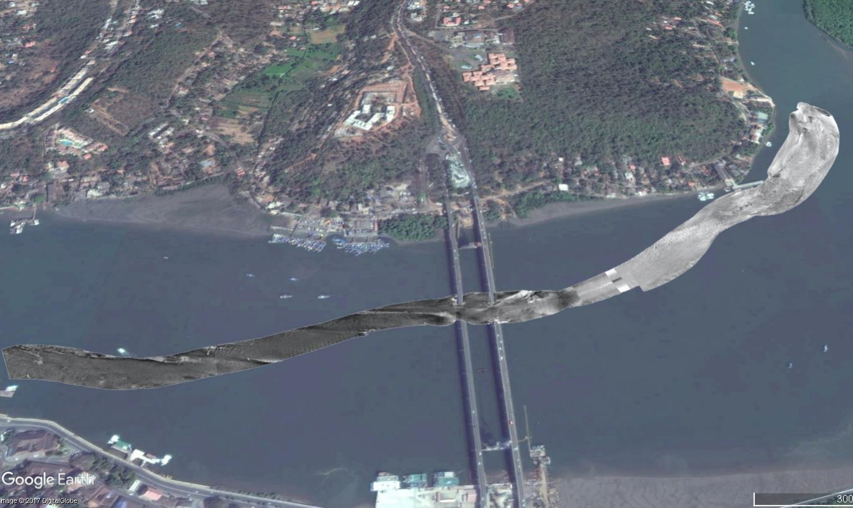
Goa, India – T50 Normalized Backscatter
SeaBat T50-P
Acquisition: Teledyne PDS
Processing: Teledyne PDS

Slide 32
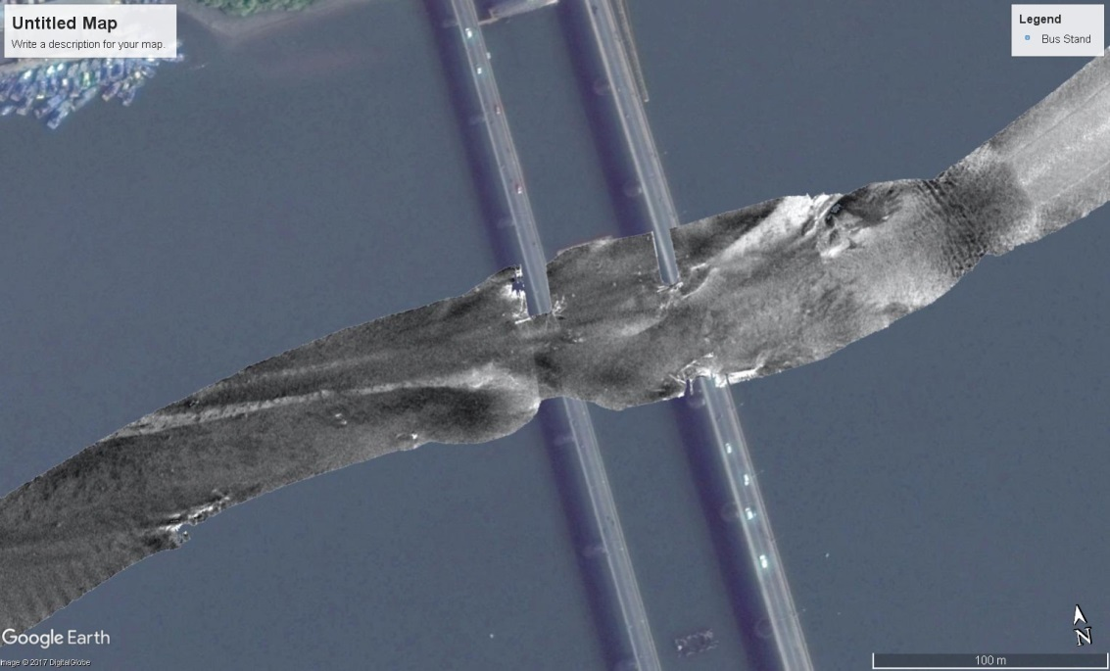
Goa, India – T50 Normalized Backscatter
SeaBat T50-P
Acquisition: Teledyne PDS
Processing: Teledyne PDS

Slide 33
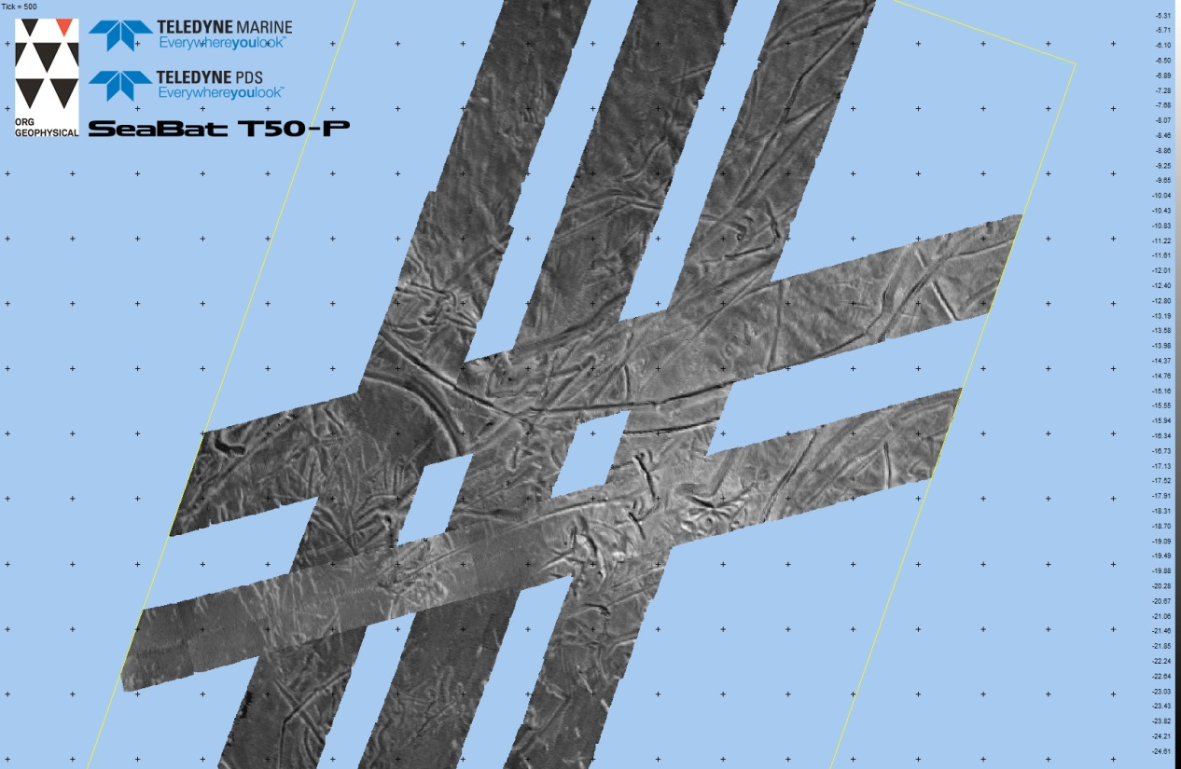
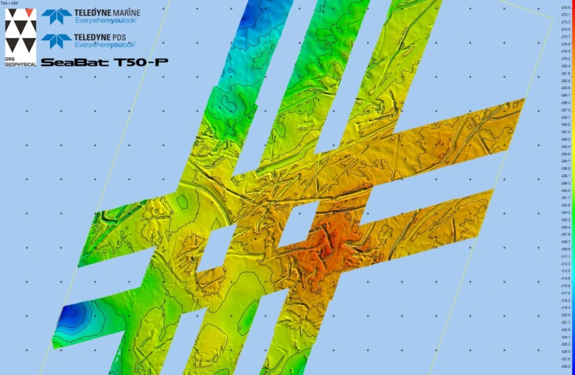
SeaBat T50 & Teledyne PDS
Standard Snippets Backscatter
Waterdepth ~300-400m

Slide 34
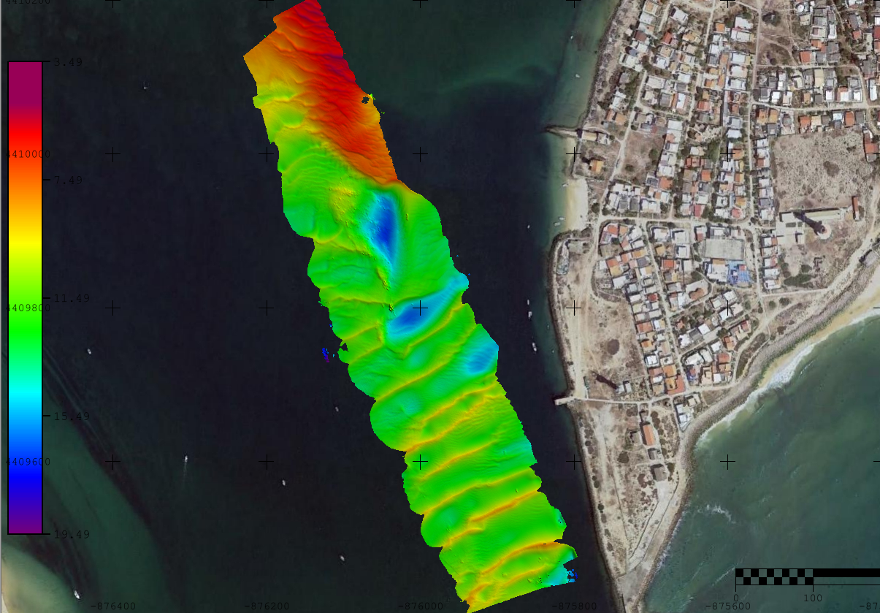
SeaBat T50-P Normalized Backscatter
Acquisition: Teledyne PDS
Processing: Teledyne CARIS

Slide 35
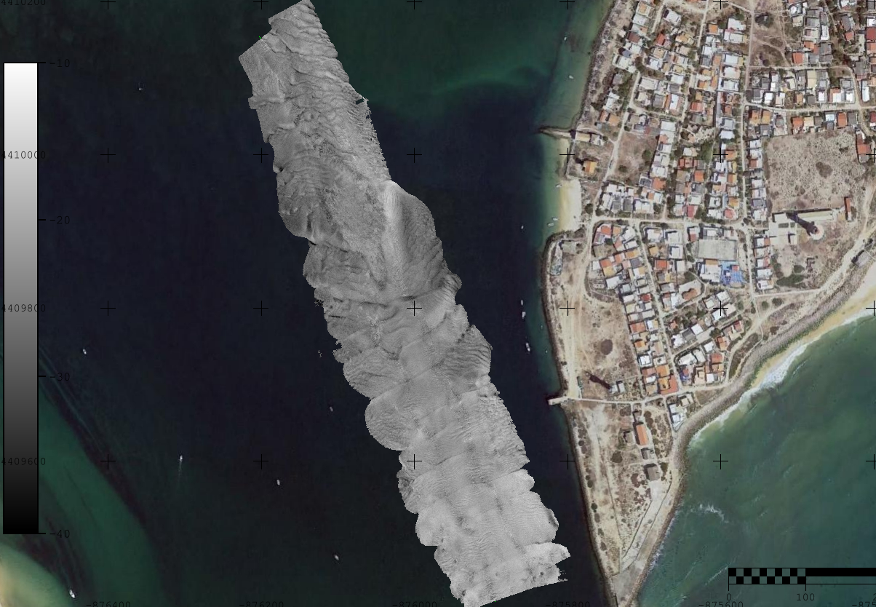
SeaBat T50-P Normalized Backscatter
Acquisition: Teledyne PDS
Processing: Teledyne CARIS

Slide 36
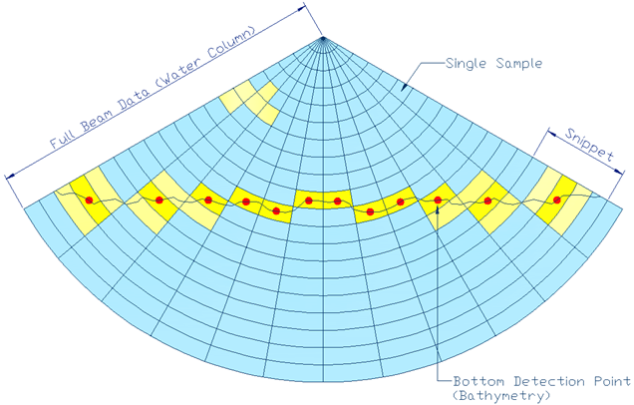
SeaBat Backscatter type 3):
Water Column Backscatter
Also known as: Full backscatter; Imagery; Beam Data
All intensities above the digitised bottom represent the water column backscatter

Slide 37
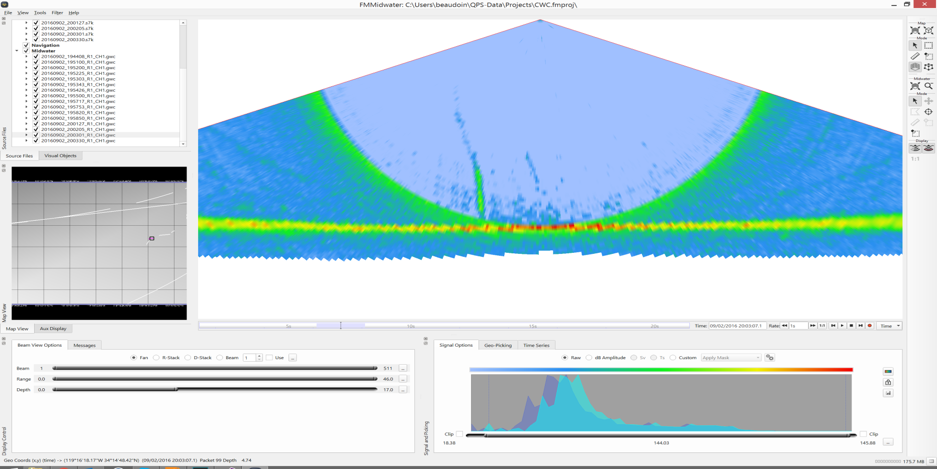
Water Column

Slide 38
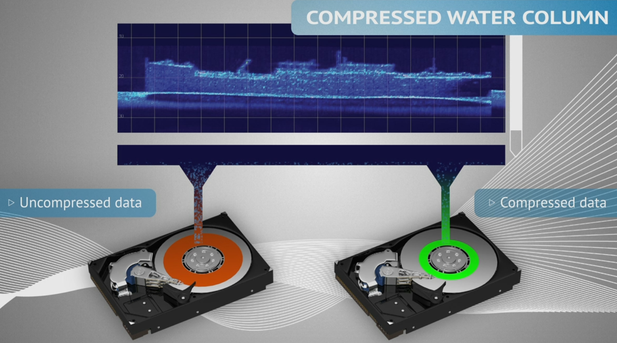
Water Column Data
Notes:
Compressed Water Column:
Reduces data volume significantly by intelligently removing data…
No samples below the sea floor detections (reduce by ~40%)
Convert to dB and remove 8 least significant bit (reduce by ~40%)
Remove phase information (reduce by ~40%)
Downsample by factor x (reduce by at least 50%)

Slide 39
Applications of Water Column data
Wreck surveys
Gas vents
Sediment plumes
Oil spills
Marine mammal monitoring
Multidetect

Slide 40
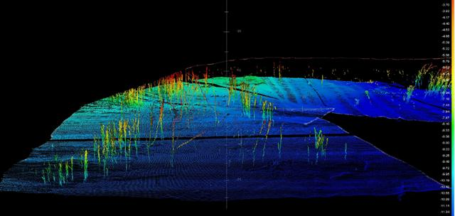
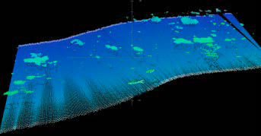
Multidetect
Bottom detection and digitalisation of intensity in beam
Up to 5 detections per beam
Detects details in the water column

Slide 41
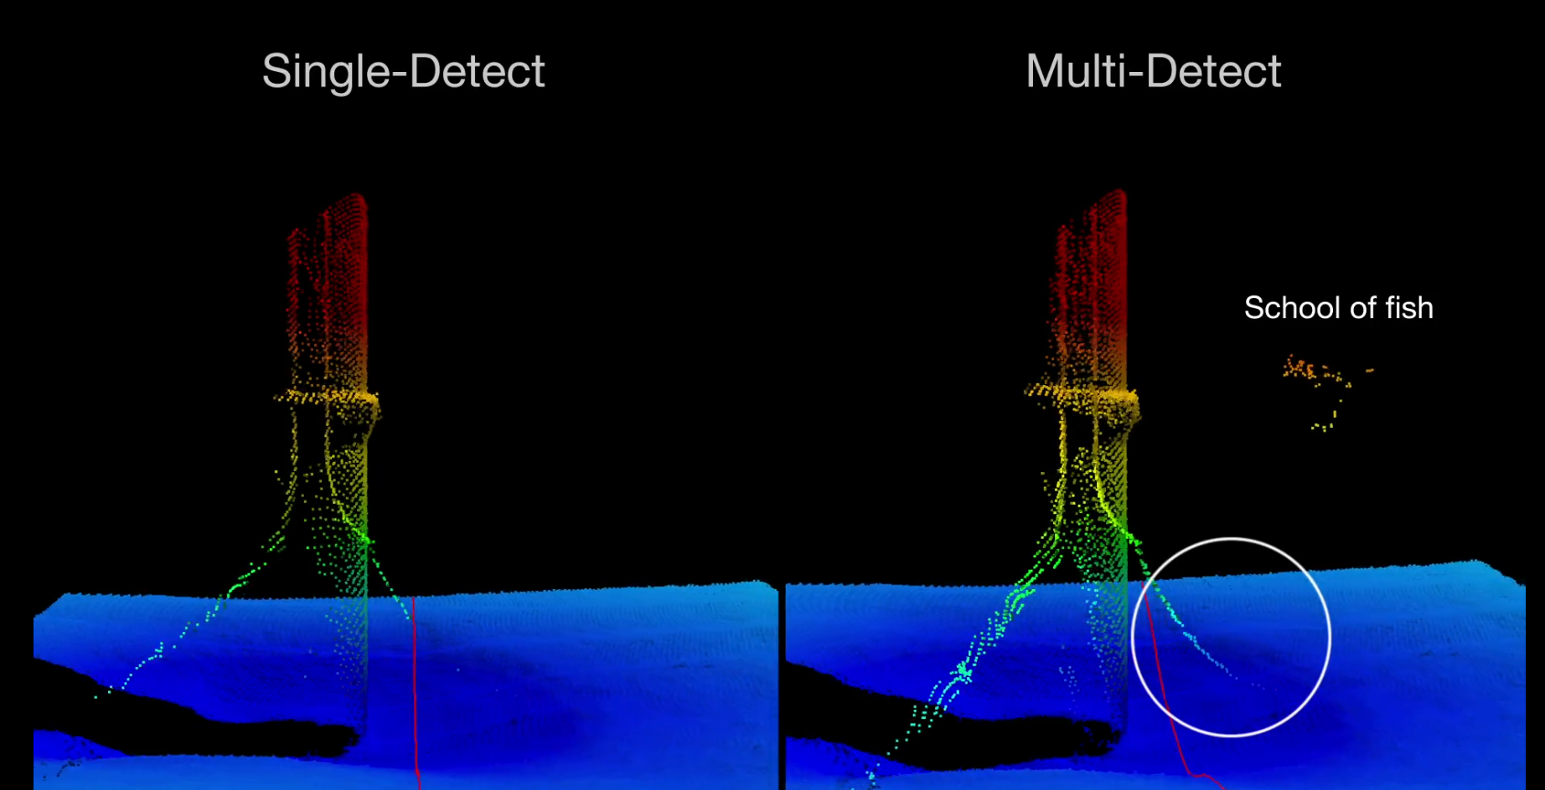
Multi-Detect Turbine Data

Slide 42
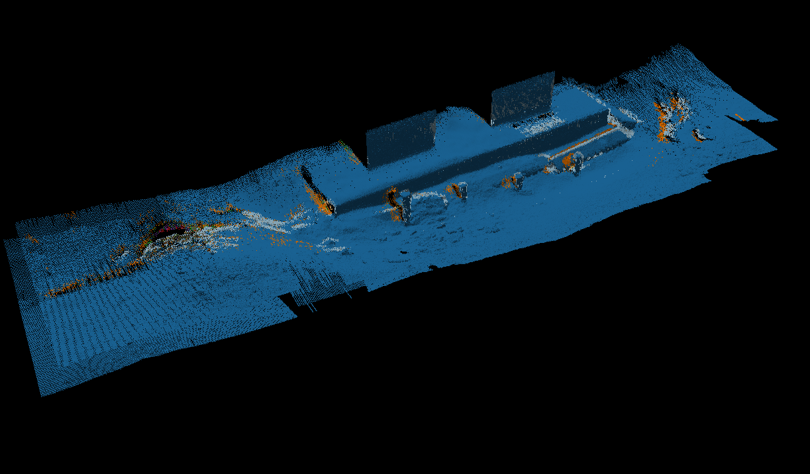
Multi detect on Bridge Pillar

Slide 43

Pipe Detection
Pipe position automatically determined by detection algorithm
Pipe displayed on User Interface
Steering of beams to pipe
Pipe adjacent depths calculated
Mean seabed depths calculated
Export in S7K data
  Top of Pipe
  Adjacent markers
  Mean seabed markers
Free spans may be calculated

Slide 44

Feedback to Bottom Detection
Detection algorithm initially calculates top of pipe positions
BDA searches for detections in vicinity of pipe
Pipe detection algorithm automatically matches pipe position
Top of Pipe position is exported in 7k record as a 5 points file
Pipe position for next ping is initialised from previous pings

Slide 45
Summary
Data from one multibeam system is more than only bathymetry data.
Backscatter delivers invaluable information for target detection, seabed characterization, habitat mapping
Possible to collect data at the same time
New Normalized Backscatter allows for improved consistency for repetitive mapping.
SeaBat T50 offers Normalized Backscatter and Compressed Water Column backscatter.

Slide 46




Thank you
Questions?
You can also visit our booth L4

Slide 48

SeaBat T50-P Compressed WC
QPS Fledermaus Mid-Water

Slide 49
What’s that Nadir striping?
τ pulse length
Grazing angle θ
Few samples (low res)
But strong specular
Many samples (high res)
Weak specular

Slide 50
What’s that Nadir striping?
MBES
time
phase
time
Few samples (low res)
But strong specular
Many samples (high res)
Weak specular
Notes:
The geometry of the sonar used to map the seabed generates signals of quite different characteristics whether it is pointing straight down or off to the side.

Slide 51



Water Column: Backscatter Time Series Mapped

Slide 52
Tips For Snippets Backscatter Acquisition (1)
Snippets data is centred around the bottom detection so settings to ensure good bottom detection is key.
Do not over gain (7125), i.e reach saturation.
CW gives best snippets quality
Run straight lines, doe not use infill's or cross lines in the mosaic
(if not using Normalized Backscatter:) Keep constant settings. Find the right power/gain/pulse/abs/spread settings and change only if in a different survey block (ie. Not throughout a line).

Slide 53
Automatic snippet window – flat seabed
Beam (n)
Beam (n-1)
Beam (n+1)
time samples
Snippet window
Bottom detection @ sample (n+1)
Bottom detection @ sample (n-1)
Bottom detection @ sample (n)
Window = (S_{n+1} – S_{n}) + (S_{n} – S_{n-1})

Slide 54
Automatic snippet window – target on seabed
Beam (n)
Beam (n-1)
Beam (n+1)
time samples
Snippet window
Bottom detection @ sample (n+1)
Bottom detection @ sample (n-1)
Bottom detection @ sample (n)
Window = (S_{n+1} – S_{n}) + (S_{n+1} – S_{n})

Slide 55
Automatic snippet window – no neighbouring beam
Beam (n)
Beam (n+1)
time samples
Snippet window
Bottom detection @ sample (n+1)
Bottom detection @ sample (n)
Window = (S_{n+1} – S_{n}) + (S_{n+1} – S_{n})

