Slide 1
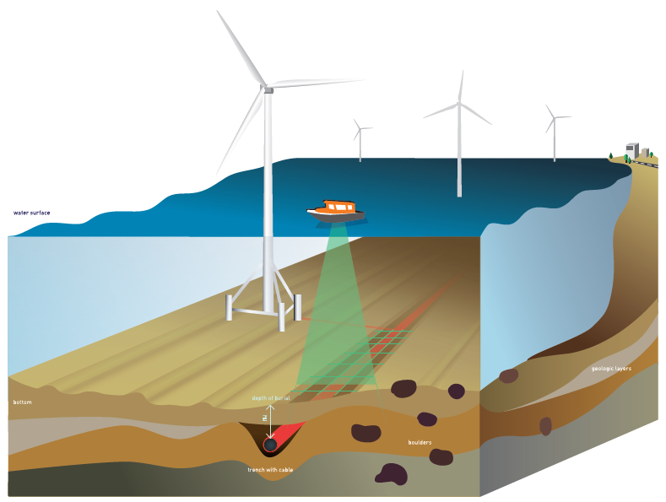
Hydro ’17
Cable Detection Using Automated Contact Recognition In Acousitcs
J. Kwee - Geologist
Notes:
Version 20160921. All font: Calibri (Hoofdtekst) zwarte tekst 1, lichter 50%. [main titles] 40 [other tekst] 24. Layout figures: rechthoek met slagschaduw + zwart omrand (zwarte, tekst 1, dikte 3/4).

Slide 2
Introduction
Cable and pipeline construction:
Safe vessel passage
No obstruction for commercial fishing
No dredging possible
No anchorage
Existing infrastructure!

Slide 3
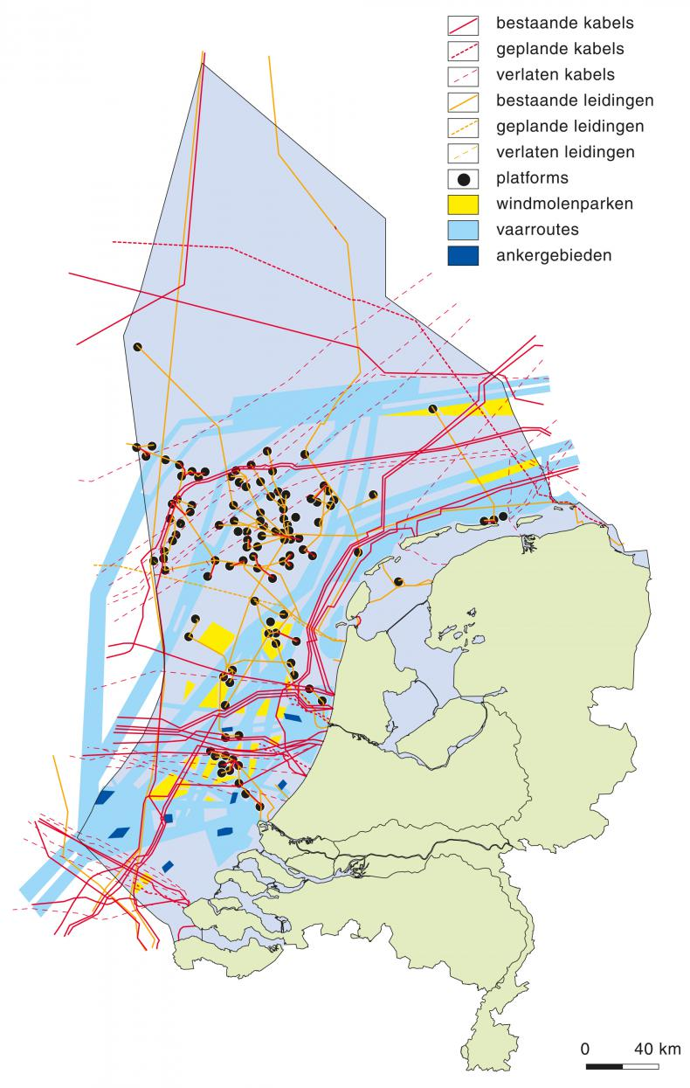
Introduction
North Sea (Dutch Continental shelf)
4.500 km pipeline
6.000 km cable
(Source: Noordzeeloket)
(Source: Rijksdienst voor het Cultureel erfgoed)

Slide 4
Introduction
Exact location is important for a guaranteed power and communication flux
Owners responsibility.
Pre-construction work
If the location is not known to all parties, consequences can be severe!

Slide 5
(Source: gcaptain.com)

Slide 6
Internet outage Somalia
Approx. $10 M per day
Total loss ~ $210 M
(Source: www.bbc.com)
Notes:
Internet outage Congo - Brazzaville (July 2017)
15-day long disruption
Marine cable was cut

Slide 7
Introduction
Key features to identify
Position X,Y
Depth of Burial (DOB)
→ Sub-bottom Acousitcs

Slide 8
Sub-bottom acoustics
What are sub-bottom acoustics?
How are they acquired?
How are linear objects (cables & pipelines) identified?

Slide 9
Sub-bottom Acoustics
Notes:
Most of you have probably seen a sub-bottom profile, but what is it exactly?

Slide 10
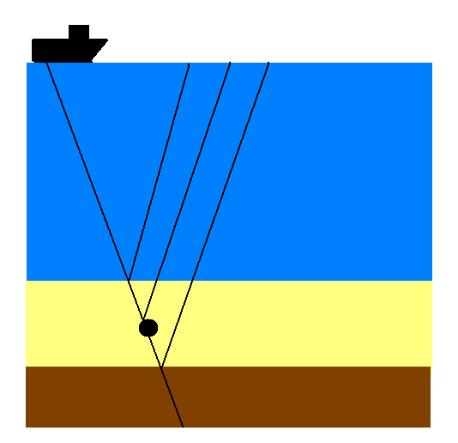
Sub-bottom Acoustics
Notes:
Explain Acoustics

Slide 11
Objects in Acousitcs
How are object visible?
Objects are visible as hyperbola
Notes:
How do Objects show in your acoustic profile?

Slide 12
Hyperbola in acoustics

Slide 13
Data Acquisition
Frequency selection
Penetration vs resolution
Optimal amount of pings
Surveyspeed and Pingrate
As high resolution as possible!
Notes:
Expected depth of burial vs. object size

Slide 14
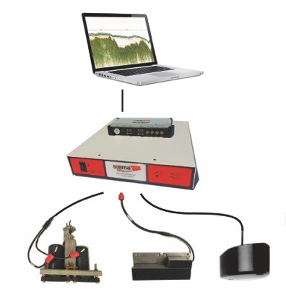
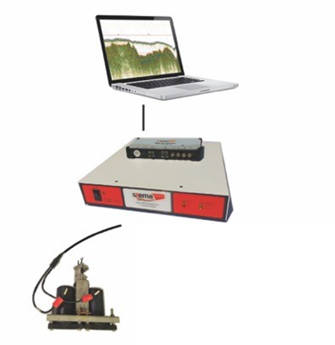
Data Acquisition
Ultra-high resolution
sub-bottom profiling
Silas acquisition software
EBP hardware
Dual or quad transducer array
(3 – 7 kHz)

Slide 15
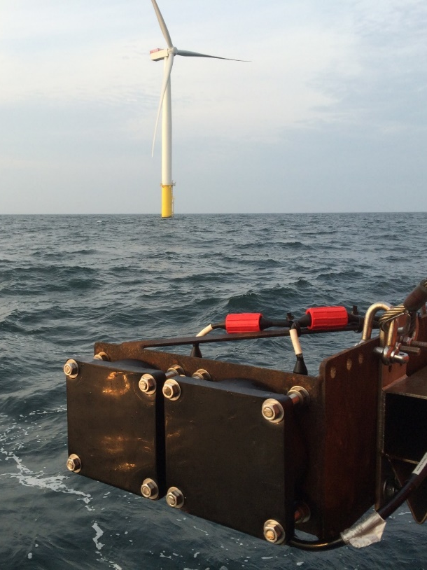
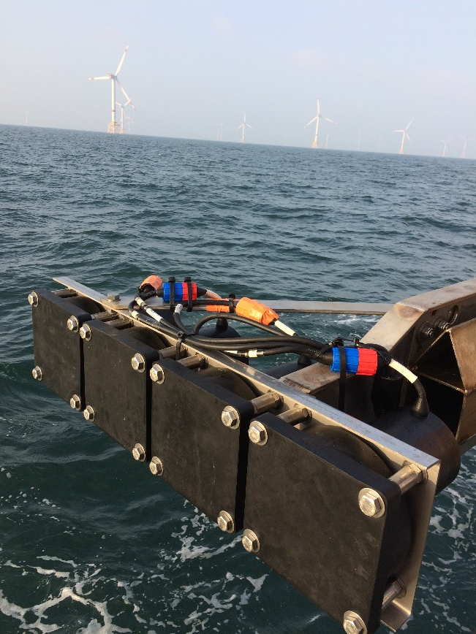
Data Acquisition
Vessel mounted

Slide 16
Processing
Data can be viewed online…
But processing is needed for a proper QC

Slide 17
Processing
Heave

Slide 18
Processing
No Heave

Slide 19
Interpretation
Where is the exact top?
Notes:
Picking is mainly interpretation work requiring experienced personnel and leaves room for man made errors

Slide 20
Interpretation
Manual interpretation
Time consuming
Subjective
Difficulties
Overprinting bottom structures
Weak reflection
Small object
Loss of signal
Small reflection coefficient
Notes:
As has been told by many in the past

Slide 21
Automated contact recognition
Silas Processing – Automated contact recognition
Automatic contact picking

Slide 22
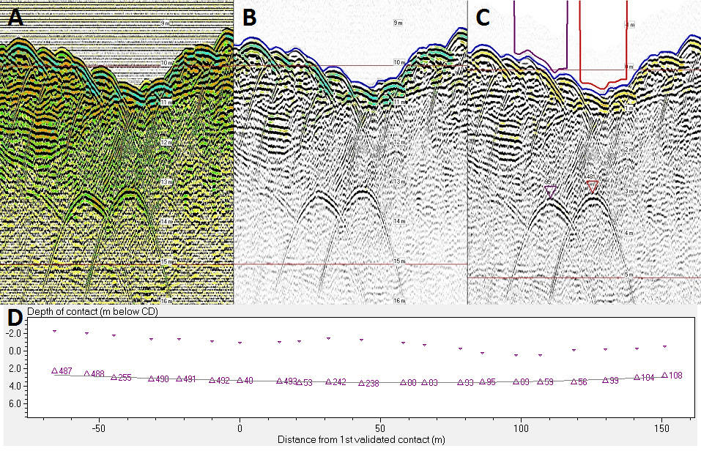
Silas Object Detection
Automated contact recognition
A: Raw B: Processed C: Auto Detect D: Vertical Cross Display

Slide 23
Automated contact recognition
Silas Processing – Automated contact recognition
Automatic contact picking
Batch process multiple lines
Quality parameters

Slide 24
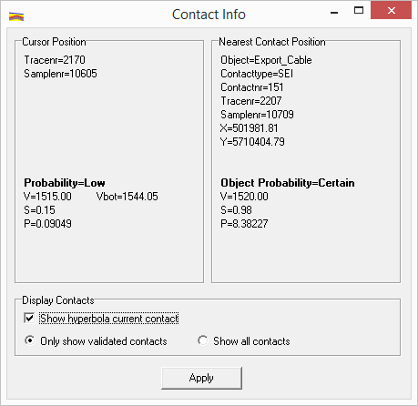
Quality parameters
Power
Semblance

Slide 25
Automated contact recognition
Silas Processing – Automated contact recognition
Automatic contact picking
Batch process multiple lines
Quality parameters
Theoretical hyperbola

Slide 26
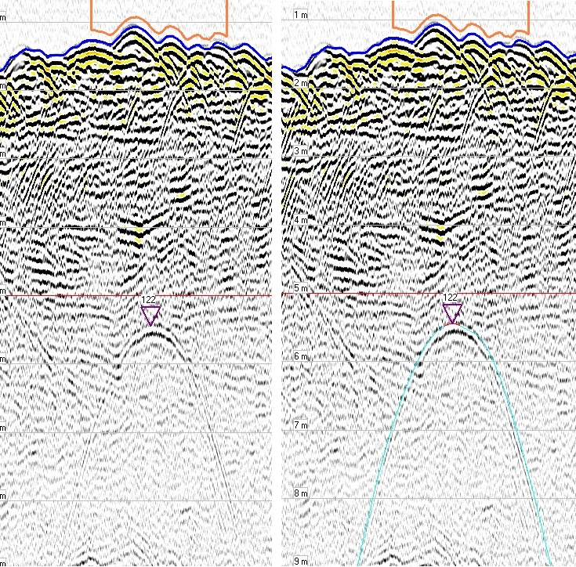
Theoretical hyperbola
Plotting of theoretical hyperbola

Slide 27
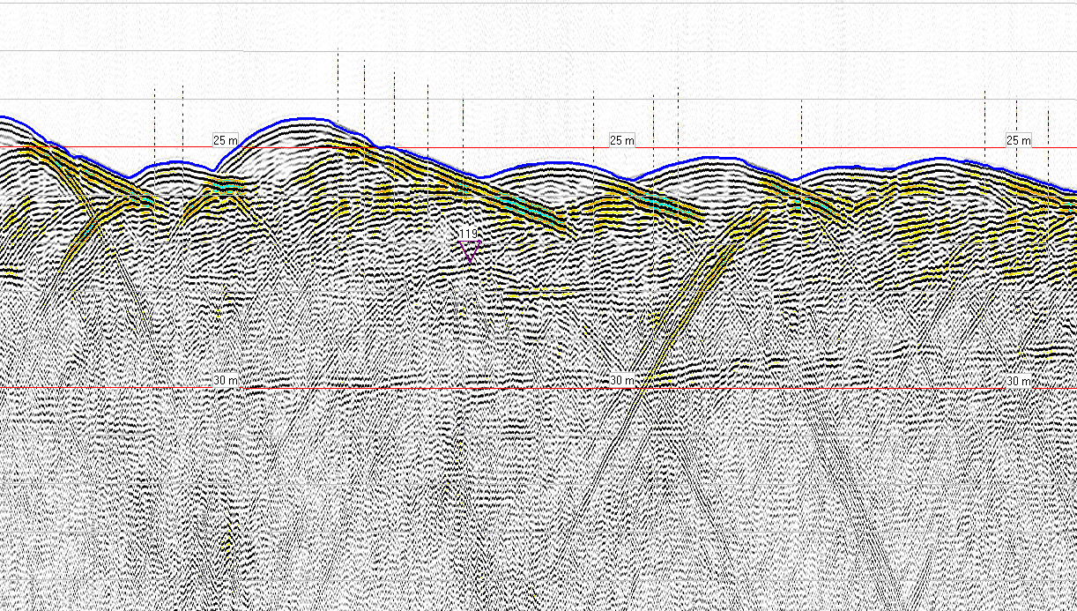
Theoretical hyperbola

Slide 28
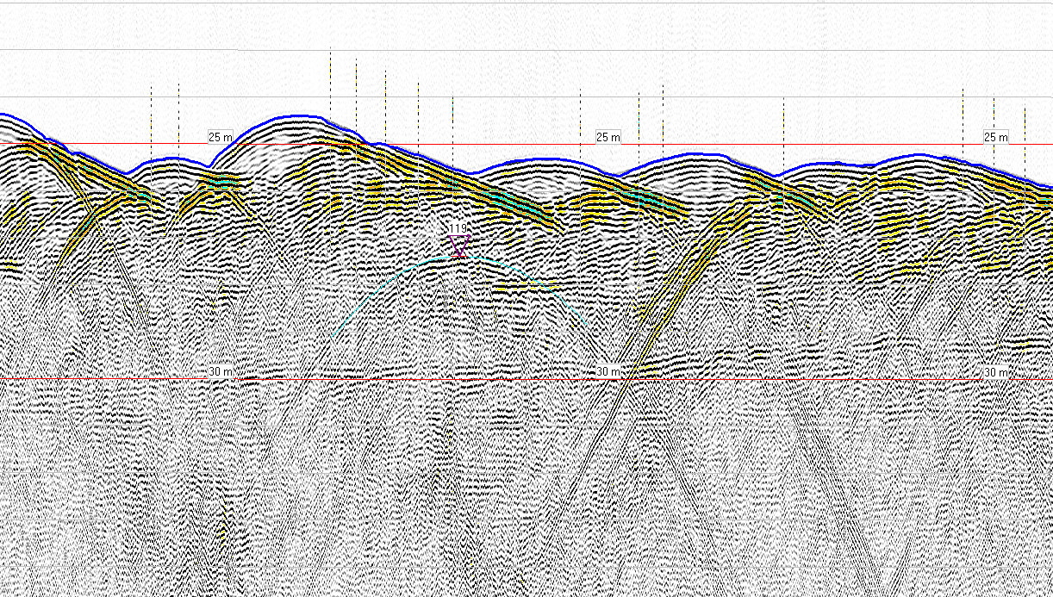
Theoretical hyperbola

Slide 29
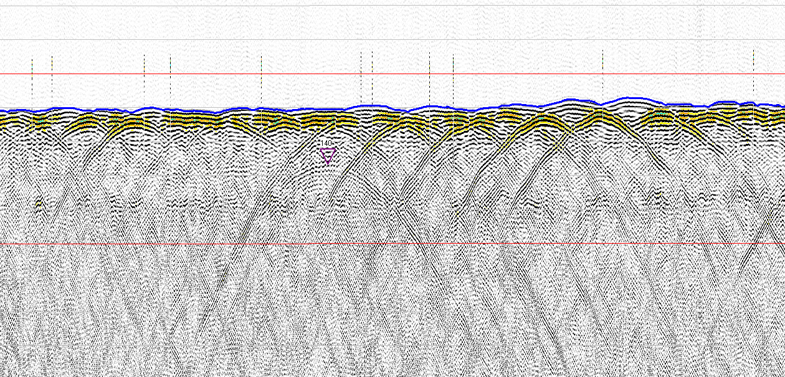
Theoretical hyperbola
Overprinting by other structures
Notes:
Sand ripples

Slide 30
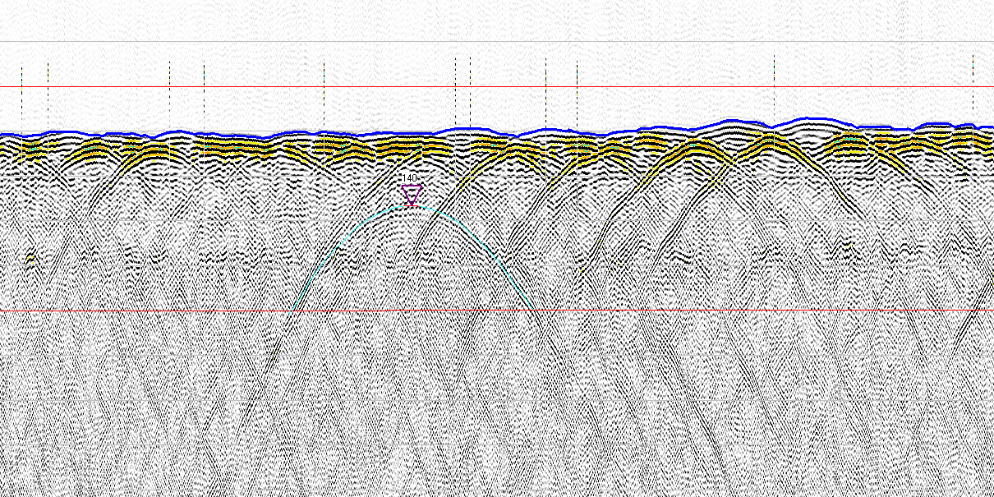
Theoretical hyperbola
Overprinting by other structures

Slide 31
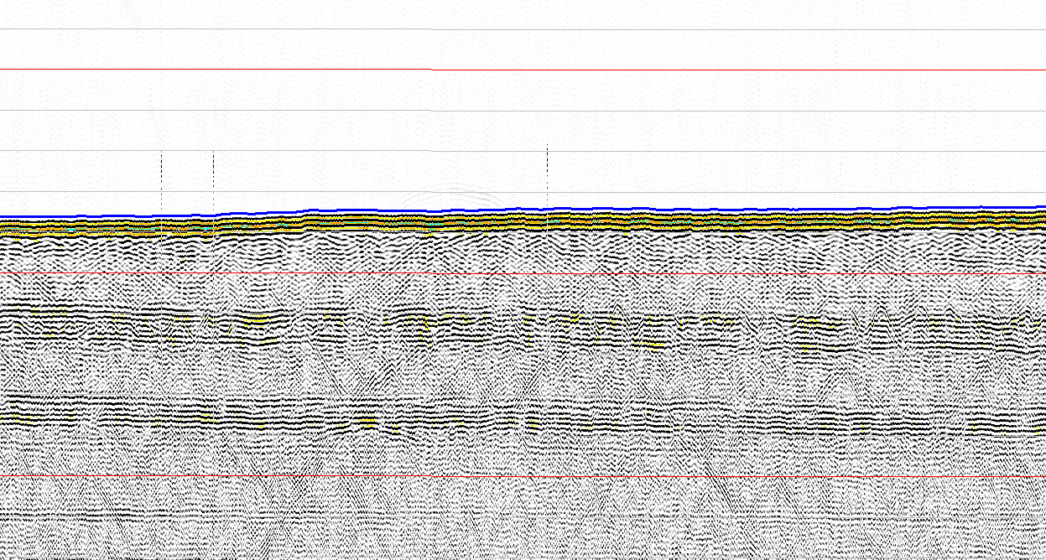
Theoretical hyperbola
Overprinting by layers

Slide 32
Theoretical hyperbola
Overprinting by layers

Slide 33
Automated contact recognition
Silas Processing – Automated contact recognition
Automatic contact picking
Batch process multiple lines
Quality parameters
Theoretical hyperbola
Combination with other data sets

Slide 34
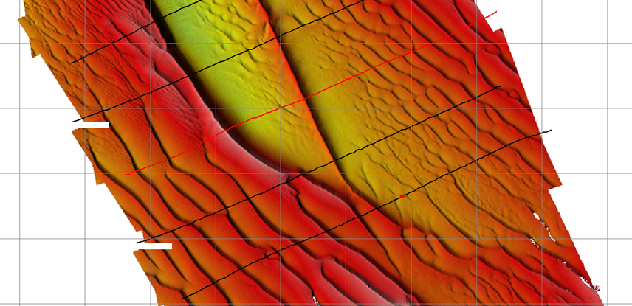
Combination of data

Slide 35
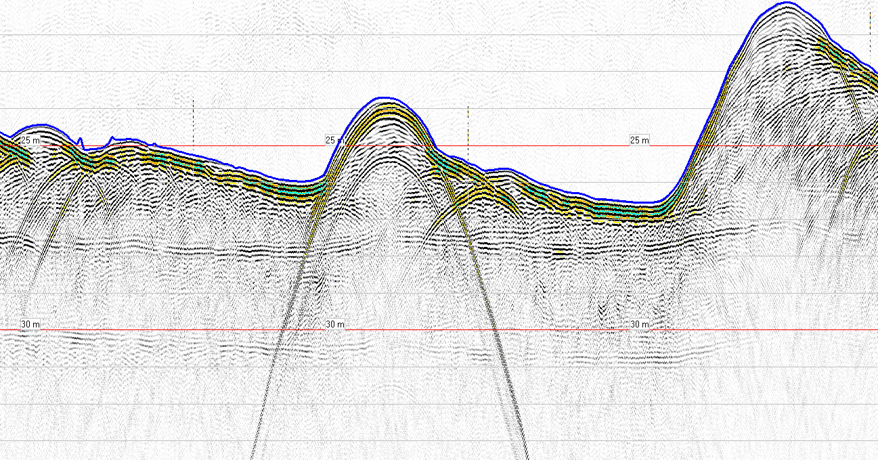
Combination of data

Slide 36
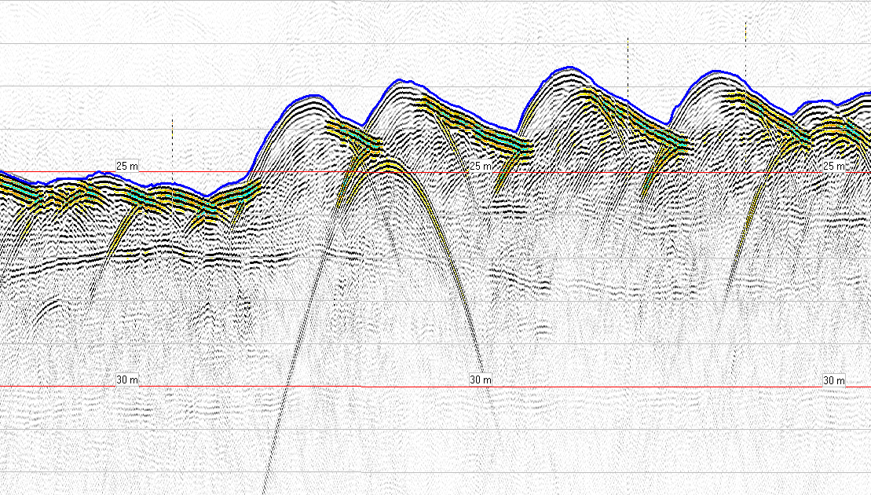
Combination of data

Slide 37
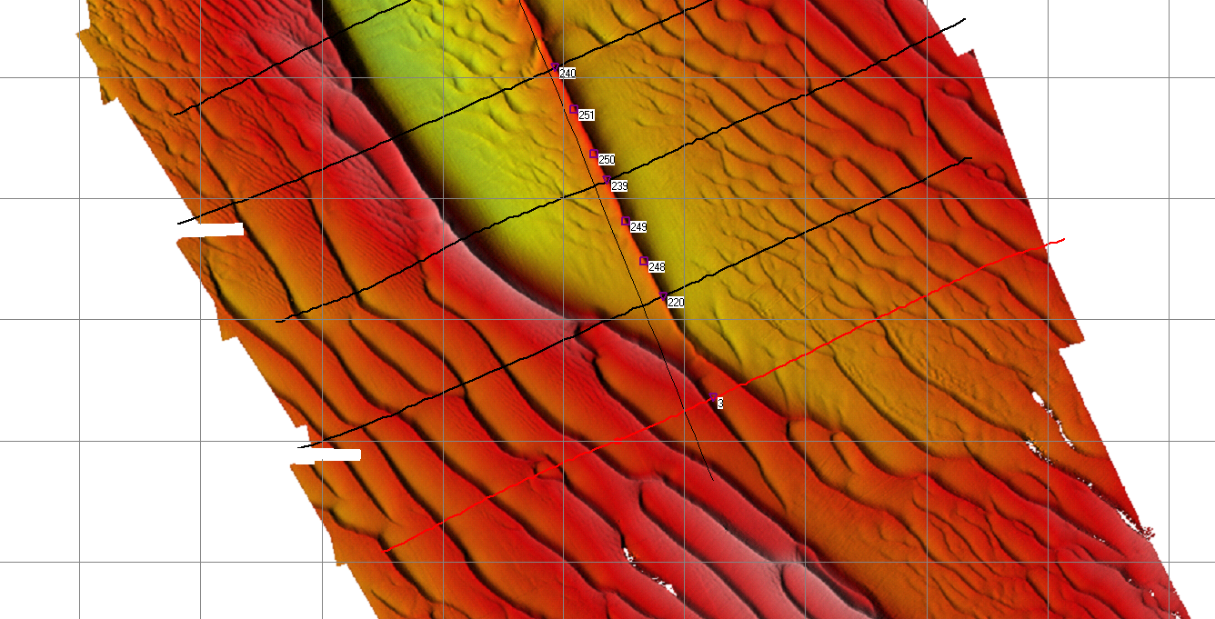
Combination of data

Slide 38
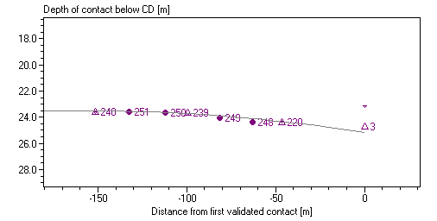
Combination of data

Slide 39
Summary
Silas Processing - Automated contact detection
Objective and accurate detection
Time saving
Quality parameters
Comparison with theoretical hyperbola
Combination of data

Slide 40
Thank you
www.stema-systems.com
www.fluidmud.com
www.geo-matching.com/rental
Stema Systems
@StemaHQ

