Slide 1
THE HYDROGRAPHIC MONITORING OF VENICE INLET CHANNELS:
THE GATEWAY TO THE LAGOON
C. Toso, A. Kruss, F. Madricardo, N. Pizzeghello, F. Trincardi, L. Lamberti
Rotterdam, 16th November 2017
Notes:
1
Prova intestazione

Slide 2
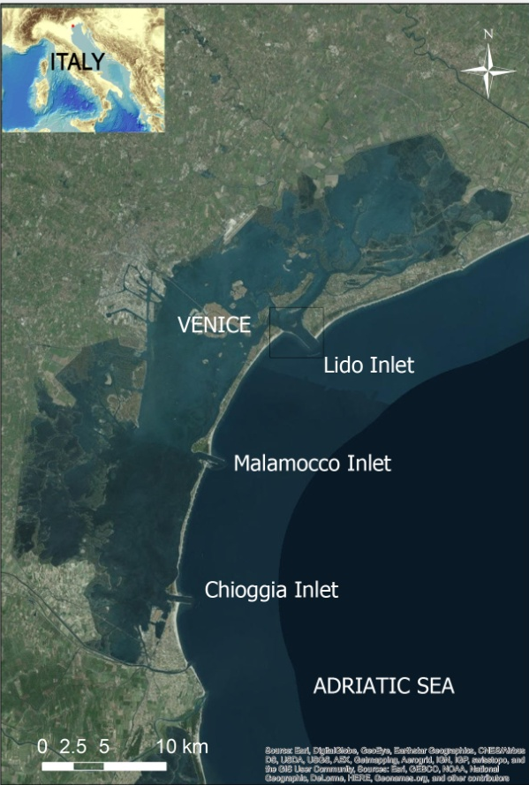
Objective
Describe the key geomorphological aspects of the Venice inlet channels through the hydrographic data
Notes:
2
This is the biggest coastal lagoon of the whole Mediterranean area Scarton, 2016, covering a surface of 550 km² it develops for 50 km along the coastline, with a mean width of 15 km and an average depth of 1.5 m
Every tidal cycle 12 hours the lagoon exchanges about the 60% of its water with the Adriatic Sea through three wide inlets; they are from north to south Lido, Malamocco and Chioggia, and they assure a sediment exchange between the lagoon and the sea too
Prova intestazione

Slide 3
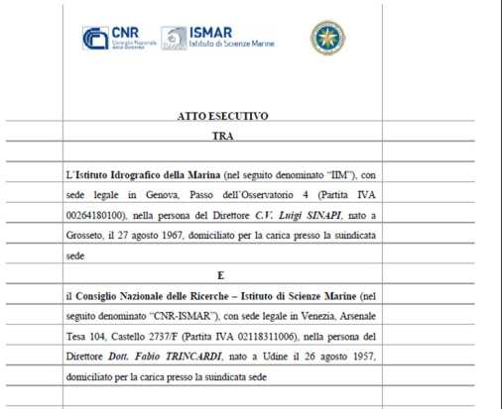
Framework
Agreement about the study of the Venice Lagoon between:
the Italian Hydrographic Institute (IIM) and the Marine Science Institute of the National Research Council (CNR-ISMAR)
Notes:
3
This is the biggest coastal lagoon of the whole Mediterranean area Scarton, 2016, covering a surface of 550 km² it develops for 50 km along the coastline, with a mean width of 15 km and an average depth of 1.5 m
Every tidal cycle 12 hours the lagoon exchanges about the 60% of its water with the Adriatic Sea through three wide inlets; they are from north to south Lido, Malamocco and Chioggia, and they assure a sediment exchange between the lagoon and the sea too
Prova intestazione

Slide 4
Agenda
Overiview of conducted
surveys
Different points of view
Inlets analysis
Notes:
4

Slide 5
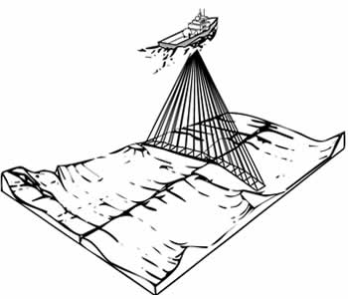
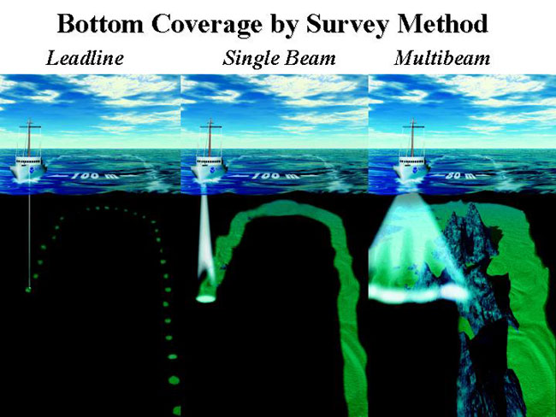
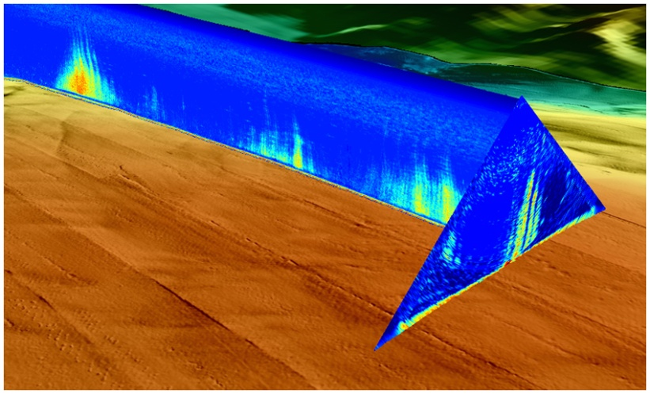
Echosounders
LEAD LINE-SINGLEBEAM vertical beam
vs MULTIBEAM pointing angle and travel time + backscatter + water column
Notes:
Misure grezze: pointing angle e travel time
Con vs ray tracing
Alla fine xyz rispetto al trasduttore
Prova intestazione
5

Slide 6
Surveys of the Lido inlet
YEAR | VESSEL | SURVEY | LINE SPACING | INSTRUMENT
1886 | WASHINGTON | 3083 | 50 meters | LEAD LINE
1894 | WASHINGTON | 4456 | 50 meters
1895 | WASHINGTON | 4574 | 50 meters
1903 | WASHINGTON | 5293 | 100 meters
1905 | STAFFETTA | 5403 | 50 meters
1913 | CAPITANO VERRI | 5699 | 50 meters
1938 | BERTA | 6771 | 50 meters
1951 | AZIO | 7161 | 50 meters | SINGLEBEAM
2011 | ARETUSA | 9085-1 | FULL SEAFLOOR SEARCH | MULTIBEAM
2013 | LITUS ISMAR | 4565-4V | FULL SEAFLOOR SEARCH
2016 | MBF 1213 | 9142 | FULL SEAFLOOR SEARCH

Slide 7
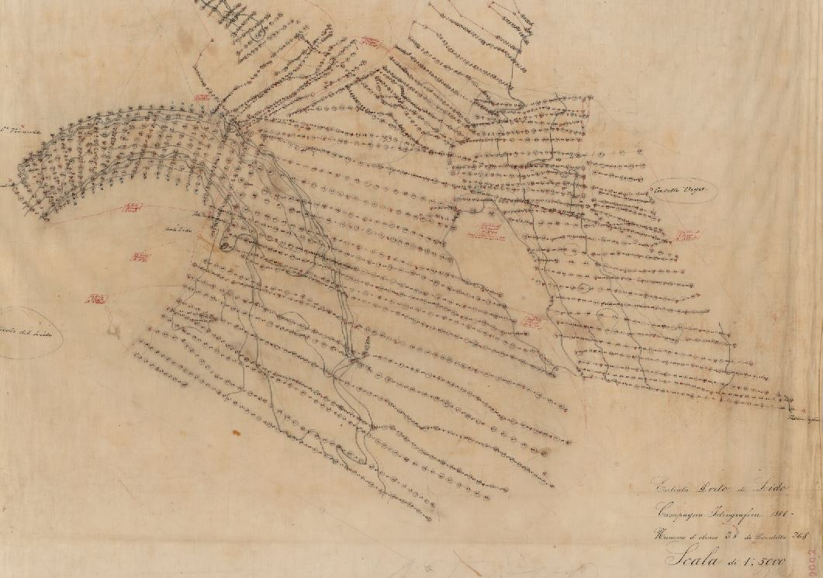
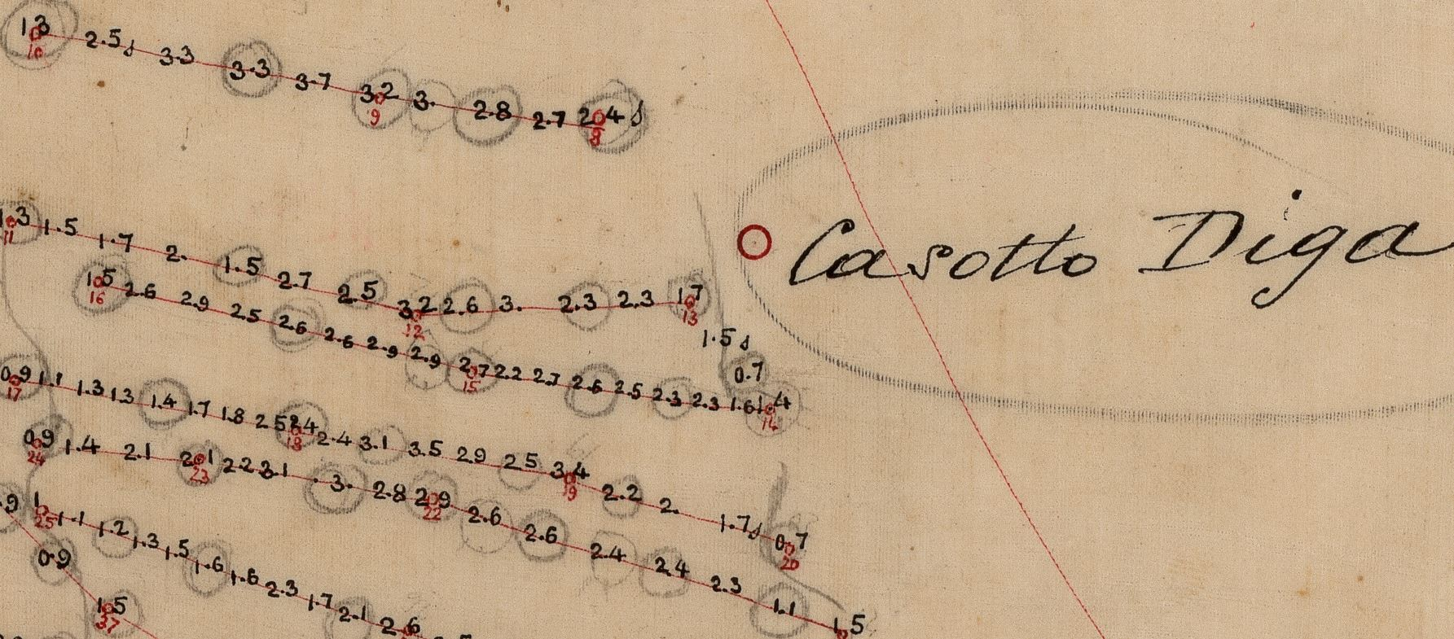
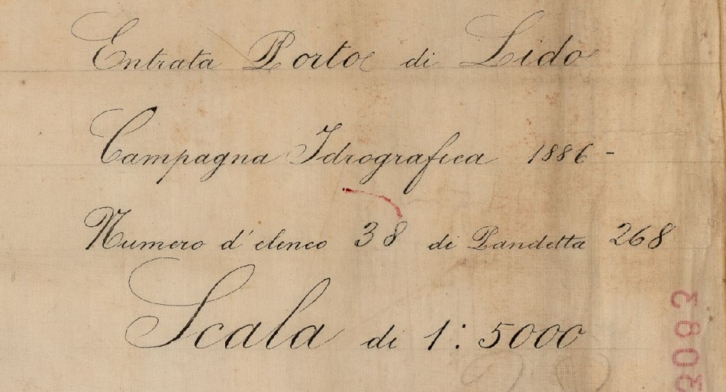
First Lead Line Survey: 1886
Notes:
Only IIM

Slide 8
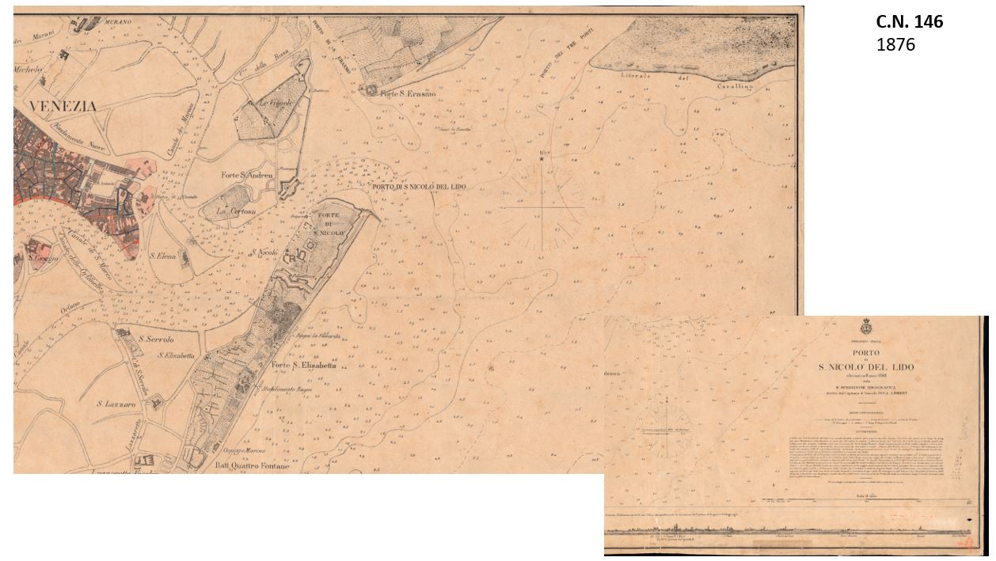
First Nautical Chart 1876

Slide 9
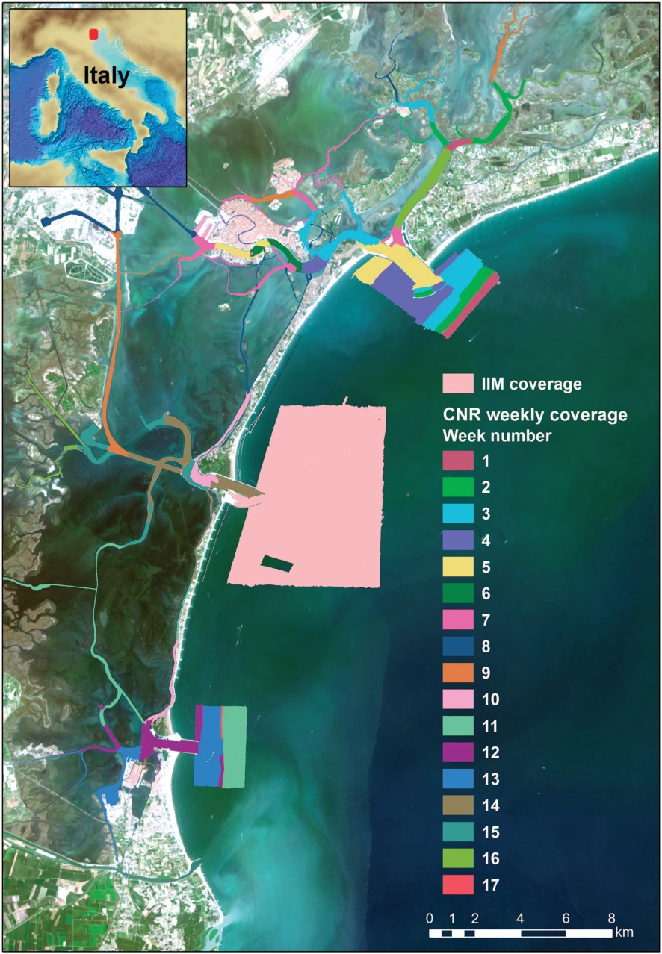
First MBES Survey: 2011-2013
Conducted TOGETHER by IIM and CNR-ISMAR
Data FREE and available (High resolution multibeam and hydrodynamic datasets of tidal channels and inlets of the Venice Lagoon – Nature Scientific Data)

Slide 10
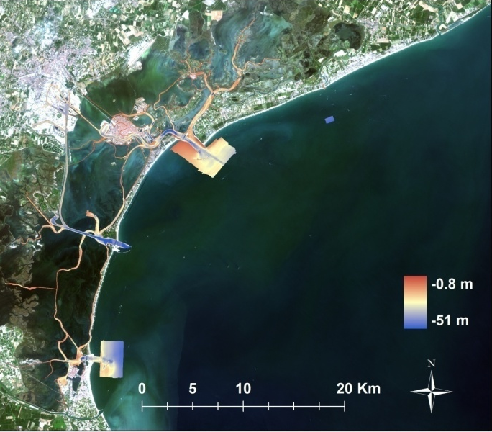
Last Survey: 2016
New survey of the main critical areas: the inlets
Coordination of different objectives: safety of navigation and research
Lido
Inlet
Chioggia
Inlet

Slide 11
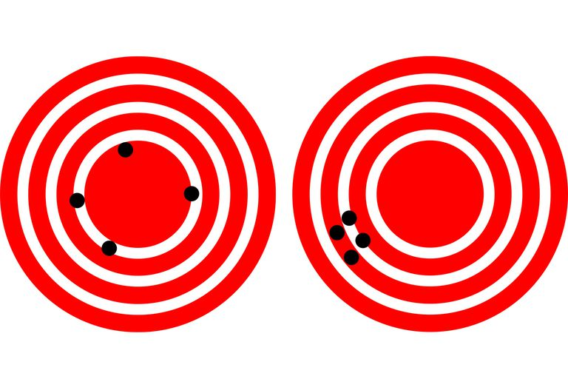
Traditional points of view
Hydrographic Institute: safety of navigation, minimum depth, hydrographic standards and accuracy
Research Institute: research, minimum resolution and precision

Slide 12
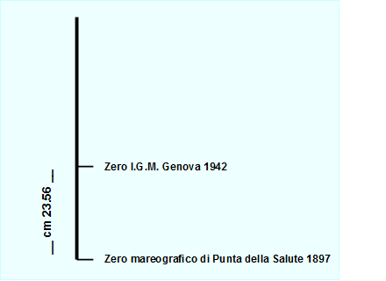
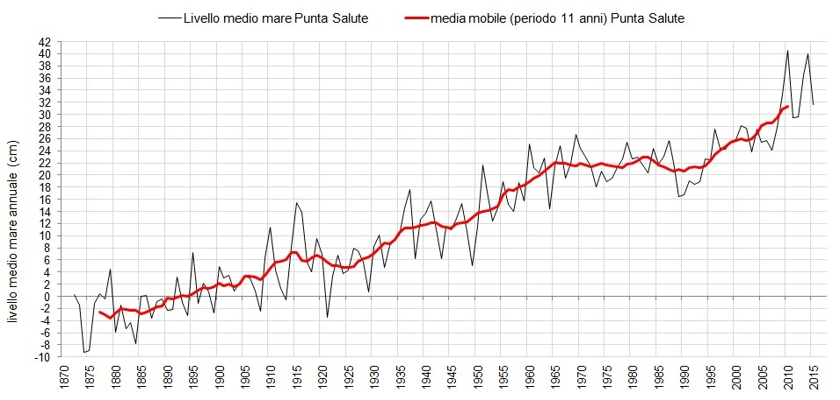
Vertical reference frame
H
Local MSL
Instantaneous level
Conventional MSL (ZMPS 1897)
CD
_{d}
Notes:
12
Prova intestazione

Slide 13
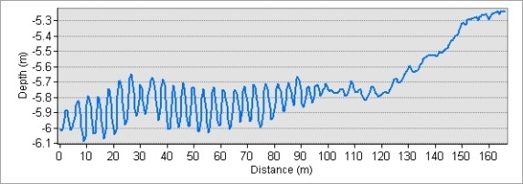
Morphology
1
Notes:
13
Planimetric dimension 2 to 3 meters
Vertical 15 to 20 centimeter
Prova intestazione

Slide 14

Hydrographic standards
IHO S44 ED. 2008
I.I. 3176 ED. 2016
Notes:
14
Prova intestazione

Slide 15

New point of view
Best data acquisition (sharing costs)
Basic common processing
Different advanced processing
CONCEPT: MAP ONCE, USE MANY TIMES
Notes:
Slower speed for backscattering
Instruments are expensive, same performance
Processing CARIS same project
Different resolutions

Slide 16
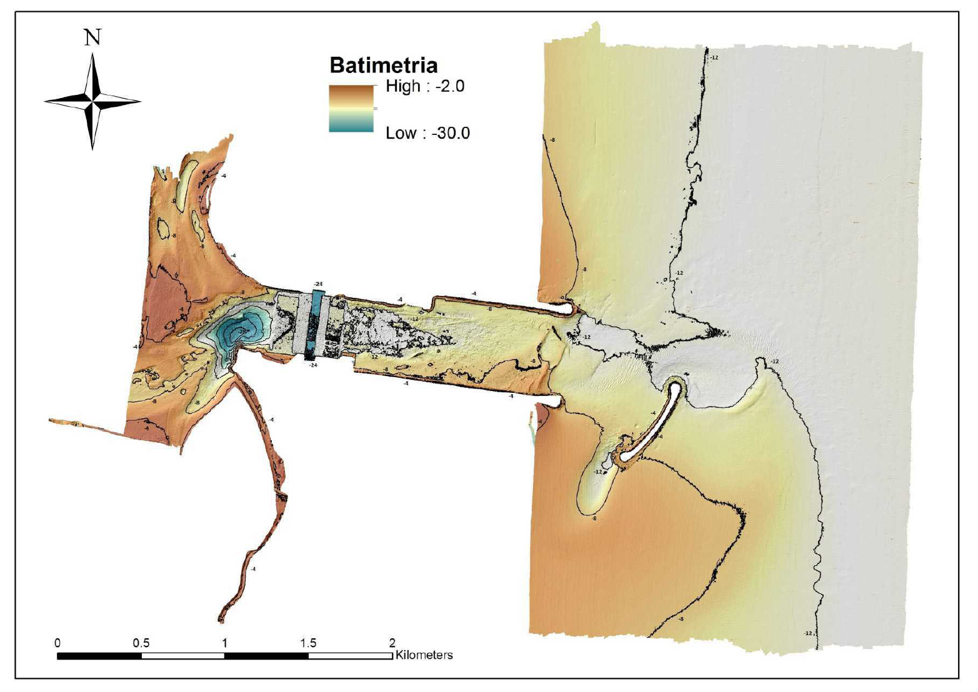
Inlets morphology
Bathymetry (m)
A
Chioggia
Inlet
FACTORS:
Sandy seabed
MOSE (A)
Breakwaters (B)
B

Slide 17
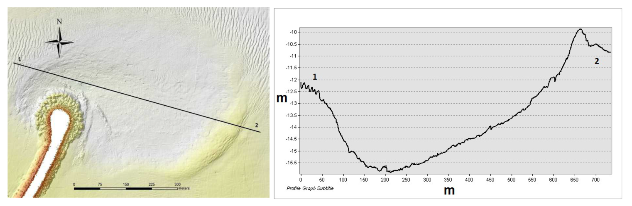
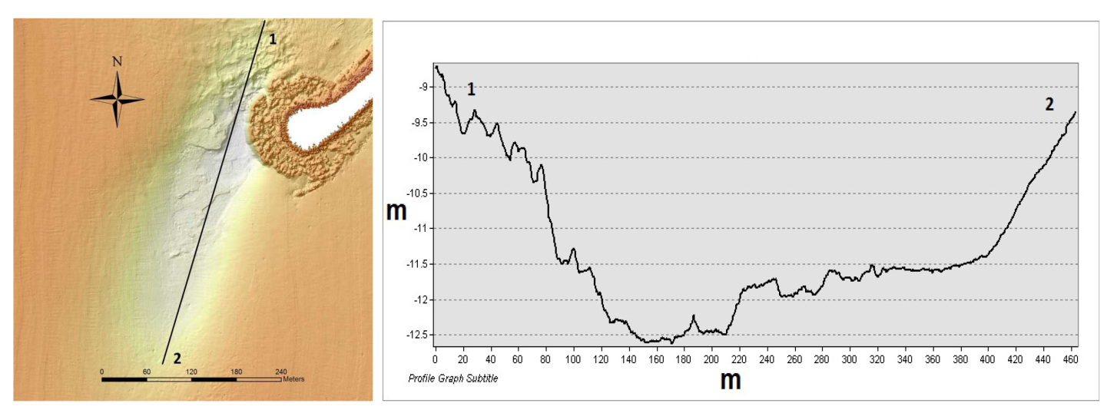
SCOURS at the breakwaters (formed in less than 10 years)
550 m
5.5 m
400 m
3.5 m

Slide 18
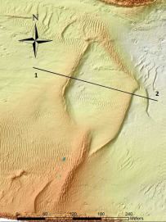

Dunes
140 m
2.5 m

Slide 19
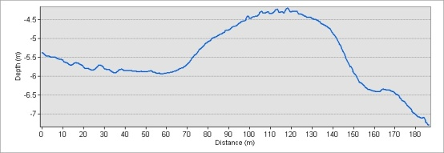
Dunes
1
2
1
2
λ= 4.5 m, h=0.3 m
2 m
90 m

Slide 20
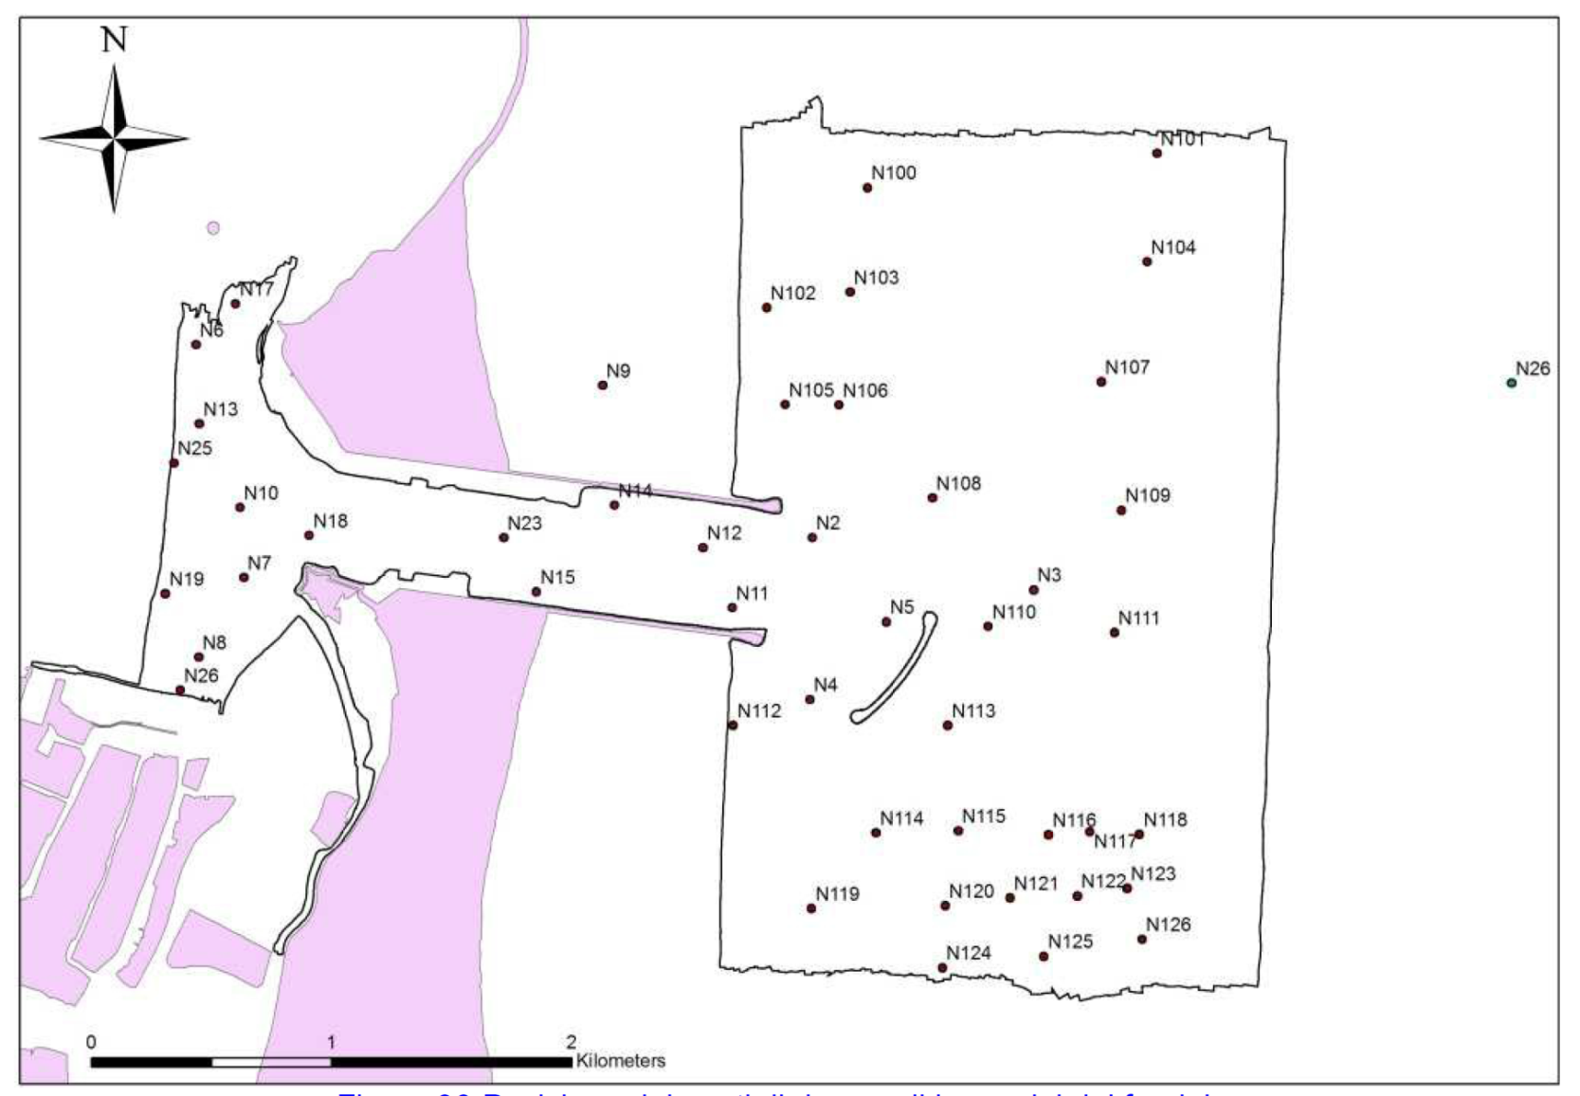
Backscattering
+ ground sampling

Slide 21
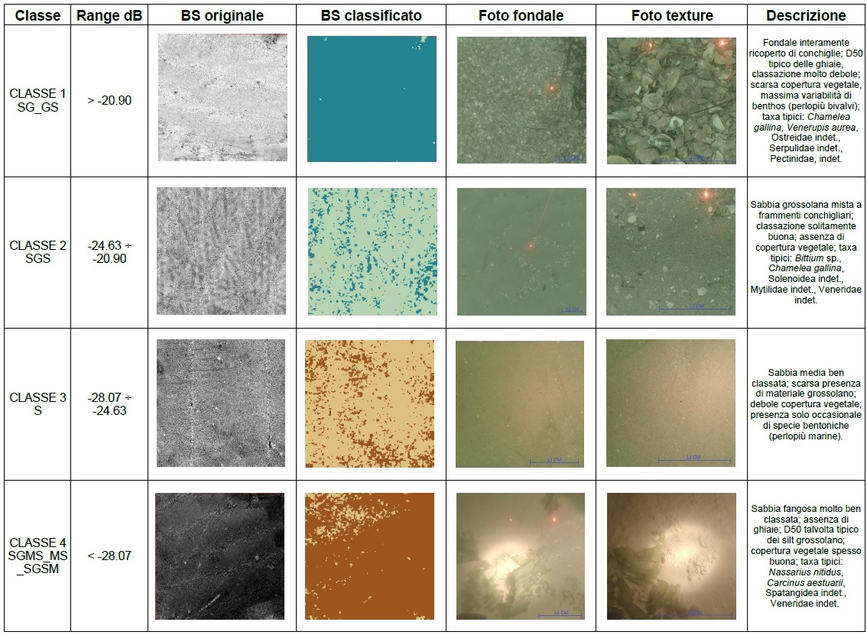
Classification
BS mosaic
Classified BS
Seabed image
Description
SG_GS
Sandy Gravel + Gravelly Sand
Seafloor covered by shells,
D50 typical of gravel;
scarse vegetation;
Typical taxa: Chamelea gallina, Venerrupis aurea,
Undet. Ostereidae, Serpulidae, Pectinidae
Coarse sand with shell fragments, well sorted,
D50 typical of gravel;
no vegetation;
Typical taxa: Chamelea gallina, Undet. Solenoidea, Mytilidae, Veneridae.
SGS
Slightly Gravelly Sand
S
Sand
Well sorted medium sand; scarse presence of coarse material; little vegetation presence.
SGMS_MS_SGSM
Slightly Gravelly
Muddy Sand+ Muddy Sand + Slightly Gravelly Sandy Mud
Well sorted muddy sand; no gravel; D50 sometimes typical of coarse silt; good presence of vegetation;
Tyical taxa: Nassarius nitidus, Carcinus aestuarii, Undet. Spatangidae, Veneridae

Slide 22
Classification

Slide 23
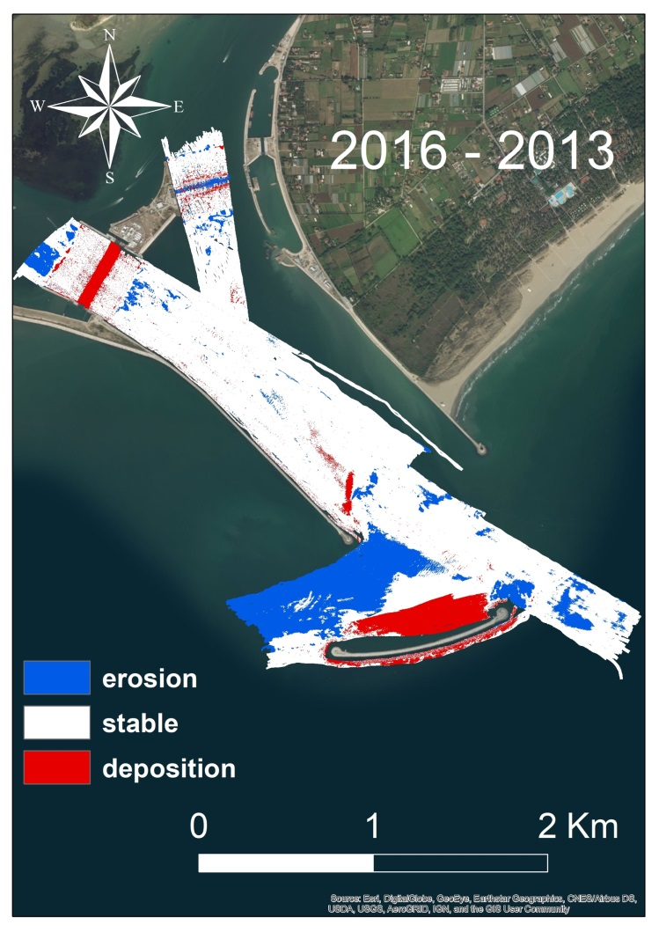
Surface differences
Deposition-erosion behind the breakwater
Erosion at the edge
Deposition in the MOSE

Slide 24
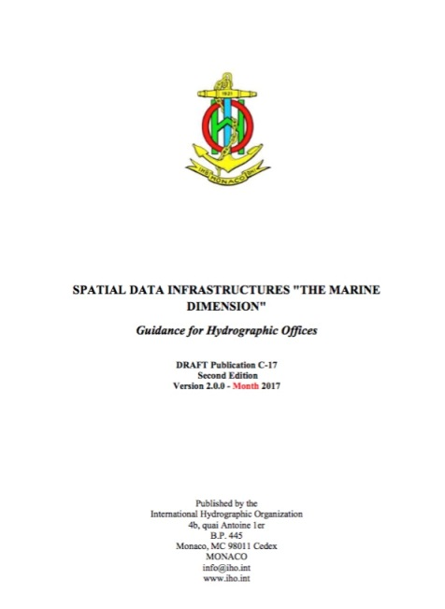
Conclusions
Map once
use many times using common standards
Share data, information and knowledge
Create a common
Marine Spatial Data Infrastructure
Notes:
Prova intestazione

Slide 25
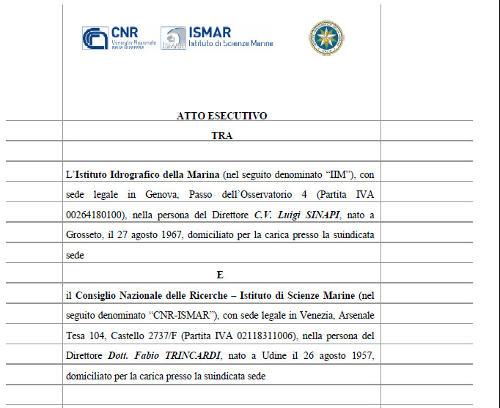
THANK YOU FOR YOUR ATTENTION
Monitoring is going on….
Notes:
Prova intestazione

