Slide 1
Knowledge leads to connections

Slide 2
Specialized in hydrographic training for the hydrographic survey, dredging and offshore industry since 2000

Slide 3
Our services
Hydrographic training and courses since 2000
Developed by people who gained their experience in the field and taught by those same individuals
Skilltrade provides courses and training in three areas:
Introductory and general courses
E-learning modules
Hydrographic Survey IHO-Category B programme

Slide 4
Our accredited Category B course
Skilltrade Category B programme has been officially recognised as such on the 1st July 2008
In 2016 our programme received continued recognition as a FIG/IHO/ICA Cat B Hydrographic Survey Programme in accordance with the Standards of Competence for Hydrographic Surveyors FIG/IHO/ICA S-5, Edition 11.1.0

Slide 5
Our accredited Category B course
Intense course of 30 weeks basic training
The curriculum is compiled with weekly workshops, transfer of technology and a practical project (Educational Survey Project)
After completion of the 12 week course in IJmuiden (NLD) a 4-week Field Training Project (FTP) required
Block | I | II-0 | II-1 | II-2 | II-3 | III | IV
Week | 1 – 13 | 14 | 15 - 18 | 19 – 25 | 26 | 27 - 30 | 30 – max. 185
Modules | E-Learning | Safety induction | Basic modules | Essential and Optional modules | Educational Survey Project (ESP) | Field Training Project (FTP) | Field Proficiency Period (FPP)
Outcome | Eligible to enter Cat.B Course | BOSIET + OLF-supplement Universal Basic Survival | QINSy Online Cert. Skilltrade Cert. of Attendance, or Skilltrade Cert. of Education |  |  | FIG/IHO/ICA Cert. of Course Completion | FIG/IHO/ICA Cert. of Field Proficiency

Slide 6
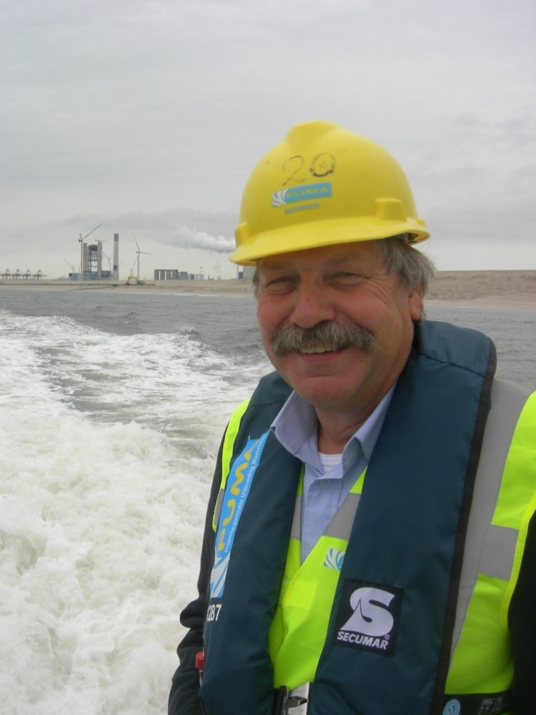
Skilltrade BV
Phone: +31 (0)71 561 13 65
www.skilltrade.nl
info@skilltrade.nl
Office: Schoolstraat 174
2252 CN Voorschoten
The Netherlands

