Slide 1
Recent evolutions of the demand for hydrographic surveyors in the Benelux
Alain DE WULF
Ghent University – Geography Dept. (Belgium)
3D Data acquisition

Slide 2
Outline
Scope of the inquiry
Education
Future: global market prospect

Slide 3
Scope of the inquiry

Slide 4
A few key figures of the response:
2009: 59/180 = 33 % (828 hydrographic surveyors)
HSB corporate members
Geobusiness group members
2015: 25/61 companies = 41 % (855 hydrographic surveyors)
HSB corporate members
2017: 9/58 companies = 16 % (1564 hydrographic surveyors)
HSB corporate members

Slide 5
Education

Slide 6
Education
1. What is the expected education level over 5 years in your company ?
2. Which certificate/diploma is an asset for applying in your company ?
3. Do you know the different types of hydrographic education in the Benelux ?

Slide 7
Education
1. What is the expected education level over 5 years in your company ?
2. Which certificate/diploma is an asset for applying in your company ?
3. Do you know the different types of hydrographic education in the Benelux ?

Slide 9
2015:
IHO certification wanted in absolute numbers (5 year horizon):
Cat. B
Belgium: 31 (6/year)
The Netherlands: 25 (5/year)
Cat. A
Belgium: 11 (2/year)
The Netherlands: 95 (19/year)

Slide 13
Education
1. What is the expected education level over 5 years in your company ?
2. Which certificate/diploma is an asset for applying in your company ?
3. Do you know the different types of hydrographic education in the Benelux ?

Slide 17
Education
1. What is the expected education level over 5 years in your company ?
2. Which certificate/diploma is an asset for applying in your company ?
3. Do you know the different types of hydrographic education in the Benelux ?

Slide 18
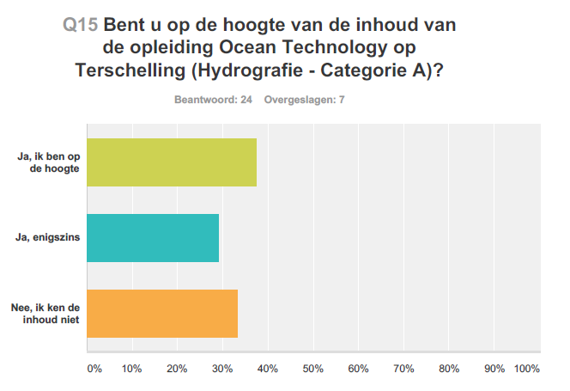
2015: Do you know ?
D
Very good
Good
Not good

Slide 19
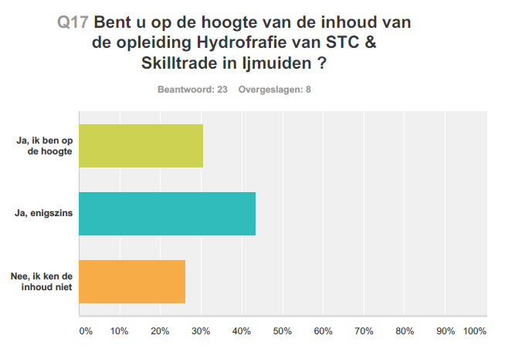
2015: Do you know ?
D
Very good
Good
Not good

Slide 20
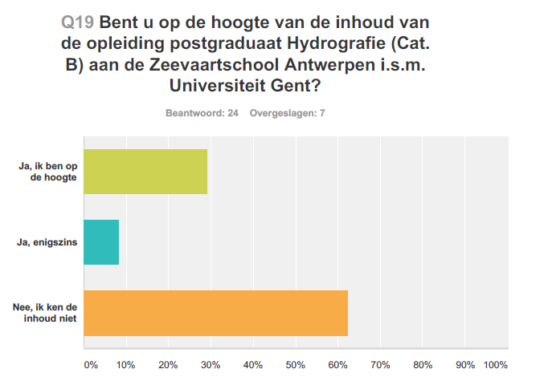
2015: Do you know ?
D
D
Cat. B at the Maritime Academy Antwerp and Ghent University (Belgium)
Very good
Good
Not good

Slide 25
Cat. B program in Belgium
Cooperation of the
Antwerp Maritime Academy (hosting institute)
Ghent University
Private companies (DEME, JAN DE NUL & GEOXYZ)
The programme is a 1 year postgraduate program
Entry requirements: Students need to have a Bachelor degree or equivalent with:
A good knowledge of mathematics
A good knowledge of physics
A good knowledge of English
Hydrographic Education in Belgium  Ocean Careers 2017  Southampton  April 2017

Slide 26
Semester 1
Module 1 3 weeks
Fieldwork 1 6 weeks
Semester 2
Module 3 3 weeks
Fieldwork 2 6 weeks
Summer
Summer recession
Examinations (resit) & Permanent Evaluation 2 weeks
Module 2 3 weeks
Examinations & permanent Evaluation 2 weeks
Module 4 3 weeks
Fieldwork 3 4 weeks
Integrated Fieldwork 4 weeks
Study Time
And revision week 3 weeks
Examinations & Permanent Evaluation 2 weeks
Certificate B
Study Time 2 weeks
Hydrographic Education in Belgium  Ocean Careers 2017  Southampton  April 2017

Slide 27
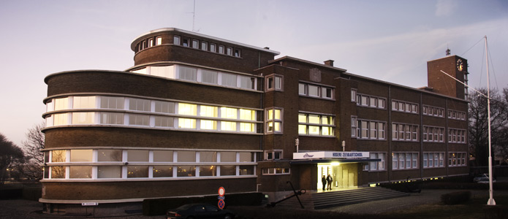
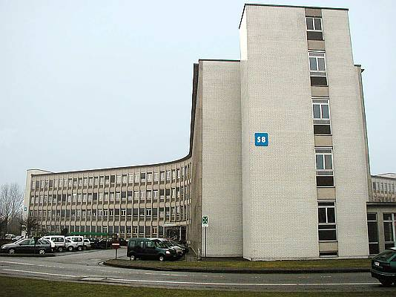
 | Course Title | ECTS | Class Hours | Location
1 | ICT | 3 | 24 | UGent
2 | Navigation | 6 | 48 | HZS
3 | Safety | 3 | 24 | HZS
4 | Seamanship | 3 | 24 | HZS
5 | Tides and Currents | 3 | 24 | HZS
6 | Hydrographic Surveying | 6 | 48 | UGent
7 | Geodesy and Cartography | 3 | 24 | UGent
8 | Data Management | 3 | 24 | UGent
9 | Geology and Geophysics | 3 | 24 | UGent
10 | Legal Aspects | 3 | 24 | UGent
 | TOTAL THEORETICAL CLASSES | 36 | 288
Hydrographic Education in Belgium  Ocean Careers 2017  Southampton  April 2017

Slide 28
Future education trend ?

Slide 29
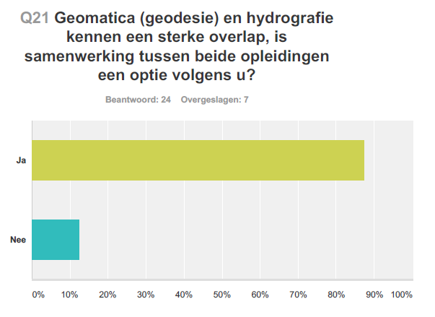
2015: Is a more cooperation/integration between geomatics and hydrography wanted ?
YES
NO

Slide 30
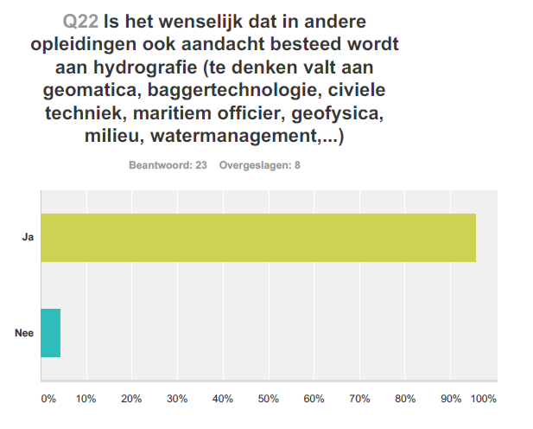
2015: Is the integration of hydrography in other programs such as geomatics, geodesy, civil engineering, geophysics, environmental studies wanted ?
YES
NO

Slide 31
Future: global market prospect for hydrographic surveyors (Benelux)

Slide 32
Global market prospect for hydrographic surveyors
1. Evolution in % of the # Hydrographic Surveyors in the global market over next 5 years ?
2. Evolution in % of hydrographic surveyors in your company (now <> +5 years) ?
3. Have we predicted the correct evolution 2 years ago ?

Slide 33
Global market prospect for hydrographic surveyors
1. Evolution in % of the # Hydrographic Surveyors in the global market over next 5 years ?
2. Evolution in % of hydrographic surveyors in your company (now <> +5 years) ?
3. Have we predicted the correct evolution 2 years ago ?

Slide 35
What is the global evolution in % of the demand for hydrographic surveyors in the next 5 years ?
9 experts (representing ca. 1564 hydrographic surveyors):
3 experts: status quo
6 experts: +10 till + 30 % increase
Average expectation: +13 % (standard deviation: 12 %)

Slide 36
Global market prospect for hydrographic surveyors
1. Evolution in % of the # Hydrographic Surveyors in the global market over next 5 years ?
2. Evolution in % of hydrographic surveyors in your company (now <> +5 years) ?
3. Have we predicted the correct evolution 2 years ago ?

Slide 37
What is the evolution in % of the demand for hydrographic surveyors in your company ?
Benelux:
now: 1564 surveyors
Within 5 years: 1781 surveyors (+ 14 %)
The Netherlands:
now: 1324 surveyors
Within 5 years: 1511 surveyors (+ 14 %)
Belgium:
now: 240 surveyors
Within 5 years: 270 surveyors (+ 13 %)

Slide 38
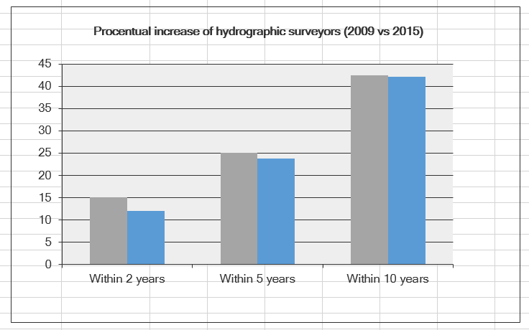
2015:

Slide 39
Global market prospect for hydrographic surveyors
1. Evolution in % of the # Hydrographic Surveyors in the global market over next 5 years ?
2. Evolution in % of hydrographic surveyors in your company (now <> +5 years) ?
3. Have we predicted the correct evolution 2 years ago ?

Slide 40
Predicted number in 2009 of # of hydrographic surveyors for 2015 vs. real number in 2015.

Slide 41
2015:

Slide 43
What is the evolution in % of the demand for hydrographic surveyors in your company ?
Benelux:
2 years ago: 2081 surveyors
now: 1564 surveyors (- 25 %)
The Netherlands:
2 years ago: 1841 surveyors
now: 1324 surveyors (- 28 %)
Belgium:
2 years ago: 240 surveyors
now: 240 surveyors (0 %)

Slide 45
What is the evolution in % of the demand for hydrographic surveyors in your company ?
Benelux:
2 years ago: 2081 surveyors
now: 1564 surveyors (- 25 %) (only 3/9 show slight increase)
Within 5 years: 1781 surveyors (+ 14 % but -14 % related to 2 years ago)
The Netherlands:
2 years ago: 1841 surveyors
now: 1324 surveyors (- 28 %) (only 3/9 show slight increase)
Within 5 years: 1511 surveyors (+ 14 % but -18 % related to 2 years ago)
Belgium:
2 years ago: 240 surveyors
now: 240 surveyors (0 %)
Within 5 years: 270 surveyors (+ 13 %)

Slide 46
CONCLUSION
EDUCATION
Big differences between Belgium and The Netherlands:
Master (BE) versus Bachelor (NL)
Cat. B (BE) versus cat. A (NL)
IHO certification is perceived as much less essential in Belgium.
GLOBAL MARKET PROSPECTS IN THE BENELUX FOR HYDROGRAPHIC SURVEYORS
In general, a very slightly optimistic view (2 till 3 % increase per year) appears.
But much less optimistic than 2 years ago.
The recent past learnt that most predictions for the demand for hydrographic surveyors were way too optimistic.
The demand for hydrographic surveyors is quite sensitive to market evolutions.

Slide 47
Questions ?

