Slide 1
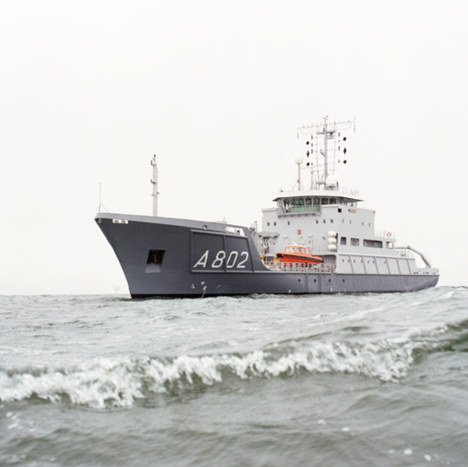
Bathymetry as a keystone for the blue economy of the Netherlands: the implementation of INSPIRE at the Netherlands Hydrographic Service
Leendert Dorst, RNLN
Charles de Jongh, Teledyne CARIS
George Spoelstra, GGSgc
Hydro17, 16 November 2017

Slide 2
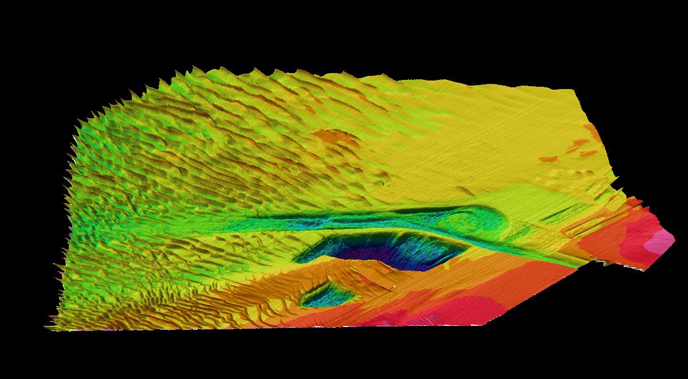
Introduction: Approach to Rotterdam

Slide 3
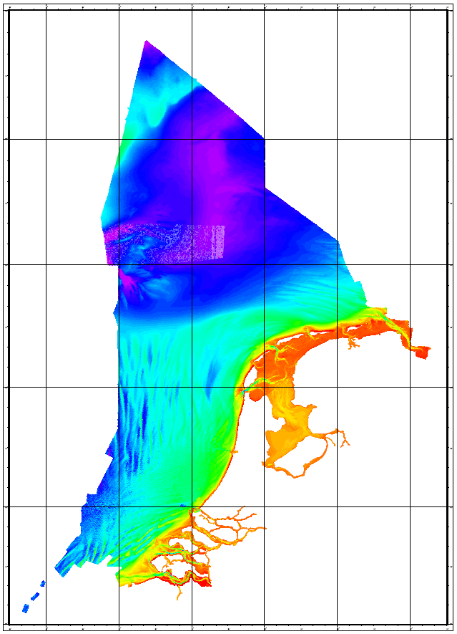
Introduction: Representative Bathymetric Data Set

Slide 4
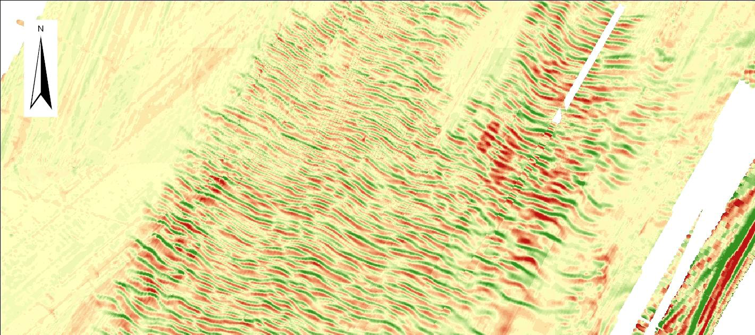
Introduction: sand wave migration (ValHYD, 2011)

Slide 5
The Blue Economy: the sea as a resource
The sea is a resource for:
Energy;
Food;
Medicines;
Minerals;
Recreation;
Telecommunications;
Transportation.
The sea is now the workplace of the blue economy.

Slide 6
The Blue Economy: data centricity
Towards Data Centricity
Data custodian vs product producer:
traditional focus on nautical products
Loss of potential:
fraction of data is passed to third party users
MSDI requires data in generic format:
not a particular product for a user group

Slide 7
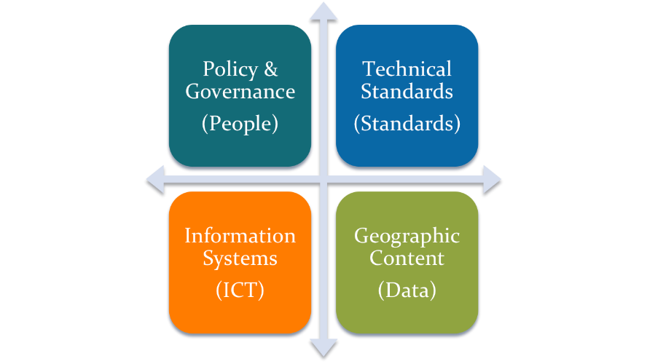
The Blue Economy: the elements of an MSDI

Slide 8
The Blue Economy: the road to MSDI
1990s: National Oceanographic Data Centers (NODC)
1994: Open GIS Consortium (OGC)
2000s: NODCs cooperate under SeaDataNet
2006: EU Green paper on Future Marine Policy leads to EMODnet
2007: INSPIRE Directive
2008: IHO Marine SDI WG (MSDIWG)
2010: Gunther Pauli, “The Blue Economy” report to the Club of Rome
2013: PSI Directive
2014: EU Communication Marine Knowledge 2020 “Blue Growth”
2015: Sendai Framework for Disaster Risk Reduction
2015: Paris Agreement on Climate Change
2016: Conference UN Sustainable Development Goal 14 “Oceans”
2016: OGC Marine Domain WG (MDWG)
2017: UN-GGIM Marine Geospatial Information WG (MGI-WG)

Slide 9
European SDIs: NLHO as a contributor
Managed by DG Environment | Managed by DG Maritime Affairs
34 themes | 8 themes
Directive | Programme
Obligations for Member States | Public tenders involving Member States
Investments necessary | Annual payments
A national SDI per Member State | One European MSDI
supported by Teledyne CARIS
supported by GGSgc

Slide 10
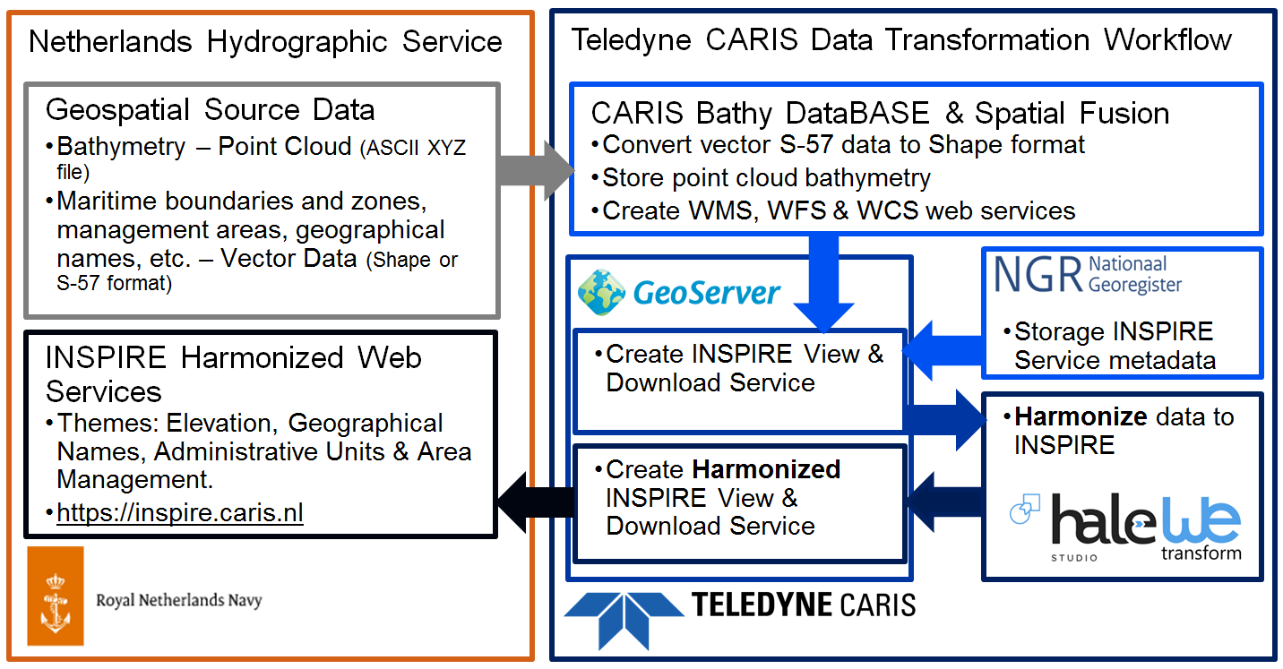
European SDIs: INSPIRE harmonization

Slide 11
Some critical notes
Lack of interaction with the user:
metadata, shoal biasing
(2) This could lead to confusion and accidents:
responsibilities of the provider and the user
(3) web services are complicated:
in addition to traditional data streams
(4) bathymetry in nautical publications is protected:
only source data is open, IPR and licencing
(5) common environmental picture:
at the source level?
at the product level?

Slide 12
Conclusion
The continued implementation of the INSPIRE Directive at NLHS, in combination with its involvement in EMODnet projects, will have a positive effect on the Blue Economy of the Netherlands, and fulfils its obligations under the PSI Directive.
But the implementation will not come without some risks and complications.
A frank and detailed discussion, as presented in our critical notes, will help to manage those effects.

