Slide 1
Developments in the Interconnectivity of
Tide and Weather Data
By
Dr Mike Osborne
OceanWise Ltd

Slide 2
What We Do
Marine Data Management and Decision Support:
  Marine Mapping
  Enterprise GIS and Maritime Productivity Tools
  Training, Mentoring and Capacity Building
  Data Policy, Strategy and Management Systems
  Environmental Data Sharing and Publishing
System Integration and Interconnectivity

Slide 3
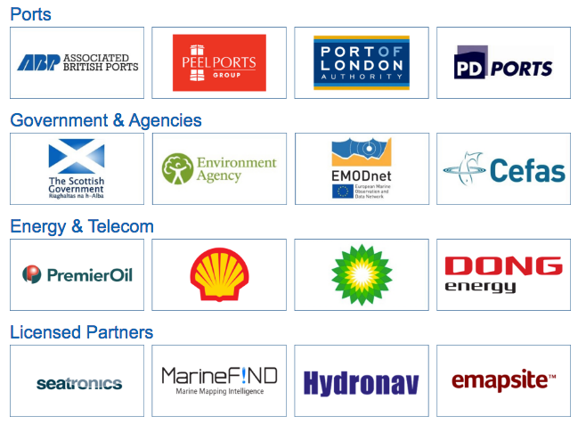
Some of Our Customers

Slide 4
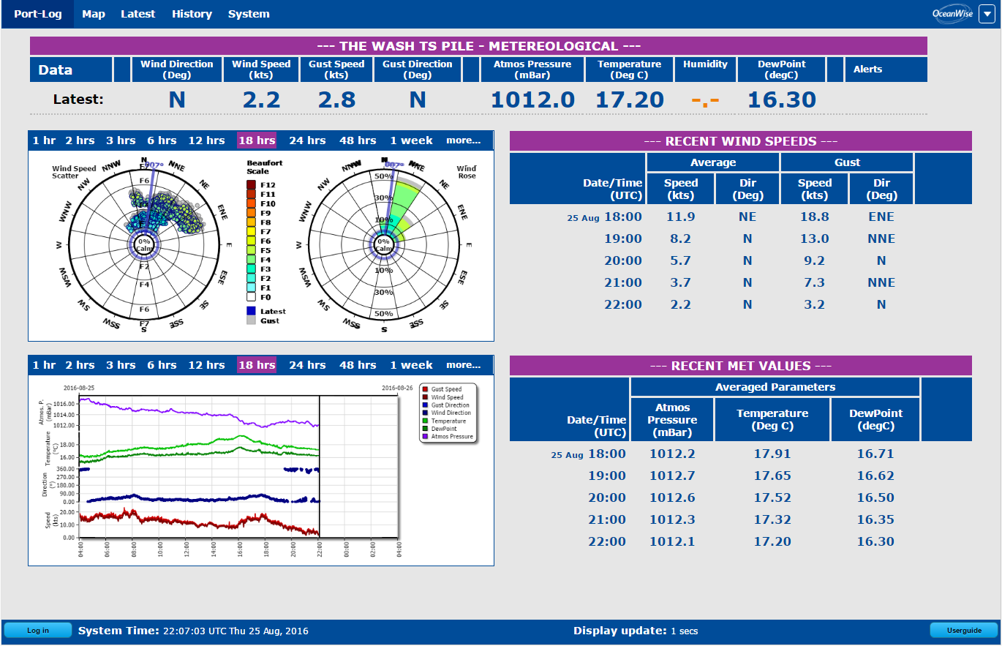
Core Requirement
Multiple Sensors
Real Time / Historic Datasets
Data Management and Display System
Designed for use
in VTS

Slide 5
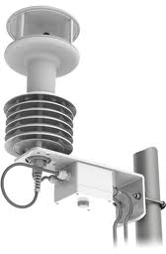
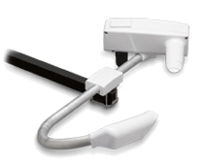

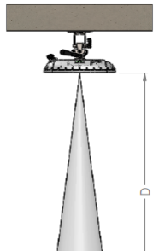
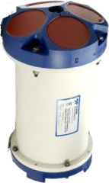
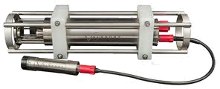
Data Collection and Storage
Gill
MaxiMet
Vaisala
PWD
Bidirectional
Multiple
Telemetry
3G/4G
Valeport
Pressure
/ Radar
TideMaster
ip.buffer
Multiple
Sensors
UHF/
WAN
Multiple
Receivers
Valeport CTD
RDI
ADCP
Notes:
There are animations on this page
Good data management requires all areas to be connected
This is a simplified view of the equipment schema and transmission protocols.
All the instrumentation was connected to a Multi-port GPRS Data Logger / Modem.
This transmits to a receiver (server) through the internet via a local GPRS Link.
No reason why this can’t also be a UHF Radio Link or Satellite Link rather than GPRS.
<CLICK> to reveal the sections!
A Reception Server gathers the data. In this case (as discussed later) we will use PHP Scripts for reliability and flexibility.
It is now an IT Networking issue – no reason why we can’t duplicate the feeds to one or more servers.

Slide 6
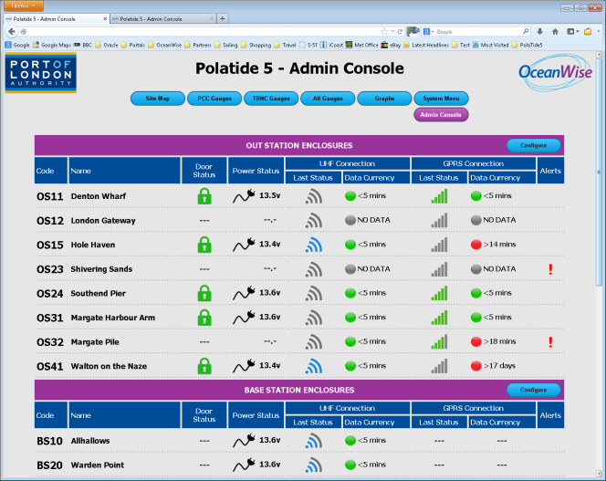
System Console
Calibration data and history
QC/QA
parameters
System status
Alerts and
triggers
User
management
Metadata

Slide 7
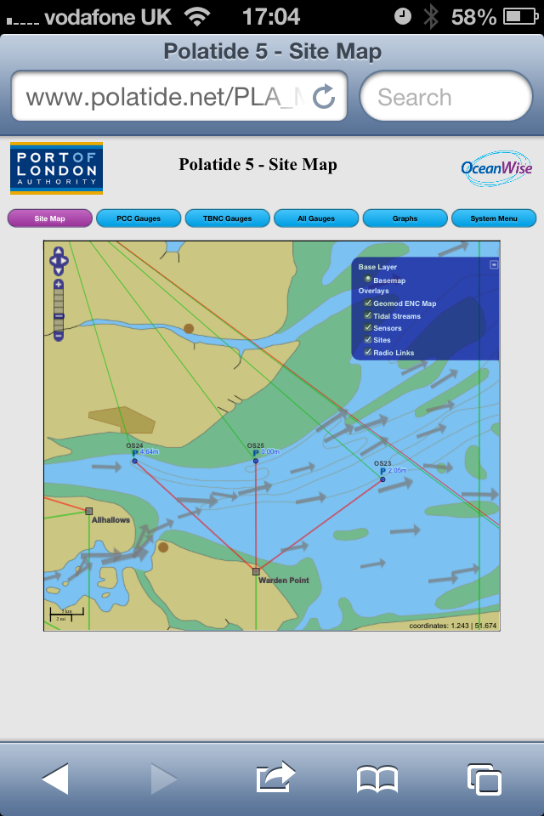
Mapping Interface
User defined base maps
Application overlays
Port specific datasets
Additional functionality
Scalable screen size
All Good, No Issues
BUT THEN …

Slide 8
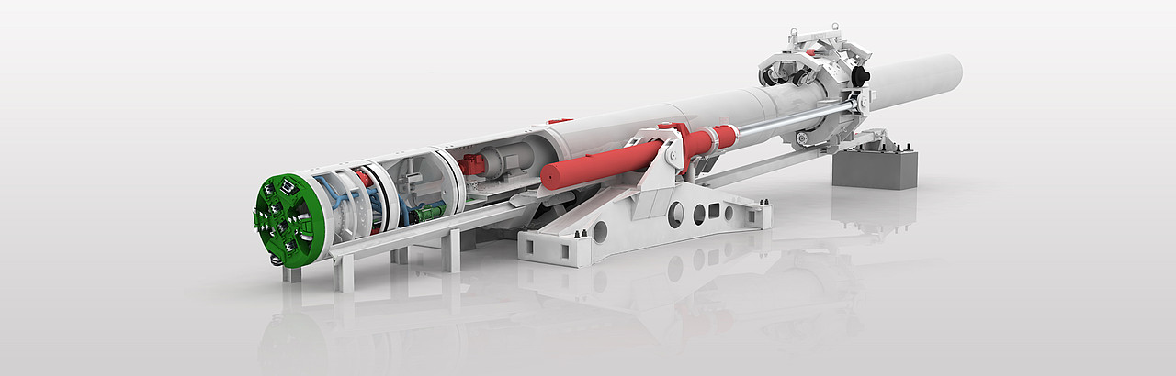

Please can you interface with ....
Port Authority Website
Public Service Website
Gov. Monitoring Network
AIS Transponder
AIS Network Controller
Survey Vessel
Forecast Provider
Portable Pilot Units
Dredgers
Tunnelling Machine!
Source:
YES Really!

Slide 9

Yes we can!
But how?

Slide 10








Standardisation, of course!
NMEA Sentences
AIS ASM
ISO 19100
S-112
OGC Sensor Web

Slide 11
What’s available
NMEA standard / proprietary sentences
AIS Application Specific Messaging (ASM)
XML
- SensorML?
JSON
  Sensor Stream Format (SSF)
  JSON Sensor Format (JSF)
  Other?

Slide 12
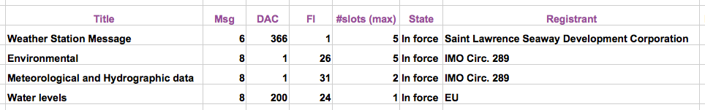
AIS Application Specific Messages (ASM)
A good standard
Multiple specifications
Which one to use?

Slide 13
NMEA OneNet
Network interface standard built on
IEEE 802.3 i.e. Ethernet
Transports standard and proprietary NMEA sentences over TCP/IP networks
Introduced to address lack of interoperability between different implementations
Lesson for AIS ASM?

Slide 14
WMO Information System 2.0
WIS, mainly the GTS, is a niche infrastructure that supports the expert meteorological community
WIS 2.0 supporting Internet technologies including APIs and Web Services
Built on commercially available services and industry standards
WMO strategy for a one stop shop of weather, water and climate information

Slide 15
New Port-Log API
Realises Port-Log existing download functionality as a REST service
Payload standardised on IMO 8-1-31
Other payloads e.g. SensorML, Port-Log XML
Uses NMEA sentences for streaming
Binary encoded to AIS ASM 8-1-31
Metadata / payload available as JSON
Implemented on 7Cs using Pegel format

Slide 16


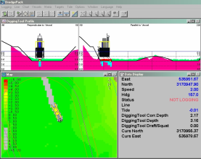
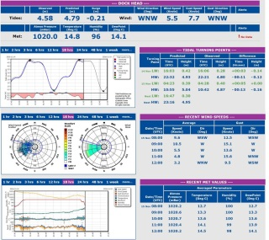

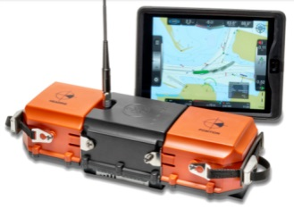

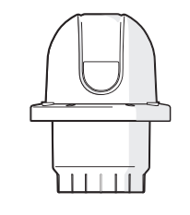

Port-Log Web Displays used by VTS (for example)
Weather Forecast Services
Synthetic AtoN
VTS Software
REST ASM 8-1-31
Port-Log ETL
Service
3G/4G
LoRA
AIS Network Controller
ODB /
Port-Log
Port-Log REST API
RF/3G/4G
Iridium
ip.buffer
Port-Log Connect
REST ASM
8-1-31
ip.buffer
PPUs
Sensors & Modem
Real AtoN
Notes:
From http://www.iala-aism.org/asm/
The need to keep track of all existing Application Specific Messages (ASM) in order to facilitate data exchange has been established (IALA Recommendation e-NAV 144). IALA has taken the responsibility to collect these, and now maintains this online IALA ASM Collection. Stakeholders should endeavour to use the ASM´s in this Collection before developing new ASM’s. If and when new ASM´s are developed, these should be reported to the IALA Secretariat as soon as possible, so that the IALA ASM Collection can be updated.
Note: This collection is not an endorsement of any message, and is not an authority for any DAC/FI combinations.

Slide 17
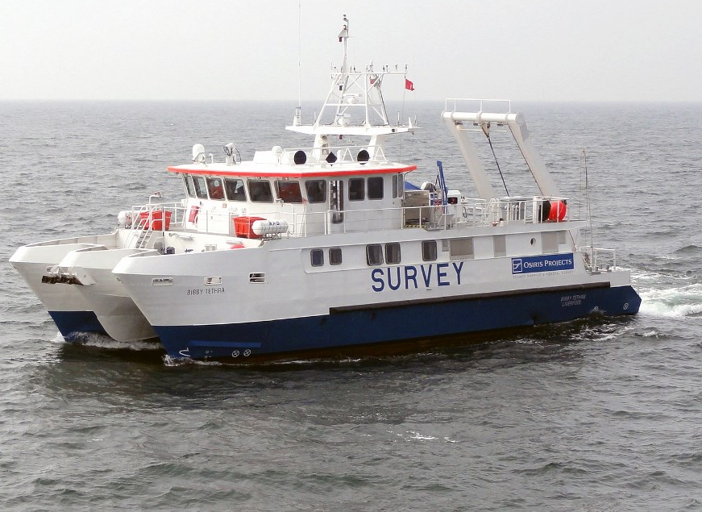
Port-Log ‘Connect’
Port-Log
Connected
Sensors
Legacy systems
Proprietary formats
User selects format / source station
Auto selection based
on vessel position
Port-Log REST API
3G/4G
ip.buffer
RS232
Survey & Dredger Control Software

Slide 18
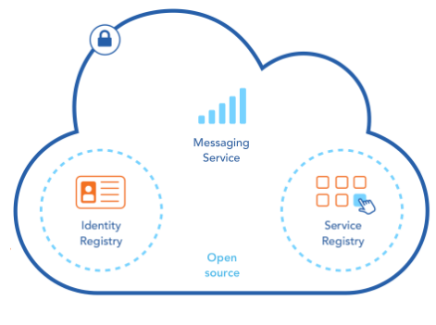
Maritime Connectivity Platform
MCP Core Components:
Identity Registry – Trusted Users Access
Service Registry – Phone Book of Services
Maritime Messaging Service
– Facilitates Data Exchange
Core components are Open Source
Testbed for Port-Log API (tbc)
Notes:
The Identity Registry- For secure and reliable identity information, it provides a single login to all services, using identity information provided by trusted stakeholders.
The Service Registry - For registering, discovering and using all relevant e-Navigation and e-Maritime services, commercial and non-commercial, authorised and non-authorised, for free and against payment. It can be seen as a sophisticated yellow pages phone book or the equivalent of an App Store.
The Maritime Messaging Service- An information broker that intelligently exchanges information between communication systems connected to the cloud, taking into account the current geographical position and communication links available to the recipient.

Slide 19
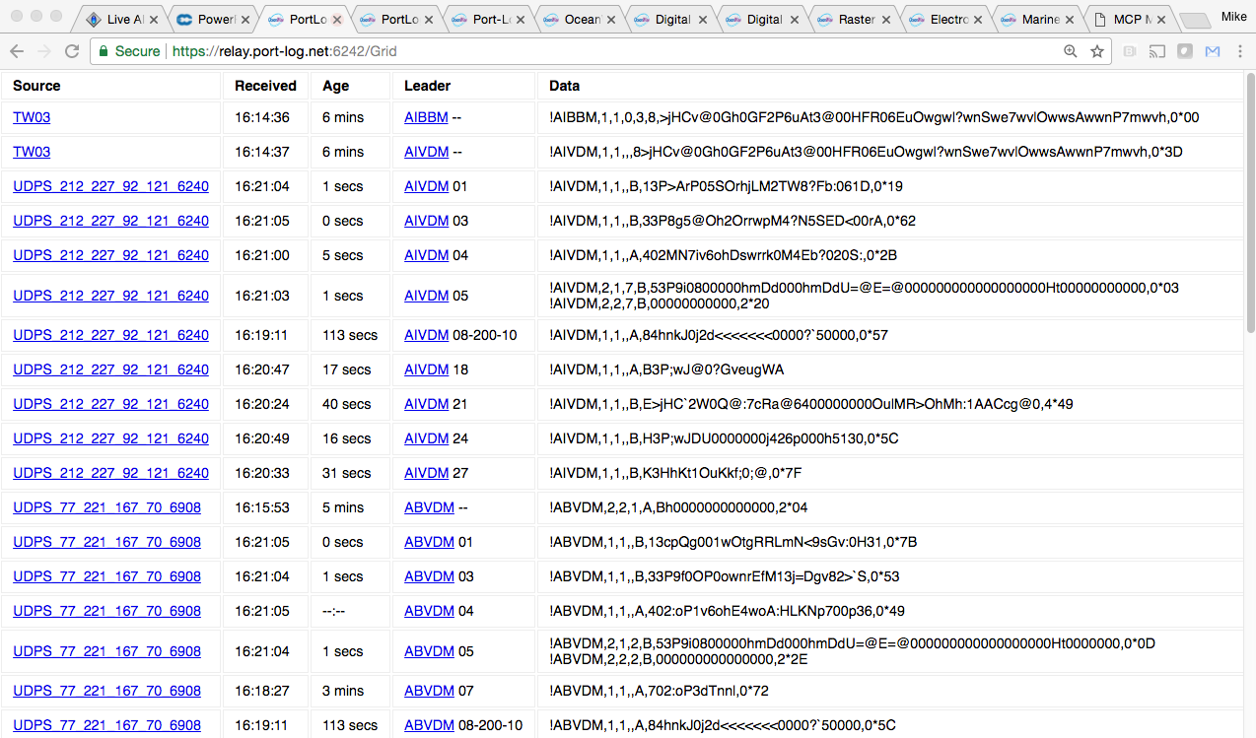
Port-Log Real-Time Data

Slide 20
Concluding Remarks
Standardisation – but which standard / specification?
Multiple users / applications require multiple interfaces
Port-Log API / ‘Connect’ addresses this issue
Convergence is happening e.g. on ISO19100
BUT the specifications are diverging – a problem?
Test platforms e.g. MCP are major step forward
More work required by governing bodies to address challenges e.g. MMSI if not ‘AtoN’
Way forward is to keep talking to each other & externally
Notes:
Authoritative or Not? ; Secure or Open?

Slide 21
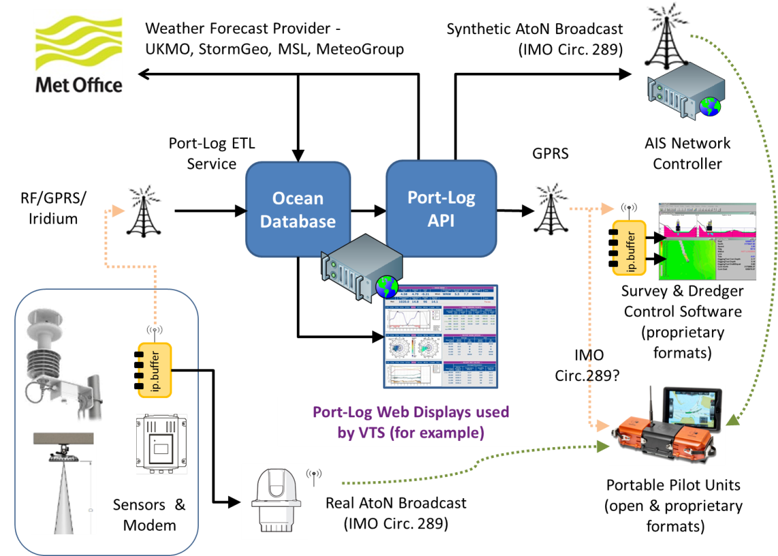

Thank You! mike.osborne@oceanwise.eu
Have a Safe Journey Home

